Slide 1
Planning, Running, and Analyzing Controlled Experiments on the Web
Part 1
Ronny Kohavi,
GM, Experimentation Platform, Microsoft
Slides available at http://exp-platform.com

Slide 2

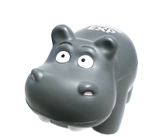
Amazon Shopping Cart Recs
Add an item to your shopping cart at a website
  Most sites show the cart
At Amazon, Greg Linden had the idea of showing recommendations based on cart items
Evaluation
  Pro: cross-sell more items (increase average basket size)
  Con: distract people from checking out (reduce conversion)
HiPPO (Highest Paid Person’s Opinion) was: stop the project
Simple experiment was run,
wildly successful
From Greg Linden’s Blog: http://glinden.blogspot.com/2006/04/early-amazon-shopping-cart.html

Slide 3
Stress HiPPO
  The less data, the stronger the opinions
Whenever you feel stressed that a decision is made without data, squeeze the Stress-HiPPO
Put one in your office to show others you believe in data-driven decisions based on experiments
Hippos kill more humans than any
other (non-human) mammal (really)
Don’t let HiPPOs in your org
kill innovative ideas. ExPeriment!

Slide 4
Agenda
Controlled Experiments in one slide
Examples: you’re the decision maker
Culture, OEC (Overall Evaluation Criterion)
Controlled Experiments: deeper dive
Two key messages to remember
  It is hard to assess the value of ideas.
  Get the data by experimenting because data trumps intuition
  OEC: Make sure the org agrees what you are optimizing

Slide 5

Controlled Experiments in One Slide
Concept is trivial
  Randomly split traffic between
  two (or more) versions
    A/Control
    B/Treatment
  Collect metrics of interest
  Analyze
Best scientific way to prove causality, i.e., the changes in metrics are caused by changes introduced in the treatment(s)
Must run statistical tests to confirm differences are not due to chance

Slide 6
Examples
Three experiments that ran at Microsoft recently
All had enough users for statistical validity
Game: see how many you get right
  Everyone please stand up
  Three choices are:
    A wins (the difference is statistically significant)
    A and B are approximately the same (no stat sig diff)
    B wins
  If you guess randomly
    1/3 left standing after first question
    1/9 after the second question

Slide 7
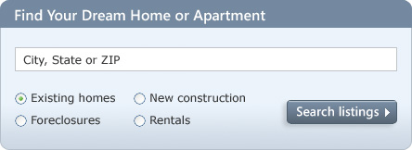
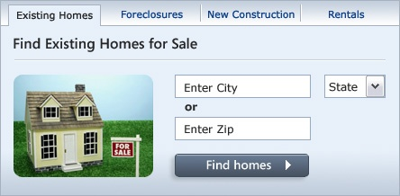
MSN Real Estate
“Find a house” widget variations
Overall Evaluation Criterion: Revenue to Microsoft generated every time a user clicks search/find button
A
B
Raise your right hand if you think A Wins
Raise your left hand if you think B Wins
Don’t raise your hand if you think they’re about the same

Slide 8
MSN Real Estate
If you did not raise a hand, please sit down
If you raised your left hand, please sit down
A was 8.5% better

Slide 9
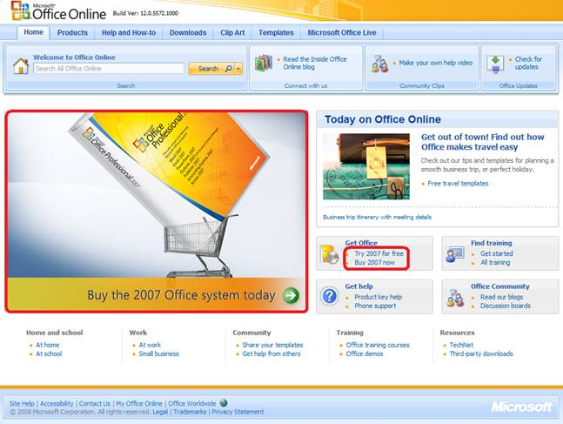
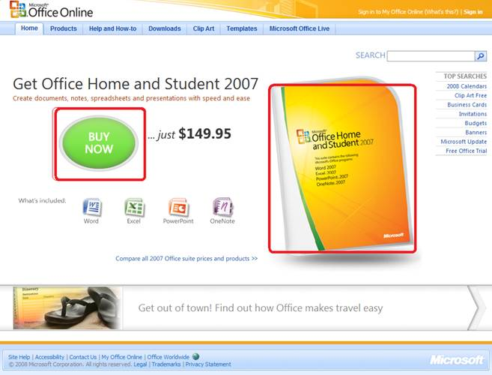
Office Online
Test new design for Office Online homepage
OEC: Clicks on revenue generating links (red below)
A
B
Raise your right hand if you think A Wins
Raise your left hand if you think B Wins
Don’t raise your hand if you think they’re about the same

Slide 10
Office Online
If you did not raise a hand, please sit down
If you raised your left hand, please sit down
B was 64% worse
The Office Online team wrote
  A/B testing is a fundamental and critical Web services… consistent use of A/B testing could save the company millions of dollars

Slide 11


MSN Home Page Search Box
OEC: Clickthrough rate for Search box and popular searches
A
B
Differences: A has taller search box (overall size is the same), has magnifying glass icon, “popular searches”
B has big search button
Raise your right hand if you think A Wins
Raise your left hand if you think B Wins
Don’t raise your hand if they are the about the same

Slide 12
Search Box
If you raised any hand, please sit down
Insight
  Stop debating, it’s easier to get the data

Slide 13
Agenda
Controlled Experiments in one slide
Examples: you’re the decision maker
Culture, OEC (Overall Evaluation Criterion)
Controlled Experiments: deeper dive
Two key messages to remember
  It is hard to assess the value of ideas .
  Get the data by experimenting because data trumps intuition
  OEC: Make sure the org agrees what you are optimizing

Slide 14
The Cultural Challenge
It is difficult to get a man to understand something when his salary depends upon his not understanding it.
-- Upton Sinclair
Why people/orgs avoid controlled experiments
  Some believe it threatens their job as decision makers
  At Microsoft, program managers select the next set of features to develop. Proposing several alternatives and admitting you don’t know which is best is hard
  Editors and designers get paid to select a great design
  Failures of ideas may hurt image and professional standing.
  It’s easier to declare success when the feature launches
  We’ve heard: “we know what to do. It’s in our DNA,” and
  “why don’t we just do the right thing?”

Slide 15
Experimentation Culture
Learn from flat/negative results
  Even if an idea failed to improve the OEC,
  the org learned something. Failing fast is good
  “If you're not prepared to be wrong, you'll never come up with anything original” – Sir Ken Robinson (TED 2006)
  Deploy the positive experiments: only their sum really matters
To innovate, experiment often
  “To have a great idea, have a lot of them” -- Thomas Edison
  If you have to kiss a lot of frogs to find a prince,
  find more frogs and kiss them faster and faster

Slide 16
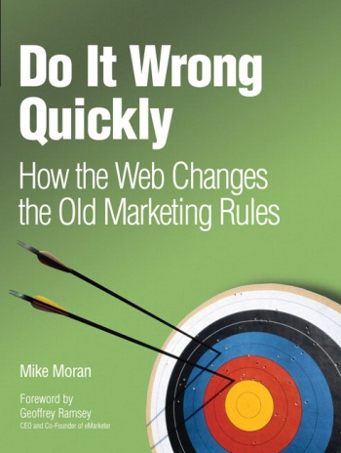

Do It Wrong Quickly
We work on “the plan,” which is
reviewed and approved by execs,
then we execute flawlessly (or do we?)
We’re looking to hit the arrow in the
center—the bulls-eye
But what if we the game is to score the most points, i.e., the sum of arrow scores.
Shooting three arrows may be much
more effective

Slide 17
Do It Wrong Quickly (2)
Netflix considers 90% of what they try to be wrong (p. 240).
What customers do is just as important as what they say.
Measuring the “do” is easier and friendlier than surveying them all the time]
Try the game at http://www.redbooks.ibm.com/ibmpress/ibmpressgame/DIWQ_game.html

Slide 18
Enlightened Experimentation: The New Imperative for Innovation
HBR article by Stefan Thomke (Feb, 2001)
Experimentation lies at the heart of every company's ability to innovate
In the past, testing was relatively expensive, so companies had to be parsimonious with the number of experimental iterations
The electric light bulb, required more than 1,000 complex experiments with filament materials and shapes, electromechanical regulators, and vacuum technologies

Slide 19
Enlightened Experimentation (2)
Essentials for enlightened experimentation
  Organize for rapid experimentation
    Encourage rapid experimentation
    Use small development groups with key people to iterate rapidly
    Perform experiments in parallel
  Fail early and often, but avoid mistakes
    Embrace failure to advance knowledge
    Failure can expose important gaps in knowledge
    Don't forget the basics: well designed tests with clear objectives
    IDEO's “fail often to succeed sooner”
    Don't develop expensive sleek prototypes, as you become committed to them before you know if they work.

Slide 20
Enlightened Experimentation (3)
Essentials (CONT)
  Anticipate and exploit early information
    Front-load to identify problems and provide guidance when it's cheap
    Acknowledge trade-off between cost and fidelity.
    Low-fidelity experiments (costing less) are suited in early exploratory stages
  Combine new and traditional technologies
    Today's new technology might eventually replace its traditional counterpart, but it could then be challenged by tomorrow's new technology

Slide 21
Failures are Not Mistakes
Article by Thomke, May 2006
Mistakes refer to the wrong actions that result from poor judgments or inattention; they should be avoided because they produce little new or useful information.
A poorly planned or badly conducted experiment that results in ambiguous data, forcing researchers to repeat the experiment, is a mistake.
Another common mistake is repeating a prior failure or learning nothing from the experience
Notes:
thomkeFailuresAreNotMistakes.pdf

Slide 22
Failures are Not Mistakes (2)
Story about Tom Watson Sr., IBM's founder
A promising young executive involved in a risky new venture, managed to lose more than $10 million while trying to make the venture work
When the nervous man was called into Watson's office, he offered to accept the logical consequence of losing the company such a large amount of money: "I guess you want my resignation, Mr. Watson.“
Much to his surprise, Watson countered: 'You can't be serious! We've just spent 10 million [dollars] educating you."

Slide 23
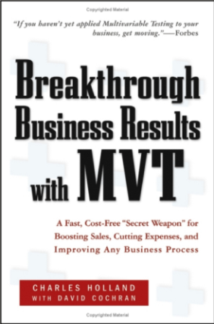
Hard to Assess the Value of Ideas:
Data Trumps Intuition
It is humbling to see how often we are wrong
  Experts are often wrong in many domains
  Doctors did bloodletting for centuries until the 1836 when Pierre Louis ran a controlled experiment (randomized clinical trial)
At Amazon, more than half of the experiments failed to show improvement
QualPro tested 150,000 ideas over 22 years
  75 percent of important business decisions and
  business improvement ideas either have no impact on
  performance or actually hurt performance…
Notes:
there is no correlation between what people in the organization think will work and what actually does work

Slide 24
Microsoft’s Batting Average
Based on experiments with ExP at Microsoft
  1/3 of ideas were positive ideas and statistically significant
  1/3 of ideas were flat: no statistically significant difference
  1/3 of ideas were negative and statistically significant
Our intuition is poor: 2/3rd of ideas do not improve the metric(s) they were designed to improve!
  Every idea was built because someone thought it was a great idea worth implementing (and convinced others)
Humbling, but that’s the value of experimentation

Slide 25
The OEC
If you remember one thing from this talk, remember this point
OEC = Overall Evaluation Criterion
  Agree early on what you are optimizing
  Getting agreement on the OEC in the org is a huge step forward
  Suggestion: optimize for customer lifetime value, not immediate short-term revenue
  Criterion could be weighted sum of factors, such as
    Time on site (per time period, say week or month)
    Visit frequency
  Report many other metrics for diagnostics, i.e., to understand the why the OEC changed and raise new hypotheses

Slide 26
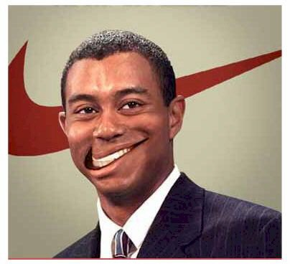
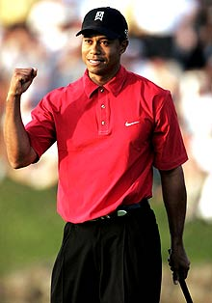

OEC Thought Experiment
Tiger Woods comes to you for advice on how to spend his time: improving golf, or improving ad revenue (most revenue comes from ads)
  Short term, he could improve his ad revenue
  by focusing on ads…
  But to optimize lifetime financial value
  (and immortality as a great golf player),
  he needs to focus on the game
  While the example seems obvious,
  organizations commonly make the mistake
  of focusing on the short term
Notes:
Motivated by Geoff Moore’s Dealing with Darwin: core vs. context

Slide 27
McNamara’s Fallacy
Beware of measuring what is easy instead of what’s important. For example:
  Clicks to the beginning of the purchase pipeline rather than actual purchases (you may change the probability of purchase given someone enters the pipeline).
McNamara’s Fallacy:
  The first step is to measure what can easily be measured.
  This is OK as far as it goes.
  The second step is to disregard that which can't easily be measured or give it an arbitrary quantitative value.
  This is artificial and misleading.
  The third step is to presume that which can't be measured easily really isn't important.
  This is blindness.
  The fourth step is to say that what can't be easily measured really does not exist.
  This is suicide.
Notes:
After Robert McNamara, US Defense secretary during the Vietnam war. It refers to make measurable important rather than to making the important measurable.
For the book how to measure anything.

Slide 28
Agenda
Controlled Experiments in one slide
Examples: you’re the decision maker
Culture, OEC (Overall Evaluation Criterion)
Controlled Experiments: deeper dive
Two key messages to remember
  It is hard to assess the value of ideas .
  Get the data by experimenting because data trumps intuition
  OEC: Make sure the org agrees what you are optimizing

Slide 29
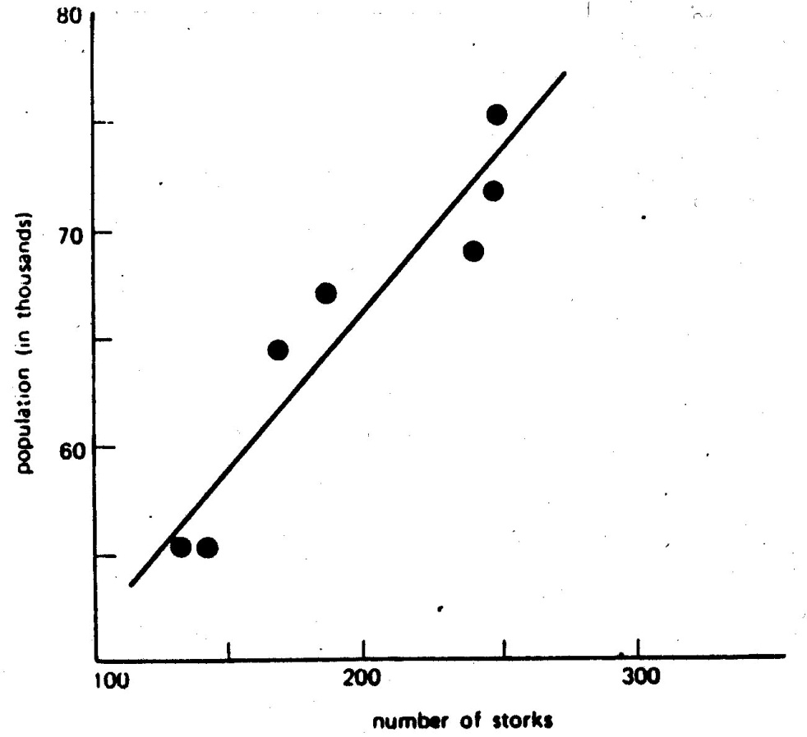
Typical Discovery
With data mining, we find patterns, but most are correlational, providing hypotheses for possible causes
Here is one a real example
of two highly correlated
variables

Slide 30
Correlations are not Necessarily Causal
Data for the city of Oldenburg, Germany
X-axis: stork population
Y-axis: human population
What your mother told you about babies and storks when you were three is still not right, despite the strong correlational “evidence”
Ornitholigische Monatsberichte 1936;44(2)

Slide 31
Correlation: Example 2
True statement (but not well known):
Palm size correlates with your life expectancy
The larger your palm, the less you will live, on average.
Try it out - look at your neighbors and you’ll see who is expected to live longer
But…don’t try to bandage your hands
Women have smaller palms and live 6 years longer
on average

Slide 32
Advantages of Controlled Experiments
Controlled experiments test for causal relationships, not simply correlations
When the variants run concurrently, only two things could explain a change in metrics:
  The “feature(s)” (A vs. B)
  Random chance
  Everything else happening affects both the variants
  For #2, we conduct statistical tests for significance
The gold standard in science and the only way to prove efficacy of drugs in FDA drug tests

Slide 33
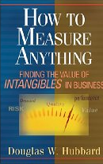
Issues with Controlled Experiments (1 of 2)
If you don't know where you are going, any road will take you there
—Lewis Carroll
Org has to agree on OEC (Overall Evaluation Criterion).
  This is hard, but it provides a clear direction and alignment
  Some people claim their goals are “soft” or “intangible” and cannot be quantified.
  Think hard and read Hubbard’s How to Measure Anything: Finding the Value
  of Intangibles in Business
Quantitative metrics, not always explanations of “why”
  A treatment may lose because page-load time is slower.
  At Amazon, we slowed pages by 100-250msec and lost 1% of revenue
  A treatment may have JavaScript that fails on certain browsers, causing users to abandon.

Slide 34
Issues with Controlled Experiments (2 of 2)
Primacy/newness effect
  Changing navigation in a website may degrade the customer experience (temporarily), even if the new navigation is better
  Evaluation may need to focus on new users, or run for a long period
Multiple experiments
  Even though the methodology shields an experiment from other changes, statistical variance increases making it harder to get significant results.
  There can also be strong interactions (rarer than most people think)
Consistency/contamination
  On the web, assignment is usually cookie-based, but people may use multiple computers, erase cookies, etc. Typically a small issue
Launch events / media announcements sometimes preclude controlled experiments
  The journalists need to be shown the “new” version
Notes:
Good example of primacy: Office 2007 vs. Office 2003

Slide 35
Best Practice: A/A Test
Run A/A tests
  Run an experiment where the Treatment and Control variants are coded identically and validate the following:
    Are users split according to the planned percentages?
    Is the data collected matching the system of record?
    Are the results showing non-significant results 95% of the time?
This is a powerful technique for finding bugs and other integration issues before teams try to make data-driven decisions
  Generating some numbers is easy
  Getting correct numbers you trust is much harder!

Slide 36
Best Practice: Compute Statistical Significance
A very common mistake is to declare a winner when the difference could be due to random variations
Compute 95% confidence intervals on the metrics to determine if the difference is due to chance or whether it is statistically significant
Increase percentage if you do multiple tests
(e.g., use 99%)
Idea: run an A/A test in concurrent to your A/B test to make sure the overall system doesn’t declare it as significant more than 5% of the time (great QA)

Slide 37
Best Practice: Ramp-up
Ramp-up
  Start an experiment at 0.1%
  Do some simple analyses to make sure no egregious problems can be detected
  Ramp-up to a larger percentage, and repeat until 50%
Big differences are easy to detect because the min sample size is quadratic in the effect we want to detect
  Detecting 10% difference requires a small sample and serious problems can be detected during ramp-up
  Detecting 0.1% requires a population 100^2 = 10,000 times bigger
Abort the experiment if treatment is significantly worse on OEC or other key metrics (e.g., time to generate page)

Slide 38
Run Experiments at 50/50%
Novice experimenters run 1% experiments
To detect an effect, you need to expose a certain number of users to the treatment (based on power calculations)
Fastest way to achieve that exposure is to run equal-probability variants (e.g., 50/50% for A/B)
If you perceive risk, don’t start an experiment at 50/50% from the beginning: Ramp-up over a short period

Slide 39

Randomization
Good randomization is critical.
It’s unbelievable what mistakes developers will make in favor of efficiency
Properties of user assignment
  Consistent assignment. User should see the same variant on successive visits
  Independent assignment. Assignment to one experiment should have no effect on assignment to others (e.g., Eric Peterson’s code in his book gets this wrong)
  Monotonic ramp-up. As experiments are ramped-up to larger percentages, users who were exposed to treatments must stay in those treatments (population from control shifts)

Slide 40
Controversial Claims
Run concurrent univariate experiments
  Vendors make you think that MVTs and Fractional Factorial designs are critical---they are not. The same claim can be made that polynomial models are better than linear models: true in theory, less useful in practice
  Let teams launch multiple experiments when they are ready, and do the analysis to detect and model interactions when relevant (less often than you think)
Backend integration (server-side) is a better long-term approach to integrate experimentation than Javascipt
  Javascript suffers from performance delays, especially when running multiple experiments
  Javascript is easy to kickoff, but harder to integrate with dynamic systems
  Hard to experiment with backend algorithms (e.g., recommendations)

Slide 41
Summary
  The less data, the stronger the opinions
It is hard to assess the value of ideas
  Listen to your customers
  Get the data by experimenting because data trumps intuition
  Examples are humbling. More at http://exp-platform.com
Empower the HiPPO with data-driven decisions
  OEC: make sure the org agrees what you are optimizing (long term lifetime value)
Compute the statistics carefully
  Power, 95% confidence, ramp-up
  Stats/details described at http://exp-platform.com/hippo_long.aspx
Experiment often
  Triple your experiment rate and you triple your success (and failure) rate.
  Fail fast & often in order to succeed
  Accelerate innovation by lowering the cost of experimenting

Slide 42
Extra Slides

Slide 43
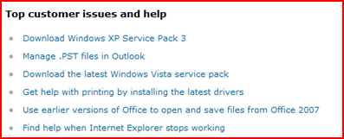
Microsoft Support
Support.microsoft.com shows “top issues”
OEC = click-through rate
A shows top issues
B filters top issues to
OS & Browser used to
visit site (useragent)
Personalization rarely hurts, but does it help?
Raise your right hand if you think B Wins by over 30%
Raise your left hand if you think B Wins by under 30%
Don’t raise your hand if you think they’re about the same

Slide 44
Microsoft Support
If you did not raise a hand, please sit down
If you raised your left hand, please sit down
B was >50% better
  Personalization helps more than people think!

Slide 45
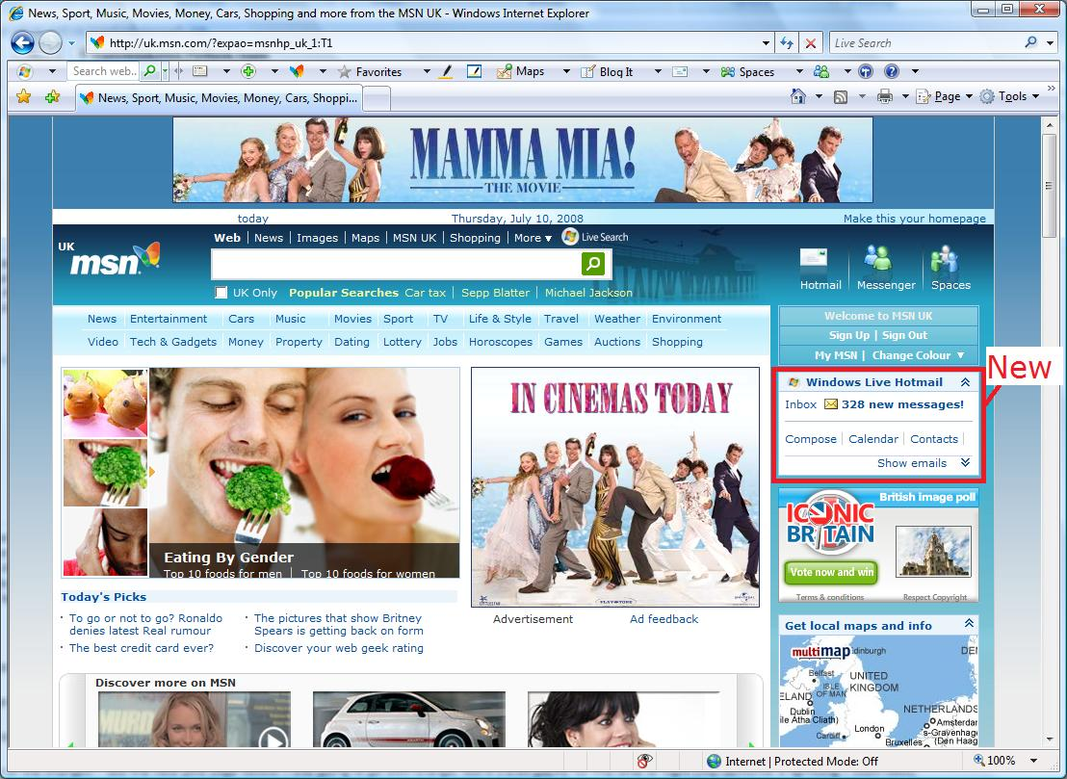
MSN UK Hotmail experiment
Hotmail module on the MSN UK home page

Slide 46
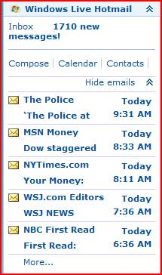
MSN UK Hotmail experiment
A: When user clicks on email
hotmail opens in same window
B: Open hotmail in separate window
Trigger: only users that click in the
module are in experiment
(no diff otherwise)
OEC: clicks on home page (after trigger)
Raise your right hand if you think A Wins
Raise your left hand if you think B Wins
Don’t raise your hand if they are the about the same

Slide 47
UK Hotmail
If you didn’t raise a hand, please sit down
If you raised your right hand, please sit down
For those in the experiment, clicks on MSN Home Page increased +8.9%
<0.001% of users in B wrote negative feedback about the new window

Slide 48
Data Trumps Intuition
  The experiment report was sent by the BI/CI team to all multiple teams across the world
  Someone who saw the report wrote
    This report came along at a really good time and was VERY useful.
    I argued this point to my team (open Live services in new window from HP) just some days ago.
    They all turned me down.
    Funny, now they have all changed their minds.

Slide 49
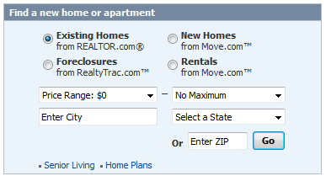
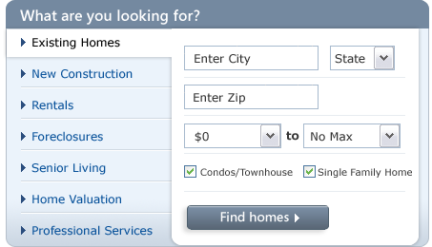
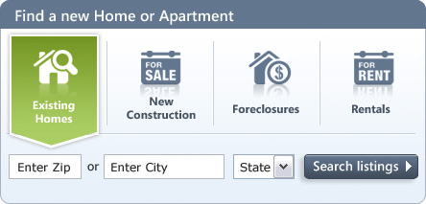
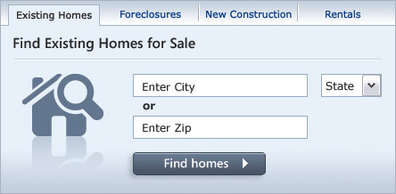
Real Example: MSN Real Estate
“Find a house” widget variations
Overall Evaluation Criterion: Revenue to Microsoft generated every time a user clicks
Think which one should win…

Slide 50
MSN Real Estate
The widget that performed the best was…
  the simplest
  Revenue increase over control: +9.7%
  Interesting note: nobody from MSN Real Estate or Zaaz (the company that did the creative) thought this widget would win

Slide 51
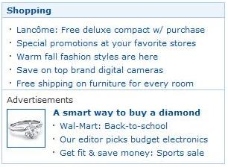

MSN Home Page
Proposal: New Offers module below Shopping
Control
Treatment

Slide 52
The Experiment
Value proposition
  The Offers module appears below the fold
  Sales estimated the three ads would sell for several millions of dollars a year
Concern
  Do more ads degrade the user experience?
How do we trade the two off?
Experiment!

Slide 53
Experimental Results
Ran experiment for 12 days on 5% of traffic
Clickthrough rate per user (CTR) decreased 0.31%
(p-value =0.044). This result is statistically significant
Clicks per user decreased 0.72% (p-value=0.015)
Value of click from home page: talk to finance and the SEM team (how much are you paying to drive traffic from search engines)
The net result: losing idea

Slide 54
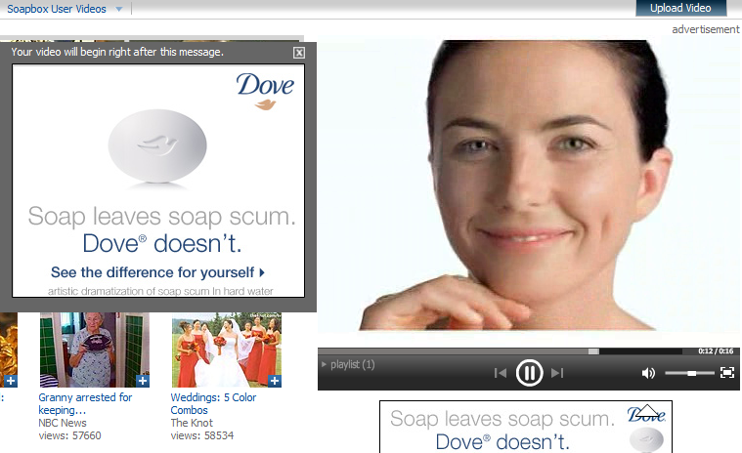
MSN Entertainment and Video Services (EVS)
Determine impact of 2 factors for video ads.
1) Factor A: pre-roll vs. post-roll ads
2) Factor B: time between ads (90, 120, 180, 300, 900 seconds)
OEC: revenue from ad starts

Slide 55
MSN EVS (results)
Eliminating the initial pre-roll ad
  Increased repeat visits by 1-3%, but
  Reduced overall ad views by 50-60%
The amount of time between ad plays had no statistically significant impact on repeat visits
Decreasing the length of time between ad streams increased the total ad streams without impacting loyalty
(as measured by return visits)
Reducing the time to 90 seconds would improve annual revenue by millions
Client wrote
  There is a preponderance of opinion driven design…
  The results of the experiment were in some respect counterintuitive.
  They completely changed our feature prioritization. It dispelled long held assumptions about video advertising. Very, very useful.

Slide 56
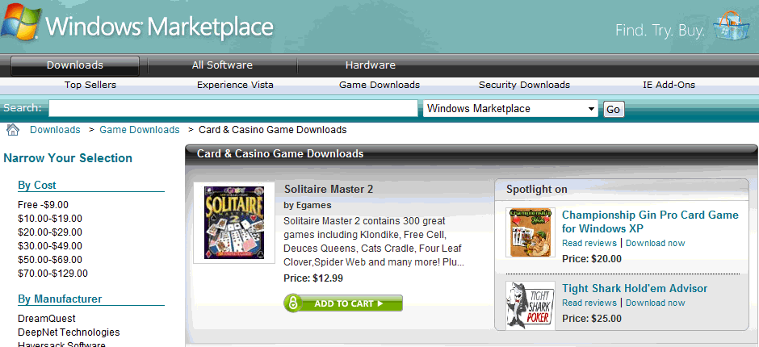
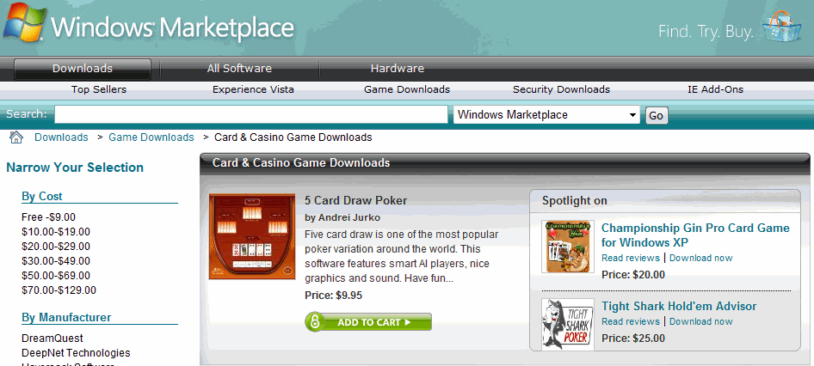
Marketplace: Solitaire v Poker
This experiment ran in Windows Marketplace / Game Downloads
Which image has the higher clickthrough? By how much?
A: Solitaire game
in hero position
B: Poker game
in hero position
A is 61% better
Notes:
B is 38% worse, or A is 61% better

Slide 57
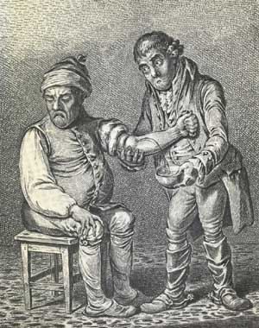
Bloodletting (1 of 2)
For many years, the prevailing
conception of illness was that the sick
were contaminated by some toxin
Opening a vein and letting the sickness
run out – bloodletting.
One British medical text recommended bloodletting for
acne, asthma, cancer, cholera, coma, convulsions, diabetes, epilepsy, gangrene, gout, herpes, indigestion, insanity, jaundice, leprosy, ophthalmia, plague, pneumonia, scurvy, smallpox, stroke, tetanus, tuberculosis, and for some one hundred other diseases
Physicians often reported the simultaneous use of fifty or more leeches on a given patient.
Through the 1830s the French imported about forty million leeches a year for medical purposes
Notes:
Hebrew: hakazat dam. הקזת דם

Slide 58
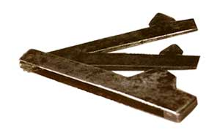
Bloodletting (2 of 2)
Lancet
President George Washington had a sore throat and
doctors extracted 82 ounces of blood over 10 hours
(35% of his total blood), causing anemia and hypotension.
He died that night.
Pierre Louis did an experiment in 1836 that is now recognized as one of the first clinical trials, or randomized controlled experiment. He treated people with pneumonia either with
  early, aggressive bloodletting, or
  less aggressive measures
At the end of the experiment, Dr. Louis counted the bodies. They were stacked higher over by the bloodletting sink.
Notes:
I’m telling this horrific story because experts are often wrong about their beliefs. This is one of the central themes: we need to run experiments and make data-driven decisions.

Slide 59
Design Goals
Tight integration with other systems (e.g., content management) allowing “codeless experiments”
Accurate results in near real-time
  Trust is important
  Quickly detect and abort poorly performing experiments
  High-performance data pipeline with built-in data loss detection
Minimal risk for experimenting applications
  Encourage bold innovations with reduced QA cycles
  Auto-abort catches bugs in experimental code
  Client library insulates app from platform bugs
Experimentation should be easy
  Client library exposes simple interface
  Web UI enables self-service
  Service layer enables platform integration

Slide 60
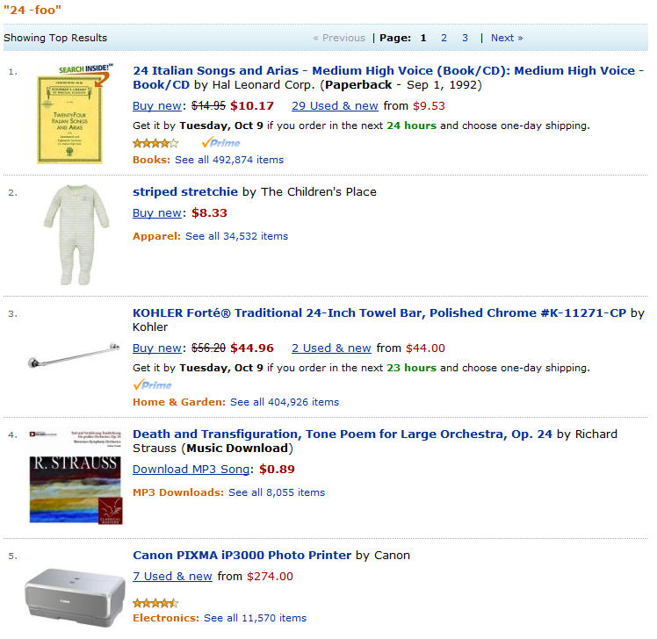
Amazon Behavior-Based Search
Searches for “24” are underspecified, yet most humans are probably searching for the TV program
Prior to Behavior-based search, here is what you would get (you can get this today by adding an advanced modifier like –foo to exclude foo)
Mostly irrelevant stuff:
24 Italian songs
Toddler clothing suitable for 24 month olds
24” towel bar
Opus 24 by Strauss
24- lb stuff, cases of 24, etc

Slide 61
The Idea Behind BBS(*)
Amazon/P13N had an engine for X to Y
People who bought item X bought Y
Feed searches, i.e.,
People who searched for X bought Y
Prototype looked great
Integration with Search would take a long time: different team in A9 in the Bay Area
They also highlighted a flaw:
The results don’t always have the search terms.
Example: search for “duracell charger” and you will see a best selling Sony charger, which does not have the word Duracell.
But people choose to buy it after searching with this phrase!
(*) Based on UW iEdge Seminar talk by Amazon, 4/2006

Slide 62
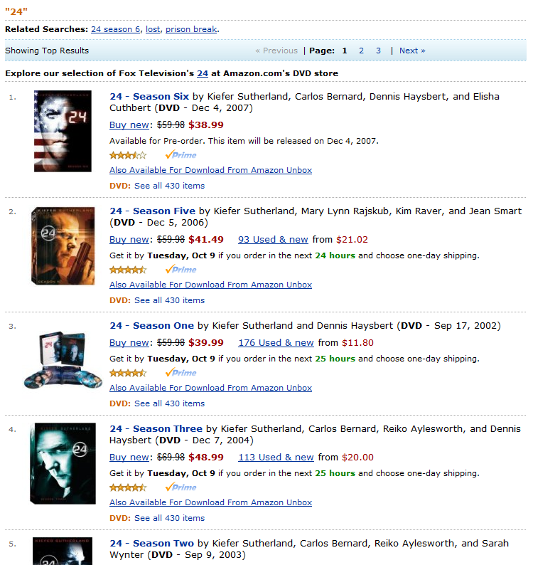
End Result
Ran experiment with very thin integration
Strong correlations shown at the top of the page, pushing search results down
Implemented simple de-duping of results
Result : +3% increase to revenue.
3% of $12B is $360M

Slide 63
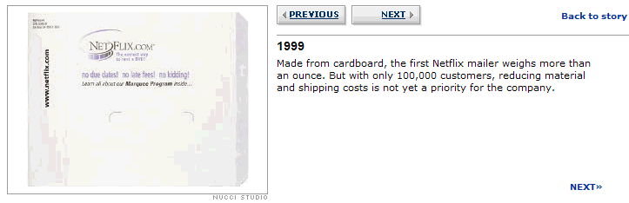
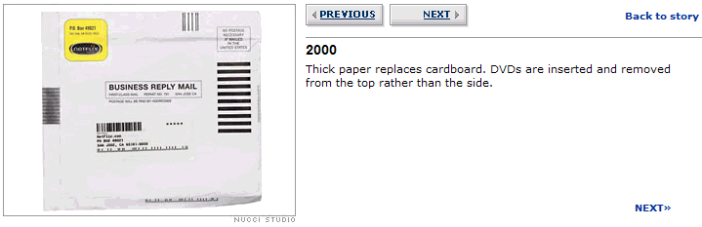
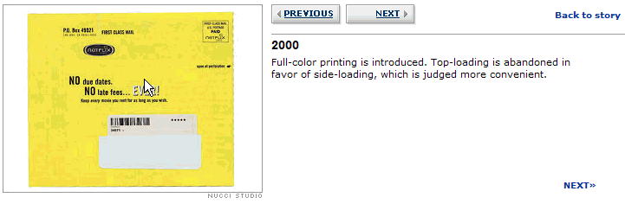
TIMITI – Try It, Measure It, Tweak It^{(*)}
I’m a Netflix user since 1/2000
Great example of a company tweaking things
(*) TIMITI acronym by Jim Sterne

Slide 64
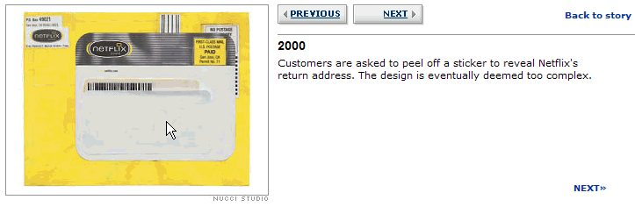
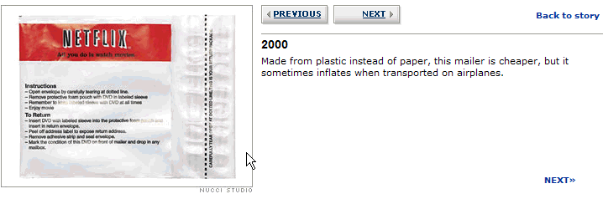
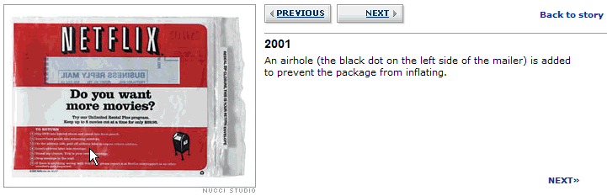
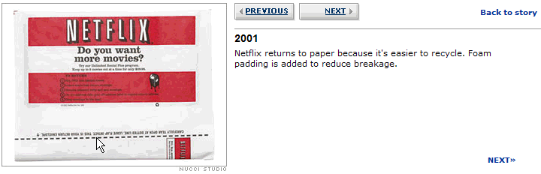
TIMITI – Try It, Measure It, Tweak It (II)

Slide 65
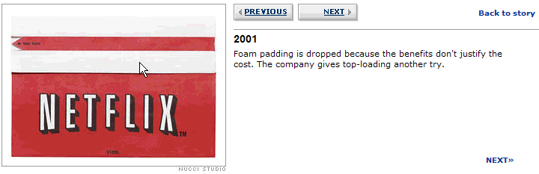
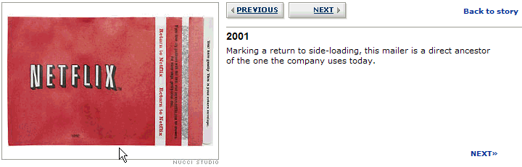
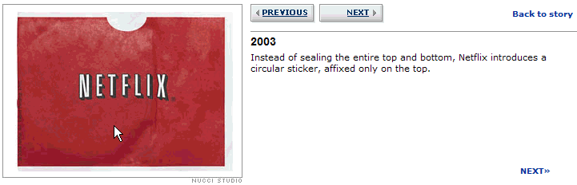
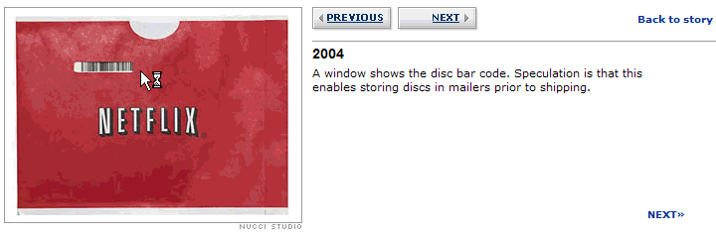
TIMITI – Try It, Measure It, Tweak It (III)
Details in Business 2.0 Apr 21, 2006.
The evolution of the NetFlix envelope

Slide 66
Mixed Effects of Inconsistency on Experimentation in Organizations
Article in Organization ScienceManagement can support experimentation and highlight it as a value (normative influence)
However, inconsistent reward systems that punish failure lead to aversion
Especially in organizations that are under constant evaluation for perfect execution
Notes:
mixedEffectsOfInconsistencyOnExp.pdf

Slide 67
Twyman’s Law
Any statistic that appears interesting
is almost certainly a mistake
Validate “amazing” discoveries in different ways.
They are usually the result of a business process
  5% of customers were born on the exact same day (including year)
    11/11/11 is the easiest way to satisfy the mandatory birth date field
  For US and European Web sites, there will be a small sales increase on Nov 1st, 2009
Notes:
http://webexhibits.org/daylightsaving/b.html
For Oct 29, 2006 it’s both Europe and the US. For starting DST, the dates are different.
Don’t forget to change your batteries: More than 90 percent of homes in the United States have smoke detectors, but one-third are estimated to have dead or missing batteries.

Slide 68
Experimentation Platform Team
Mission: accelerate software innovation through trustworthy experimentation
Build the ExP platform
Change the culture towards more data-driven decisions
Have impact across multiple teams at Microsoft, and
Make platform available externally

Slide 69

http://exp-platform.com
Accelerating software Innovation through trustworthy experimentation

