Slide 1

Online Controlled Experiments:
Listening to the Customers, not to the HiPPO
The Analytics Revolution, Apr 2010, SDForum
Ronny Kohavi, General Manager
Experimentation Platform, Microsoft
ronnyk@microsoft.com
Notes:
http://sdforum.com/

Slide 2


Amazon Shopping Cart Recommendations
Add an item to your shopping cart at a website
  Most sites show the cart
At Amazon, Greg Linden had the idea of showing recommendations based on cart items
Evaluation
  Pro: cross-sell more items (increase average basket size)
  Con: distract people from checking out (reduce conversion)
HiPPO (Highest Paid Person’s Opinion) was: stop the project
Simple experiment was run, wildly successful,
and the rest is history
From Greg Linden’s Blog: http://glinden.blogspot.com/2006/04/early-amazon-shopping-cart.html

Slide 3
Agenda
Controlled Experiments in one slide
Examples: you’re the decision maker
Cultural evolution: hubris, insight through measurement, Semmelweis reflex, fundamental understanding
Two key messages to remember
  It is hard to assess the value of ideas.
  Get the data by experimenting because data trumps intuition
  Make sure the org agrees what you are optimizing and evolve your culture towards data-driven decisions
Papers, examples, all the statistics, pros/cons at
http://exp-platform.com (reprints of key paper available here)

Slide 4

Controlled Experiments in One Slide
Concept is trivial
  Randomly split traffic between
  two (or more) versions
    A (Control)
    B (Treatment)
  Collect metrics of interest
  Analyze
Must run statistical tests to confirm differences are not due to chance
Best scientific way to prove causality, i.e., the changes in metrics are caused by changes introduced in the treatment(s)

Slide 5
Examples
Three experiments that ran at Microsoft
All had enough users for statistical validity
Game: see how many you get right
  Everyone please stand up
  Three choices are:
    A wins (the difference is statistically significant)
    A and B are approximately the same (no stat sig diff)
    B wins
  If you guess randomly
    1/3 left standing after first question
    1/9 after the second question

Slide 6
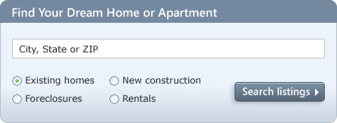
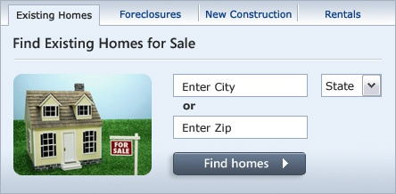
MSN Real Estate
“Find a house” widget variations
Overall Evaluation Criterion(OEC): Revenue to Microsoft generated every time a user clicks search/find button
A
B
Raise your right hand if you think A Wins
Raise your left hand if you think B Wins
Don’t raise your hand if you think they’re about the same

Slide 7
MSN Real Estate
If you did not raise a hand, please sit down
If you raised your left hand, please sit down
A was 8.5% better
Since this is the #1 monetization, it effectively raised revenues significantly
Actual experiment had 6 variants.
If you’re going to experiment, try more variants, especially if they’re easy to implement

Slide 8


MSN Home Page Search Box
OEC: Clickthrough rate for Search box and popular searches
A
B
Differences: A has taller search box (overall size is the same), has magnifying glass icon, “popular searches”
B has big search button
Raise your right hand if you think A Wins
Raise your left hand if you think B Wins
Don’t raise your hand if they are the about the same

Slide 9
Search Box
If you raised any hand, please sit down
Insight
  Stop debating, it’s easier to get the data

Slide 10
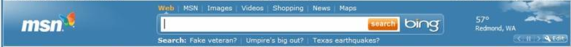

MSN US Home Page: Search Box
A later test showed that changing the magnifying glass to an actionable word (search, go, explore) was highly beneficial.
This:
is better than

Slide 11
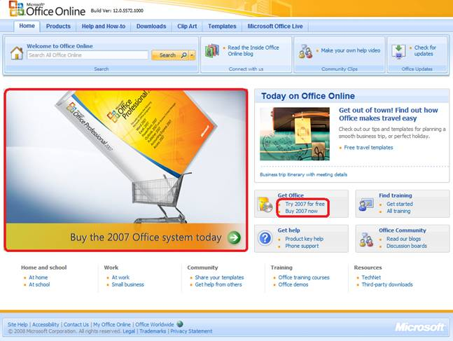
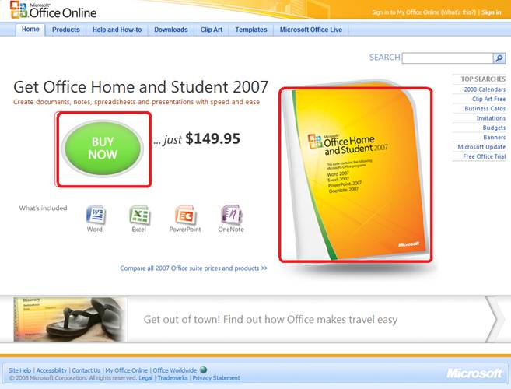
Office Online
OEC: Clicks on revenue generating links (red below)
A
B
Raise your right hand if you think A Wins
Raise your left hand if you think B Wins
Don’t raise your hand if they are the about the same

Slide 12
Office Online
If you did not raise a hand, please sit down
If you raised your left hand, please sit down
B was 64% worse
What % of the audience is still standing?
Humbling!

Slide 13
Twyman’s Law
Any statistic that appears interesting
is almost certainly a mistake
If something is “amazing,” find the flaw!
Examples
  If you have a mandatory birth date field and people think it’s unnecessary, you’ll find lots of 11/11/11 or 01/01/01
  If you have an optional drop down, do not default to the first alphabetical entry, or you’ll have lots jobs = Astronaut
The previous Office example assumes click maps to revenue.
Seemed reasonable, but when the results look so extreme, find the flaw (conversion rate is not the same; see why?)
Notes:
One has the price. Sends more qualified buyers

Slide 14
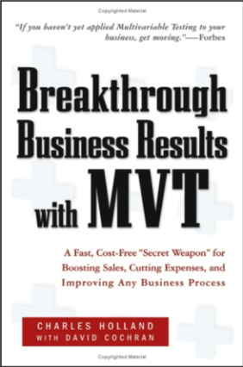
Hard to Assess the Value of Ideas:
Data Trumps Intuition
At Amazon, half of the experiments failed to show improvement
QualPro tested 150,000 ideas over 22 years
  75 percent of important business decisions and
  business improvement ideas either have no impact on
  performance or actually hurt performance…
Based on experiments with ExP at Microsoft
  1/3 of ideas were positive ideas and statistically significant
  1/3 of ideas were flat: no statistically significant difference
  1/3 of ideas were negative and statistically significant
Our intuition is poor: 2/3rd of ideas do not improve the
metric(s) they were designed to improve. Humbling!
Notes:
there is no correlation between what people in the organization think will work and what actually does work

Slide 15
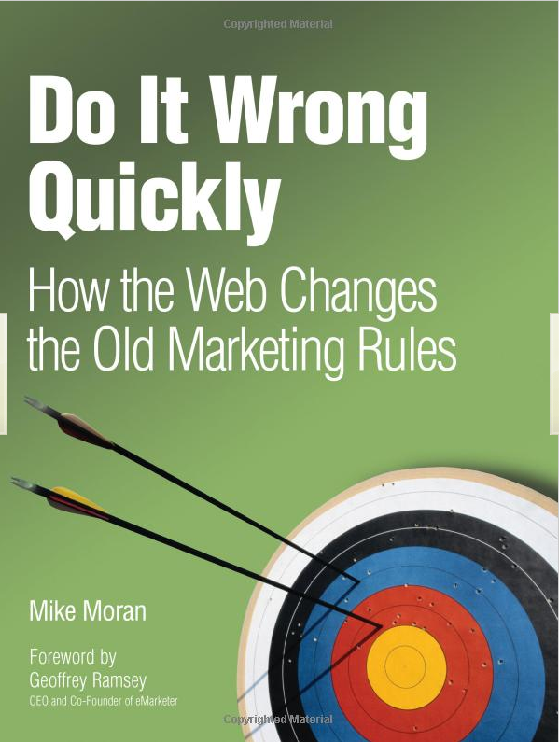
Key Lessons
Avoid the temptation to try and build optimal features through extensive planning without early testing of ideas
Experiment often
  To have a great idea, have a lot of them -- Thomas Edison
  If you have to kiss a lot of frogs to find a prince,
  find more frogs and kiss them faster and faster
  -- Mike Moran, Do it Wrong Quickly
Try radical ideas. You may be surprised
  Doubly true if it’s cheap to implement (e.g., shopping cart recommendations)
  If you're not prepared to be wrong, you'll never come up
  with anything original – Sir Ken Robinson, TED 2006

Slide 16
The OEC
If you remember one thing from this talk, remember this point
OEC = Overall Evaluation Criterion
  Agree early on what you are optimizing
  Getting agreement on the OEC in the org is a huge step forward
  Suggestion: optimize for customer lifetime value, not immediate short-term revenue
  Criterion could be weighted sum of factors, such as
    Time on site (per time period, say week or month)
    Visit frequency
  Report many other metrics for diagnostics, i.e., to understand the why the OEC changed and raise new hypotheses

Slide 17
Agenda
Controlled Experiments in one slide
Examples: you’re the decision maker
Cultural evolution: hubris, insight through measurement, Semmelweis reflex, fundamental understanding
Two key messages to remember
  It is hard to assess the value of ideas.
  Get the data by experimenting because data trumps intuition
  Make sure the org agrees what you are optimizing and evolve your culture towards data-driven decisions

Slide 18
The Cultural Challenge
It is difficult to get a man to understand something when his salary depends upon his not understanding it.
-- Upton Sinclair
Why people/orgs avoid controlled experiments
  Some believe it threatens their job as decision makers
  At Microsoft, program managers select the next set of features to develop. Proposing several alternatives and admitting you don’t know which is best is hard
  Editors and designers get paid to select a great design
  Failures of ideas may hurt image and professional standing.
  It’s easier to declare success when the feature launches
  We’ve heard: “we know what to do. It’s in our DNA,” and
  “why don’t we just do the right thing?”

Slide 19
Cultural Stage 1: Hubris
The org goes through stages in its cultural evolution
Stage 1: we know what to do and we’re sure of it
  True story from 1849
  John Snow claimed that Cholera was caused by polluted water
  A landlord dismissed his tenants’ complaints that their water stank
    Even when Cholera was frequent among the tenants
  One day he drank a glass of his tenants’ water to show there was nothing wrong with it
He died three days later
That’s hubris. Even if we’re sure of our ideas, evaluate them
Controlled experiments are a powerful tool to evaluate ideas

Slide 20
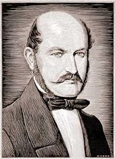

Semmelweis
Cultural Stage 2: Insight through Measurement and Control
Semmelweis worked at Vienna’s General Hospital, an
important teaching/research hospital, in the 1830s-40s
In 19th-century Europe, childbed fever killed more than a million women
Measurement: the mortality rate for women giving birth was
  15% in his ward, staffed by doctors and students
  2% in the ward at the hospital, attended by midwives
Notes:
Collecting stats is the first phase – instrument, measure

Slide 21
Semmelweis
Cultural Stage 2: Insight through Measurement and Control
He tries to control all differences
  Birthing positions, ventilation, diet, even the way laundry was done
He was away for 4 months and death rate fell significantly when he was away. Could it be related to him?
Insight:
  Doctors were performing autopsies each morning on cadavers
  Conjecture: particles (called germs today) were being transmitted to healthy patients on the hands of the physicians
He experiments with cleansing agents
  Chlorine and lime was effective: death rate fell from 18% to 1%
Notes:
Collecting stats is the first phase – instrument, measure

Slide 22
Cultural Stage 3: Semmelweis Reflex
Success? No! Disbelief. Where/what are these particles?
  Semmelweis was dropped from his post at the hospital
  He goes to Hungary and reduced mortality rate in obstetrics to 0.85%
  His student published a paper about the success. The editor wrote
    We believe that this chlorine-washing theory has long outlived its usefulness… It is time we are no longer to be deceived by this theory
In 1865, he suffered a nervous breakdown and was beaten at a mental hospital, where he died
Semmelweis Reflex is a reflex-like rejection of new knowledge because it contradicts entrenched norms, beliefs or paradigms
Only in 1800s? No! A 2005 study: inadequate hand washing is one of the prime contributors to the 2 million health-care-associated infections and 90,000 related deaths annually in the United States

Slide 23
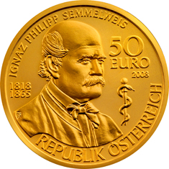
Cultural Stage 4: Fundamental Understanding
In 1879, Louis Pasteur showed the presence of Streptococcus in the blood of women with child fever
2008, 143 years after he died, there is a 50 Euro coin commemorating Semmelweis

Slide 24
Summary: Evolve the Culture
Hubris
Measure and Control
Accept Results avoid Semmelweis Reflex
Fundamental Understanding
In many areas we’re in the 1800s in terms of our understanding, so controlled experiments can help
  First in doing the right thing, even if we don’t understand the fundamentals
  Then developing the underlying fundamental theories

Slide 25
Summary
  The less data, the stronger the opinions
It is hard to assess the value of ideas
  Listen to your customers
  Get the data by experimenting because data trumps intuition
Empower the HiPPO with data-driven decisions
  Hippos kill more humans than any other (non-human) mammal (really)
  OEC: make sure the org agrees what you are optimizing (long term lifetime value)
Compute the statistics carefully
  Getting a number is easy. Getting a number you should trust is harder
Experiment often
  Triple your experiment rate and you triple your success (and failure) rate.
  Fail fast & often in order to succeed
  Accelerate innovation by lowering the cost of experimenting

Slide 26

http://exp-platform.com
Accelerating software Innovation through trustworthy experimentation

Slide 27
Bonus True Story – Scurvy and Vitamin C
  Scurvy is a disease that results from vitamin C deficiency
  It killed over 100,000 people in the 16th-18th centuries, mostly sailors
First known controlled experiment in 1747
  Dr. James Lind noticed lack of scurvy in Mediterranean ships
  Gave some sailors limes (treatment), others ate regular diet (control)
  Experiment was so successful, British sailors are still called limeys
But Lind didn’t understand the reason
  At the Royal Naval Hospital in England, he treated Scurvy patients with concentrated lemon juice called “rob.”
  He concentrated the lemon juice by heating it, thus destroying the vitamin C
  He lost faith in the remedy and became increasingly reliant on bloodletting
In 1793, a formal trial was done and lemon juice became part of the daily rations throughout the navy; Scurvy was quickly eliminated

