Slide 1


Testing with Real Users
User Interaction and Beyond, with Online Experimentation
Seth Eliot, Senior Test Manager
Experimentation Platform (ExP)
Better Software Conference - June 9, 2010
Notes:
Note: if you are reading these slides, they are meant to be reviewed with Animation active (Slide Show view should work nicely)
Rev History
2010 Mar 29 – Original – as submitted for BSC CD
2010 Mar 30 – Fix Typos
2010 Mar 31 – Add Xbox marketplace example
2010 April – Added HOPS example
2010 April – incorporated feedback from Ronny Kohavi
2010 May 16 – Added section heading slides. Cleaned up Google Talk slide
2010 June 6 – Added ExP UI shots – “Analyze and Compare”
2010 June 8 – Added RO slide and “nuts & bolts” intro slide
2010 June 9 – minor tweaks, as presented at BSC
2010 June 25 – no change in content, but made deck more readable without animation

Slide 2
Introduction
What is Online Controlled Experimentation?
Employing Online Experimentation
Data Driven Decision Making
How does this apply to SQA?
Rapid Prototyping
Exposure Control
Monitoring & Measurement
Testing in Production (TiP)
Services TiP with Online Experimentation
Services TiP with Shadowing
Complex Measurements
Latest version of this slide deck can be found at:
http://exp-platform.com/bsc2010.aspx
Notes:
define experimentation
about Websites and UX
transition to SQA
TiP

Slide 3

Who am I?
Software QA Manager
Amazon Digital Media
Microsoft Experimentation Platform
Culture Shift
  Services
  Data Driven
Notes:
For Perspective and context of this talk
Data Driven Test and Design – more later (HiPPO)
Many examples from outside MSFT

Slide 4
What is Online Controlled Experimentation?

Slide 5
Online Controlled Experimentation, Simple Example
A
B
This is an “A/B” test
    …the simplest example
A and B are Variants
  A is Control
  B is Treatment
“….System with Feature X”
can be
“….Website with Different UX”
Notes:
TEXT before DIAGRAM (gives context to explain diagram)
REAL Users
Can have multiple Treatments
Can divide %

Slide 6

…and What it’s Not.
Result is which one he THINKS he likes better
User KNOWS he is in an experiment
Opt-in
(biased population)
User Tries ALL the variants
User’s goal IS the experiment
Notes:
Opt-in: selection bias: get data only from users who are willing to participate
Tries ALL the variants: in OCE we compare populations

Slide 7
What makes a "controlled" experiment?
Nothing but the variants should influence the results
Variants run simultaneously
Users do not know they are in an experiment
User assignment is random and unbiased
….and Sticky

Slide 8
Why are controlled experiments trustworthy?
Best scientific way to prove causality
  changes in metrics are caused by changes introduced in the treatment(s)
Oprah calls Kindle "her new favorite thing"
Notes:
Website B is better? No it’s not.

Slide 9
Why are controlled experiments trustworthy?
Best scientific way to prove causality
  changes in metrics are caused by changes introduced in the treatment(s)
Oprah calls Kindle "her new favorite thing"
Notes:
Website B is better? No it’s not.

Slide 10
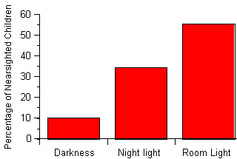
Correlation Does not Imply Causation
Higher Kindle Sales correlate with deployment of B
Did Website B cause the sales increase?
Quinn, et al, 1999
Do night-lights cause
near-sightedness in children?
Nope. Near-sighted parents do
[Zadnik, et al, 2000]
Notes:
Do you get it? Here’s a Test

Slide 11

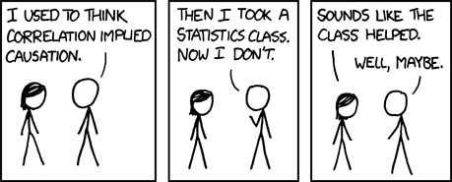
XKCD
Correlation
http://xkcd.com/552/
Notes:
if you laughed, then you get it

Slide 12
Employing Online Experimentation

Slide 13
Where can Online Experimentation be used?
“….System with Feature X”
can be
“….Website with Different UX”
System
Website
Feature X
Different UX
Different functionality
Vcurr/Vnext
Platform Change/Upgrade
Service
Notes:
Will address definition of service later

Slide 14


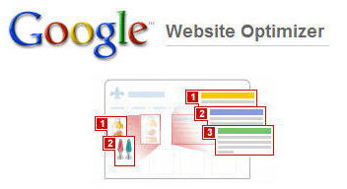




Platform for Online Experimentation
“design philosophy was governed by data and data exclusively“ – Douglas Bowman, Visual Design Lead [Goodbye, Google, Mar 2009]
Platforms used Internally
Public Platforms
Notes:
Google is data driven…drive lead designer to leave
Bowman went to Twitter – talk about data driven culture later
Internal: ones I know of. Also eBay
Google: simple and popular
Webtrends acquired Widemile

Slide 15
Nuts and Bolts of Online Experimentation
Assign Treatment
Record Observation(s)
Analyze and Compare

Slide 16
An Experiment Architecture: Assign Treatment
Web Page
  URL Does not change
Treatment Assignment
Using a Server Side Switch
Instead of a Web Page could be
  Code Path
  Service Selection
  V-curr / V-next
Notes:
Example with ExP – public platforms more complex
Switch as separate service -> Latency/Error
VIP

Slide 17
Another Experiment Architecture
Web Page
  URL changes - Redirect
Treatment Assignment
Using a Client Side Switch
  Page A contains JavaScript
Web Page Only
e.g. Google Website Optimizer “A/B”
Switch is in their Data Center
Notes:
Redirect causes bias

Slide 18
An Experiment Architecture: Record Observation
Server-side Observations
Client-side Observations
  Require Instrumented Page
PR = Page Request
UUID = Unique User ID
RO = Record Observation
Notes:
Example with ExP – public platforms more complex
Switch as separate service -> Latency/Error
VIP

Slide 19
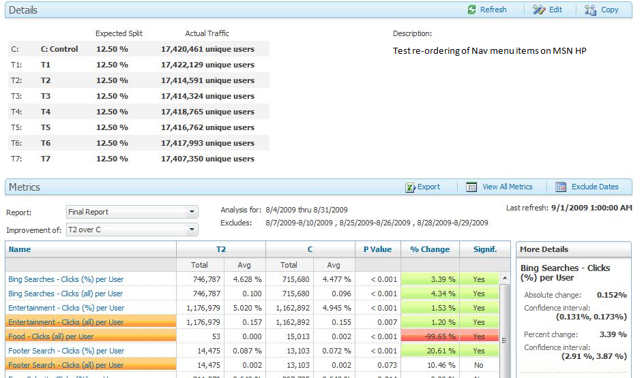
Analyze & Compare
Notes:
Population in experiment is not 100% of MSN HP population

Slide 20
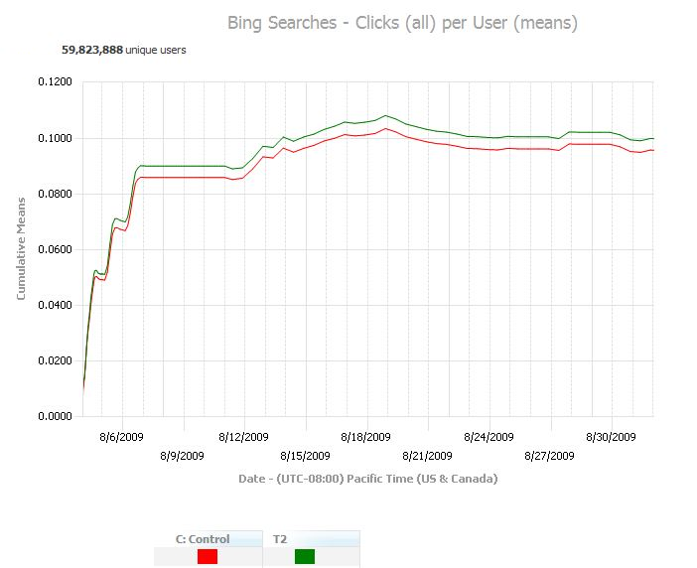
Analyze & Compare
Notes:
Population in experiment is not 100% of MSN HP population

Slide 21
Data Driven Decision Making

Slide 22

Example: Amazon Shopping Cart Recs
Amazon.com engineer had the idea of showing recommendations based on cart items [Greg Linden, Apr 2006]
  Pro: cross-sell more items (increase average basket size)
  Con: distract people from checking out (reduce conversion)
A marketing senior vice-president was dead set against it.
Ran an Experiment…
Notes:
Website/UX
The Experiment was a success

Slide 23

Introducing the HiPPO
A marketing senior vice-president was dead set against it.
Highest Paid Person’s Opinion
Highest Paid Person’s Opinion
    “A scientific man ought to have no wishes, no affections, - a mere heart of stone.” - Charles Darwin
Notes:
What does a Hippo have to do with data-driven decision making?

Slide 24
Data Trumps Intuition
Based on experiments with ExP at Microsoft
Our intuition is poor:
  2/3rd of ideas do not improve the metric(s) they were designed to improve
“It's amazing what you can see when you look“ Yogi Berra
1/3 | 1/3 | 1/3
Positive Ideas | No Statistical Difference | Negative Ideas
Notes:
there is no correlation between what people in the organization think will work and what actually does work
Help HiPPO make data-driven decisions
Don’t let HiPPOs kill innovative ideas - Experiment

Slide 25
A Different Way of Thinking
Avoid the temptation to try and build optimal features through extensive planning without early testing.
Try radical ideas. You may be surprised, especially if “cheap”
    i.e. Amazon.com shopping cart recs
Notes:
Culture Change

Slide 26

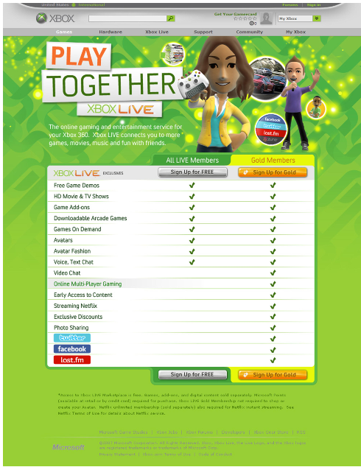
Example: Microsoft Xbox Live
Goal: Sign More People up for Gold Subscriptions
A
B
http://www.xbox.com/en-US/live/joinlive.htm
Which has higher Gold Sign-up…???
Control
Treatment
Neither
Which has higher Gold Sign-up…???
Control
Treatment – up 29.9%
Neither
Notes:
Website/UX
Jan 2010
Subscriptions for all three types of Gold memberships (3 months, 12 months and month to month) saw a significant increase for Treatment
Signups for Silver decreased (but not as much as gold increase)

Slide 27
Xbox Ideas being tested
Layout
  Comparison between FREE + Gold features is below fold
Call to Action
  Weak call to action – clicking a graphic is not standard for web
Xbox LIVE Messaging
  Paragraphs are tough to read, too long
  Missing “Online Gaming” as key theme

Slide 28
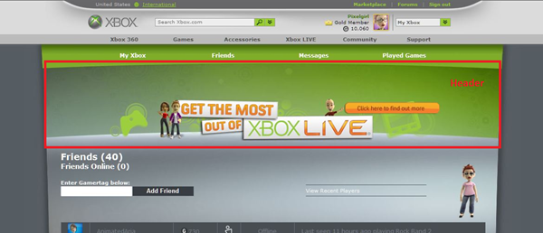
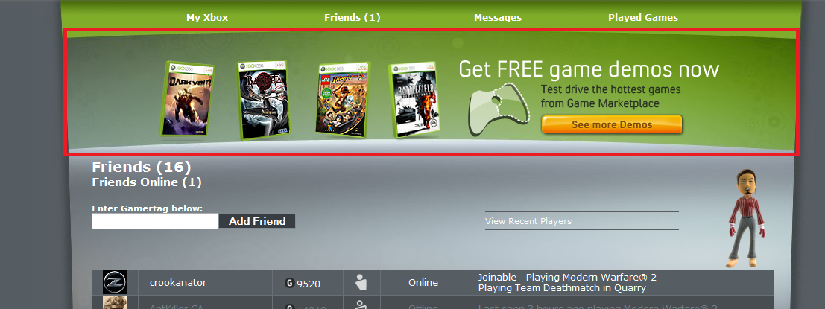
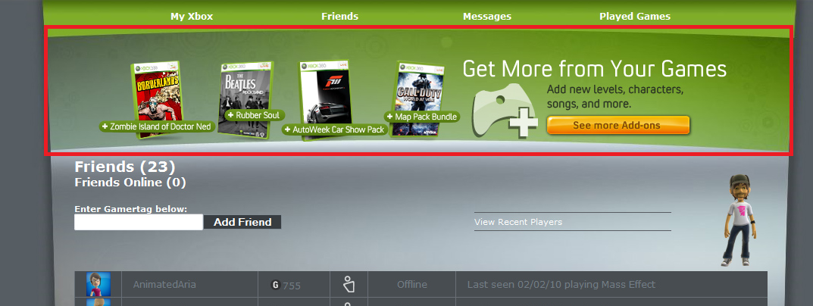
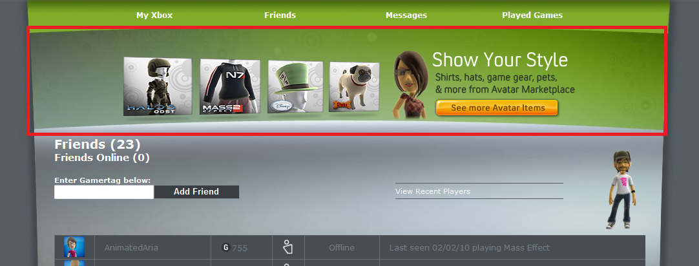
Example: Microsoft Xbox Marketplace
Goal: Increase Total Points Spent per User
A
http://marketplace.xbox.com/en-US
Which has higher Points Spent…???
Control
T1: Game Add-Ons
T2: Game Demo
T3: Avatar Gear
None
Which has higher Points Spent…???
Control
T1: Game Add-Ons
T2: Game Demo
T3: Avatar Gear
None
Promoted content up,
but at expense of others
B
C
D
Notes:
Each Treatment increased purchases of content promoted,
but cannibalized others
promoting products whose expected value is high
personalization
Control promoted Xbox live

Slide 29
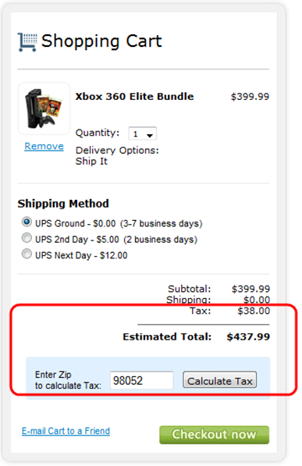
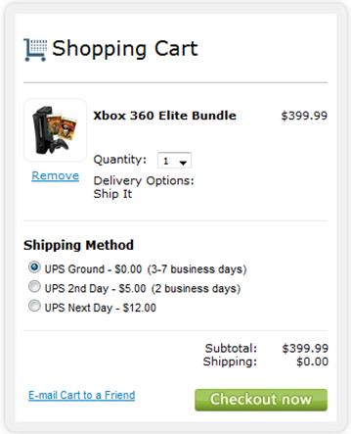
Example: Microsoft Store
Goal: Increase Average Revenue per User
A
B
http://store.microsoft.com/home.aspx
Which increased revenue…?
Control
Treatment
Neither
Which increased revenue…?
Control
Treatment – up 3.3%
Neither
Notes:
Website/UX
July 2009
Defer Tax calculation

Slide 30
How Does This Apply to SQA?

Slide 31
Online Experimentation Used for SQA…
…or more specifically, Software Testing
Meeting Business Requirements = Quality?
  Sure, But QA not often involved in User Experience testing
Experimentation Platform enables Testing in Production (TiP)
  Yes, I mean Software QA Testing
Notes:
Web/UX easiest to visualize, most common
U-turn: rest of this talk focuses on SQA Testing as we more commonly know it.

Slide 32
How Does This Apply to SQA?
Rapid Prototyping

Slide 33
Test Early, Test Often
“To have a great idea, have a lot of them” -- Thomas Edison
“If you have to kiss a lot of frogs to find a prince, find more frogs and kiss them faster and faster” -- Mike Moran, Do it Wrong Quickly
Replace BUFT (Big UpFront Test) with “Smaller” Testing and TiP
…and Iteration

Slide 34
Rapid Prototyping to Reduce Test Cost
UpFront Test your web application or site for only a subset (or one) browser
Release to only that subset of browsers
Evaluate results with real users
Enabled by ExP
Adjust and Add another browser
or
Abort
Notes:
circled= enabled by ExP

Slide 35
Rapid Prototyping
Big Scary New Code
BUFT
Release “Safe” for Everyone
oops a bug… Scramble!
Limit impact of potential problems
Big Scary New Code
Small UFT
Release to segment of users
Monitor & Fix
Ramp to 100%
Saves you from having to BUFT if product is a dud
Big Scary New Code
Small UFT
Release to segment of users
Bad Idea
Move on to a new idea
Notes:
last line may have iterations
1. Bug affects all users. Product may be wrong
2. It works case
3. It does NOT work case

Slide 36
How Does This Apply to SQA?
Exposure Control

Slide 37


Rapid Prototyping utilizes Exposure Control
…to limit the Diversity of Users exposed to the code

Slide 38
Exposure Control to limit Diversity
Other filters also
  ExP can do this.
    Location based on IP
    Time of day
  Amazon can do this
    Corporate affiliation based on IP
Still random and unbiased.
  Exposure control only determines in or out.
  If in the experiment, then still random and unbiased.
Notes:
Amazon - Control not just display of web page, but execution of entire service stack

Slide 39
Exposure Control to Limit Scale
Control how many users see your new and dangerous code
Notes:
Dangerous New b/c Even tested code is "untested" w/r/t production

Slide 40

Example: Ramp-up and Deployment: IMVU
“Meet New People in 3-D”
[v-next is deployed to] a small subset of the machines throwing the code live to its first few customers
if there has been a statistically significant regression then the revision is automatically rolled back.
If not, then it gets pushed to 100% of the cluster and monitored in the same way for another five minutes.
This whole process is simple enough that it’s implemented by a handful of shell scripts. [Timothy Fitz, Feb 2009]
Notes:
100 million registered users, 6 million unique monthly visitors

Slide 41
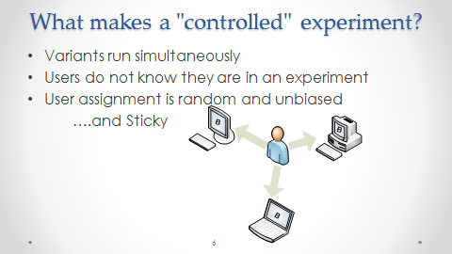
Important Properties of Exposure Control
Easy Ramp-up and Roll-back
Controlled Experiment
Notes:
sticky: once on new code should never go back to old code

Slide 42
How Does This Apply to SQA?
Monitoring and Measurement

Slide 43
Experiment Observations
Website/UX Observations
  Client Side: Page View (PV), Click
  Server Side: Page Request (PR)
Service Observations
  Client Side
    If there is a client, then client side results can indicate server side issues
  Server Side
    Service Latency
    Server performance (CPU, Memory) if variants on different servers
    Number of requests
Notes:
Other Web Client Side: MediaStart, Resize, Scroll
Other Web Server Side: PageResponse, PageError
Number of Requests: user engagement, or service bug

Slide 44
Experiment Metrics
  Compare means of your variant population
CTR per user
  CTR: % Users who Click on monitored link of those who had Page Views (PV) including that link (impression)
ExP Xbox Gold Membership
  % of Users with PV on US Xbox JoinLive page who had a PV on Gold “congrats” page.
ExP Microsoft Store
  Mean Order Total ($) per User
  Observations can have data (e.g. Shopping Cart Total $)
  Amazon Shopping Cart Reccomendations [?]
  % users who purchase recco items of those who visit checkout, or
  average revenue per user
Google Website Optimizer
  Conversion Rate: % of users with PV on Page[A] or Page[B] who had a PV on Page[convert]
Notes:
Observations → Metrics
Xbox Gold is a conversion metric
ExP (and other proprietary systems) can have rich observations and metrics
Google is limited, but simple and free

Slide 45
How Does This Apply to SQA?
Testing in Production (TiP)

Slide 46
Exposure control + Monitoring & Measurement = TiP
“Fire the Test team and put it in production…”?
BUFT
TiP
Even over here QA guides what to test and how
Let’s try to be in here
  Leverage the long tail of production, but be smart and mitigate risk.
Notes:
TiP is MORE expansive than this
Not Fire Team, but balance BUFT/TiP: Hopefully previous slides illustrate this

Slide 47
Testing in Production (TiP)
TiP can be used with Services (includes Websites)
Testing
  Functional and Non-Functional
Production
  Data Center where V-curr runs
  Real world user traffic
Notes:
Define Testing? Not here, not now (I believe it’s about evaluating risk)

Slide 48
What is a Service?
You control the deployment independent of user action.
You have direct monitoring access.
  Deploy, Detect, Patch
  “It is not the strongest of the species that survives, nor the most intelligent, but the one most responsive to change.” - Charles Darwin
Examples:
  Google: All engineers have access to the production machines: “…deploy, configure, monitor, debug, and maintain” [Google Talk, June 2007 @ 21:00]
  Amazon: Apollo Deployment System, PMET Monitoring System - company wide supported frameworks for all services.
Notes:
Responsive = deploy, detect, patch cycle

Slide 49
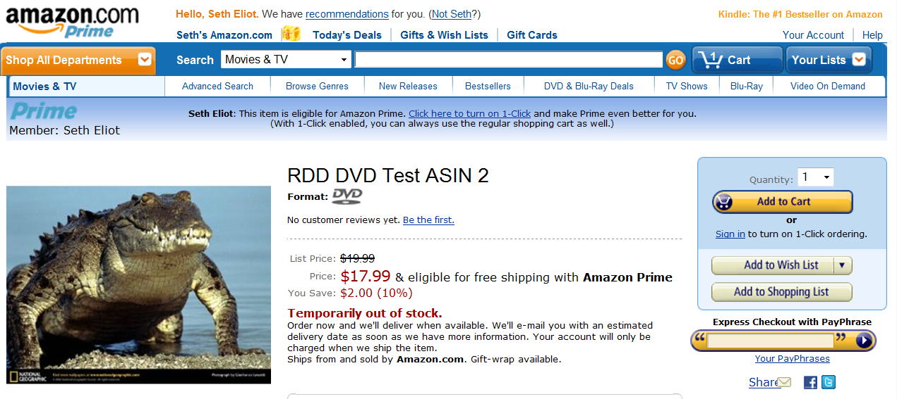
TiP is Not New
Notes:
Amazon, Wizards of the Coast, MSFT Health Vault
TiP done badly – user visible, possibly impacting (buy an ASIN)

Slide 50
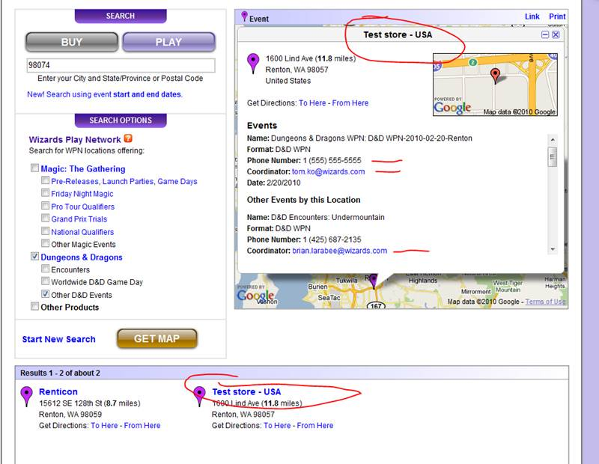
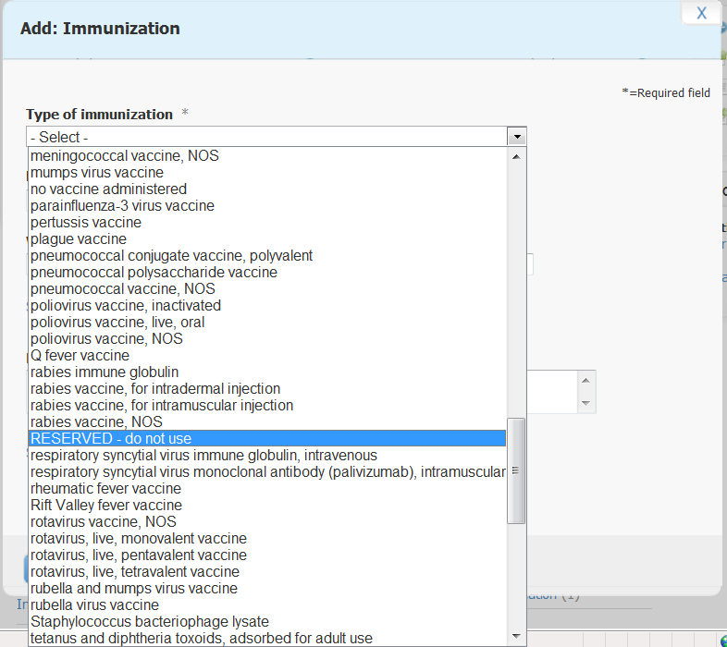
TiP is Not New
But leveraging it as a legitimate Test Methodology may be new...let's do this right
Notes:
Amazon, Wizards of the Coast, MSFT Health Vault
TiP done badly – user visible, possibly impacting (buy an ASIN)

Slide 51
How Does This Apply to SQA?
Testing Services (not Websites)

Slide 52
How can we Experiment with Services?
1 = API Request
  From Client or Another Service in the Stack
4 = Service B Response
  Likely not visible to the user
Microsoft ExP can do this
So can Amazon WebLab
Public Platforms Cannot
  Their “Switch” is Client-Side JavaScript

Slide 53
Example: Bing Launch
Notes:
non-UX

Slide 54
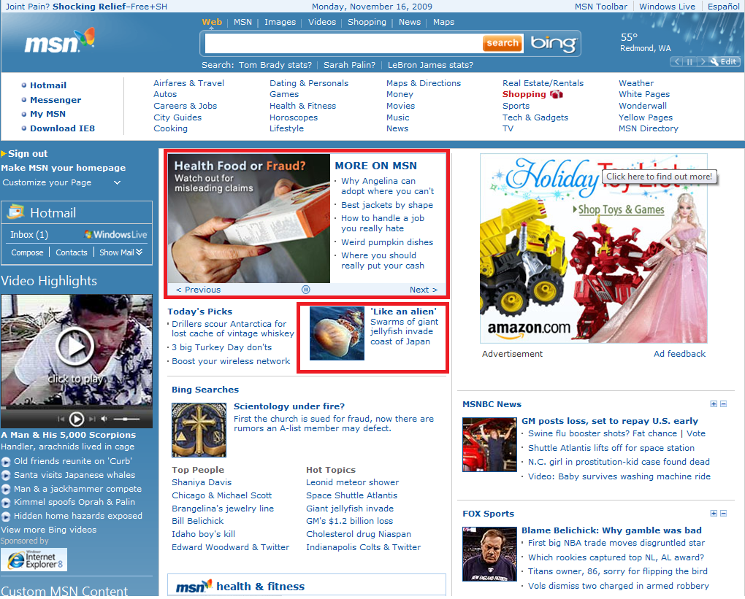
Example: MSN HOPS
Goal: Increase Clicks on Page per User via Headline Optimization
Which has higher page clicks per user…???
Control - Editor Selected
Treatment – HOPS +2.8%
Neither
and +7% to +28% increase in clicks on modules per user
but -0.3% to -2.2% cannibalization elsewhere
Which has higher page clicks per user…???
Control - Editor Selected
Treatment – HOPS
Neither
Notes:
in US, Dec 2009
HOPS = Headline Optimization Service
HOPS automatically selected and ranked the headlines with highest number of clicks
Experiment was run before new MSN launch

Slide 55
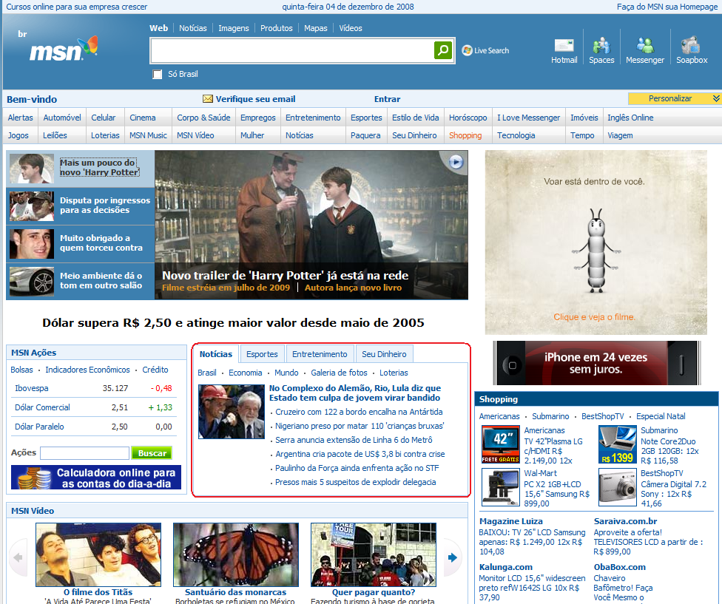
Example: MSN HOPS
Goal: Increase Clicks on News Headlines per User
Which has higher headline clicks per user…???
Control - Editor Selected
Treatment - HOPS
Neither
Which has higher headline clicks per user…???
Control - Editor Selected
Treatment – HOPS +4.4%
Neither
and no cannibalization outside news tab
Notes:
in Brazil
HOPS = Headline Optimization Service
HOPS automatically selected and ranked the headlines with highest number of clicks
Experiment was run before new MSN launch

Slide 56
Example: Amazon ordering pipeline
Amazon's ordering pipeline (checkout) systems were migrated to a new platform.
Team had tested and was going to launch.
Quality advocates asked for a limited user test using Exposure Control.
Five Launches and Five Experiments until A=B (showed no difference.)
The cost had it launched initially to the 100% users could have easily been in the millions of dollars of lost orders.
Fail
Fail
Fail
Fail
Pass
Notes:
Many services tests are A/B where you hope to show no statistically significant difference, i.e., A=B
Dev’s did not produce bad quality – Production Systems need Production Testing.

Slide 57

Example: Google Talk
Use an “Experimentation Framework”
Limit launch to
  Explicit People
  Just Googlers
  Percent of all users
Not just features, but it could be a new caching scheme
[Google Talk, June 2007 @ 20:35]
Notes:
biased populations – OK for TiP, careful about your metrics

Slide 58
How Does This Apply to SQA?
Services TiP with Shadowing

Slide 59
What is Shadowing?
TiP Technique
Like ramp-up use real user data in real-time, but mitigate risk by not exposing results to the user
The ultimate unbiased population assignment
Controlled experiment
A+B instead of A/B
Notes:
Controlled as long as one service is not at a disadvantage

Slide 60
Example: ExP RO Shadowing
RO = RecordObservation, a REST Service for client-side observations.
Migrate to a new platform.
Send all observations to BOTH systems via dual beacons.
Saw Differences – Fixed Bugs.
Controlled Experiment: both in same Data Center
  if not, then network introduces bias
Notes:
few bugfixes around exception handling, a change in the queuing algorithm, and some additional performance counters around queuing
next stage should have been to randomly assign to one of the two ROs, but we never ran that experiment

Slide 61
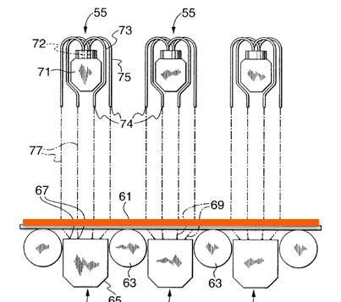
Example: USS Cooling System Shadowing
Based on steel alloy, input speed and temperature, determine number of laminar flows needed to hit target temperature.
System A: A Human Operator
System B: An Adaptive Automation
B has no control, just learn until matches operator.
Notes:
If Operator is wrong (rarely) throw out data.
“no control” = no control over the laminar flows

Slide 62
Example: Google Talk Shadowing
Google Talk Server provides Presence Status
  Billions of packets per day
Orkut integration
  Started fetching presence without showing anything in UI for weeks before launch
  Ramp-up slowly from 1% of Orkut PVs
GMail chat integration:
  Users logged in/out: used this data to trigger presence status changes w/o showing anything on the UI
[Google Talk, June 2007 @ 9:00]
Notes:
Server failures, wrong values

Slide 63
How Does This Apply to SQA?
The Power of Complex Measurements

Slide 64
TTG at Microsoft
Use of Experimentation Platform for Complex Measurements
TTG = Time To Glass
  “PLT” with a real population over all browsers and bandwidths
  Includes Browser Render Time
Calculate TTG from Observations
  Onload - PageRequest = TTG
Can analyze results by Browser, Region, etc
  But Correlation does not imply Causation
Better than monitoring tools like Gomez/Keynote
Notes:
Server side is an approximation of client side observations sent. (assume same travel time to server)
Causation: Users of a certain browser may be more likely to have faster connections
Gomez/Keynote.
Even their last-mile projects, which use real users, start with a clean cache, so they don’t represent real experience, especially as pages evolve to show personalized information (e.g., Hotmail, facebook now shown on home page, but only if you previously logged in, setup connector, etc).

Slide 65
Form Tracking at Microsoft
Submit a form (or click a link) and send a beacon to a tracking system and ExP.
Wait a fixed time or wait for calls to return or timeout (OOB)
Experiment
  Variants: Different Wait Times, Fixed vs. OOB
  Metric: % Data Lost per submit
Longer time should mean
Less Data Loss
Yes, but…..
Notes:
Metric: we know a user clicked to get to the page. Compare this to the Tracking system

Slide 66
Resources

Slide 67
More Information
seth.eliot@microsoft.com
Seth’s Blog: http://blogs.msdn.com/seliot/
ExP Website: http://exp-platform.com

Slide 68
References
Quinn, et al,1999
Quinn GE, Shin CH, Maguire MG, Stone RA (May 1999). "Myopia and ambient lighting at night". Nature 399 (6732): 113–4. doi:10.1038/20094. PMID 10335839.
Zadnik, et al, 2000
Zadnik K, Jones LA, Irvin BC, et al. (March 2000). "Myopia and ambient night-time lighting". Nature 404 (6774): 143–4. doi:10.1038/35004661. PMID 10724157.
Goodbye, Google, Mar 2009
http://stopdesign.com/archive/2009/03/20/goodbye-google.html)
Greg Linden, Apr 2006
Greg Linden’s Blog: http://glinden.blogspot.com/2006/04/early-amazon-shopping-cart.html
Timothy Fitz, Feb 2009
IMVU, Continuous Deployment at IMVU: Doing the impossible fifty times a day,
http://timothyfitz.wordpress.com/2009/02/10/continuous-deployment-at-imvu-doing-the-impossible-fifty-times-a-day/
Google Talk, June 2007
Google: Seattle Conference on Scalability: Lessons In Building Scalable Systems, Reza Behforooz
http://video.google.com/videoplay?docid=6202268628085731280

Slide 69
END
BW4. Testing with Real Users
Seth Eliot
Thank you

Slide 70
One Way to TiP
Testing in Production (TiP)
Experimentation Platform
Traditional Monitoring
Exposure Control
Diversity
Scale
Measurement
Measurement

