Slide 1
The Benefits of Online Controlled Experimentation at Scale
Aleksander Fabijan, Pavel Dmitriev, Helena Holmström Olsson, Jan Bosch
Notes:
0:50

Slide 2
Background & Motivation
We are bad at assessing the value of our ideas
At Microsoft, only ~1/3 of ideas turn out to be good for users and business (~1/3 are neutral, and ~1/3 are bad)
To develop good products we need trustworthy data from real customers!
Companies have always been collecting feedback data to learn what their customers appear to value.
Interviews, focus groups, questionnaires and other similar techniques are great in revealing what the customers say they do / like.
Although rich with qualitative information, the learnings from these techniques are typically based on small samples, risk of being biased, and do not reveal causal inference.
With the internet connectivity of the products, companies can collect feedback data to learn what their customers actually value.
Telemetry and logging reveal what the customers actually do.
The learnings can be based on much larger samples and are less likely to be biased.
Notes:
What customers say they like during a study may be different from what they actually like in their daily life.
Example: In user studies customers always prefer richer web pages (with more images/videos/carousels/etc.). In real life, when page load time and the speed of getting to the result is important, richer pages slow users down and introduce distractions from the task at hand, and often end up doing worse.
4:00

Slide 3
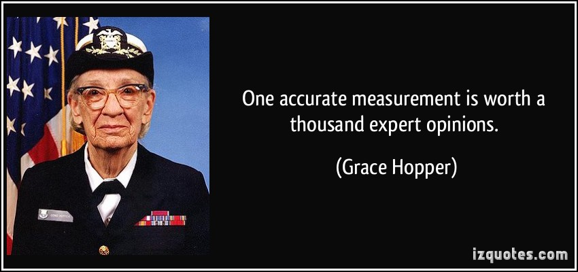
Background & Motivation
Notes:
0:15

Slide 4
Correlation is not Causation
Seattle is know for its rain
Whenever I see people on the street carrying umbrellas, very soon it starts raining
I may conclude that umbrellas cause the rain, and decide to ban them
Banning umbrellas, however, won’t stop the rain; it will just make everyone more wet.
Photo by Mike Waller, taken from Flickr
Relying on correlations isn’t just neutral, it’s often harmful to the business!
Notes:
Just collecting the data is not enough, we also need to use it correctly.
1:50

Slide 5
Online Controlled Experiments(OCEs) aka A/B Tests
Allow establishing causality, i.e., the changes in metrics are caused by changes introduced in the treatment
Can be run not just on web pages, but also on mobile and desktop apps, backend algorithms, infrastructure, OS, games, etc.
Notes:
2:30

Slide 6
Case Study
Goal: understand the benefits and challenges of running OCEs
We conducted this case study during and after Aleksander's summer internship at Microsoft’s Analysis & Experimentation team.
The team provides experimentation infrastructure and serves as a center-of-excellence for different Microsoft products that run OCEs.
Analyzed several hundred historical experiments from Bing, OneNote, Office, MSN.com, Skype, and xBox.
Complemented with a series of semi-structured interviews.
While this is an in-depth single case study, experiments from several fundamentally different products were examined, strengthening external validity.
Notes:
1:30

Slide 7
Benefits of OCEs at Scale
The well-known benefit: Incremental Product Improvements
Feb lift:
-1.2%
Aug Lift: 1.4%
Oct lift: 1.9%
Apr lift: 1%
Oct :lift 0.15%
June lift:
1.1%
Jan lift: 2.5%
May lift: 0.6%
Aug lift:
4.2%
Mar lift: 0.2%
Jul lift: 2.2%
Jul lift: -0.6%
Rollback/ cleanup
Sept lift: 1.6%
July lift: 2.6%
Aug lift: 8.6%
Oct: lift:
6.1%
Mar lift: 3.6%
May lift:
0.5%
Nov lift:
3.6%
Jan lift: -3.1%
June lift:
1.05%
New models:
0.1%
Feb lift:
0.9%
Apr lift: 2.5%
Sep lift:
1.4%
Sep lift :
6.8%
New models: 0.2%
Bing Ads revenue per search. Note: numbers have been perturbed for obvious reasons
Notes:
“Every great endeavor consists of many little steps” Eckhart Tolle
2:30

Slide 8
Benefits of OCEs at Scale
Many other benefits!
Product/Feature
Ensuring product quality
Stabilizing and lowering product/feature complexity
Optimizing and predicting infrastructure and capacity needs
Validating instrumentation quality
Team
Optimizing the planning activities
Defining performance goals for teams
Portfolio
Discovering and validating customer and business value
Notes:
0:40

Slide 9
Benefits of OCEs at Scale
Many other benefits!
Product/Feature
Ensuring product quality
Stabilizing and lowering product/feature complexity
Optimizing and predicting infrastructure and capacity needs
Validating instrumentation quality
Team
Optimizing the planning activities
Defining performance goals for teams
Portfolio
Discovering and validating customer and business value
Notes:
0:40

Slide 10
Benefits of OCEs at Scale
Many other benefits!
Product/Feature
Ensuring product quality
Stabilizing and lowering product/feature complexity
Optimizing and predicting infrastructure and capacity needs
Validating instrumentation quality
Team
Optimizing the planning activities
Defining performance goals for teams
Portfolio
Discovering and validating customer and business value
Notes:
0:20

Slide 11
Benefits of OCEs at Scale
Many other benefits!
Product/Feature
Ensuring product quality
Stabilizing and lowering product/feature complexity
Optimizing and predicting infrastructure and capacity needs
Validating instrumentation quality
Team
Optimizing the planning activities
Defining performance goals for teams
Portfolio
Discovering and validating customer and business value
Notes:
0:20

Slide 12
Benefits of OCEs at Scale
Many other benefits!
Product/Feature
Ensuring product quality
Stabilizing and lowering product/feature complexity
Optimizing and predicting infrastructure and capacity needs
Validating instrumentation quality
Team
Optimizing the planning activities
Defining performance goals for teams
Portfolio
Discovering and validating customer and business value
Notes:
0:10

Slide 13
Benefits of OCEs at Scale
Many other benefits!
Product/Feature
Ensuring product quality
Stabilizing and lowering product/feature complexity
Optimizing and predicting infrastructure and capacity needs
Validating instrumentation quality
Team
Optimizing the planning activities
Defining performance goals for teams
Portfolio
Discovering and validating customer and business value
Notes:
1:00

Slide 14
Benefits of OCEs at Scale
Many other benefits!
Product/Feature
Ensuring product quality
Stabilizing and lowering product/feature complexity
Optimizing and predicting infrastructure and capacity needs
Validating instrumentation quality
Team
Optimizing the planning activities
Defining performance goals for teams
Portfolio
Discovering and validating customer and business value
Notes:
1:30

Slide 15
Benefits of OCEs at Scale
Many other benefits!
Product/Feature
Ensuring product quality
Stabilizing and lowering product/feature complexity
Optimizing and predicting infrastructure and capacity needs
Validating instrumentation quality
Team
Optimizing the planning activities
Defining performance goals for teams
Portfolio
Discovering and validating customer and business value
Notes:
1:00
Total: 5:40

Slide 16
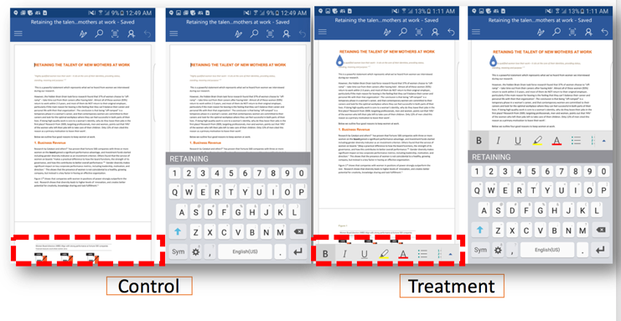
Example 1: Word Mobile App Command Bar
Treatment showed Edit Command Bar by default
Control had users tap to open it
Hypothesis: increase in edits and 2-week retention - the Overall Evaluation Criteria metric
Iteration 1: discovered instrumentation issue with capturing edit activity
Iteration 2: fixed the issue
Results:
Large increase in edit activity
No increase in 2-week retention
Decided to ship the feature
Benefits:
Improved instrumentation quality
Informed planning: similar features were prioritized in other Office apps
Impacted value discovery: realized that a better leading indicator metric than 2-week retention is needed
Notes:
2:00

Slide 17
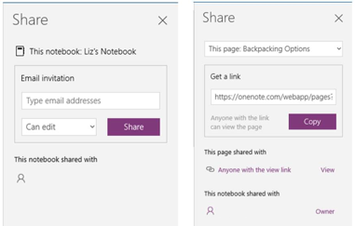
Example 2: One Note Share Pane
Treatment allowed sharing a single One Note page
Control only allowed sharing the whole notebook
Hypothesis: increase sharing
Iteration 1: positive results overall, except for a segment of users with an old version of the OS. Investigation revealed the app was crashing when trying to open share pane.
Iteration 2: fixed the issue
Results:
Increase in sharing activity
Decrease in creation of new notebooks (users were creating a notebook in order to share a page!)
control
treatment
Benefits:
Ensured product quality: discovered a bug not caught during testing
Informed value discovery: creating a new notebook used to be a key success signal; this experiment showed it can be a bad sign
Notes:
2:00

Slide 18
Example 3: Skype Infrastructure Migration
Treatment: new infrastructure for call routing
Control: old infrastructure
Hypothesis: among other effects, team wanted to evaluate whether enough infrastructure capacity will be available to support new call routing
Results:
Measured the difference in infrastructure need between the old and the new approach, and projected it to 100%. Confirmed that capacity will be sufficient.
Benefits:
Predicted infrastructure capacity need, and could confidently roll out the change to 100% of user population
Notes:
1:00

Slide 19
Challenges with OCEs
While some benefits of OCEs (e.g. quality assurance) are realized right away, many (e.g. OCE-based performance goals for teams) are only realized at scale
To scale OCEs investments are required in
Experimentation infrastructure
High quality product instrumentation
People (Data Scientists and Data Engineers)
While the theory of running OCEs is simple, in practice many issues arise that may invalidate the results. Many pitfalls in running and analyzing OCEs are reported in the literature, that may potentially lead to wrong conclusions.
E.g. see “A Dirty Dozen: Twelve Common Metric Interpretation Pitfalls in Online Controlled Experiments” (KDD 2017).
Notes:
1:15

Slide 20
Summary
OCEs provide a way to accurately evaluate incremental product improvements, with very small cost for every new experiment
Benefits of OECs, however, extend beyond this well recognized scenario. Other benefits include:
Ensuring product quality
Stabilizing and lowering product/feature complexity
Optimizing and predicting infrastructure and capacity needs
Validating instrumentation quality
Optimizing the planning activities
Defining performance goals for teams
Discovering and validating customer and business value
Notes:
0:30

Slide 21
Resources
Introduction to A/B Testing:
Tutorial on A/B Testing at Scale given at SIGIR 2017 and KDD 2017 conferences. Slides and videos are available at http://bit.ly/2017ABTestingTutorial
How to evolve experimentation in your company or product:
ICSE 2017 paper “The Evolution of Continuous Experimentation in Software Product Development”
An app based on the paper available at http://www.exp-growth.com/
More papers, talks, and resources are at http://www.exp-platform.com
Listen to the Customer, not to the HiPPO!
Notes:
1:45
Q: How does experimentation help define better metrics?
Q: How should companies start with experimentation and what is the benefit they should go for first?
Q: To me, by experimenting, we brake the quality of the product, not improve it. Can you share more on why you see this as a benefit of experimentation?
Q: What are the key skills someone needs to have to work on experimentation?
Q: Do you have your platform available?

