Slide 1

A/B Testing at Scale:
Accelerating Software Innovation
Introduction
Ronny Kohavi, Technical Fellow and Corporate Vice President,
Analysis and Experimentation, Microsoft
Slides at http://bit.ly/2019ABTestingTutorial

Slide 2
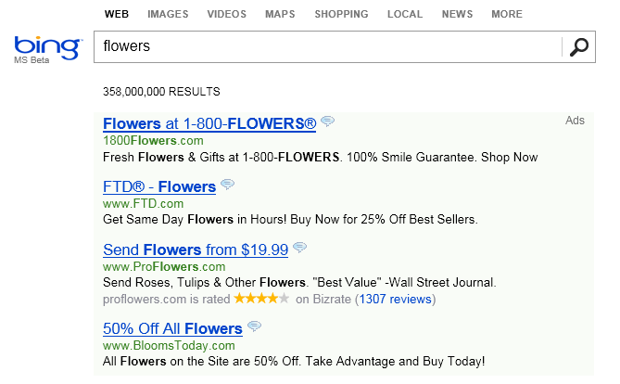
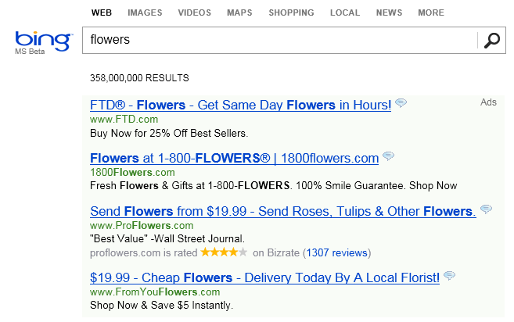
The Life of a Great Idea – True Bing Story
An idea was proposed in early 2012 to change the way ad titles were displayed on Bing
Move ad text to the title line to make it longer
Control – Existing Display
Treatment – new idea called Long Ad Titles

Slide 3
The Life of a Great Idea (cont)
…meh…
It’s one of hundreds of ideas proposed and seems
Implementation was delayed in:
Multiple features were stack-ranked as more valuable
It wasn’t clear if it was going to be done by the end of the year
An engineer thought: this is trivial to implement.
He implemented the idea in a few days, and started a controlled experiment (A/B test)
An alert fired that something is wrong with revenue, as Bing was making too much money.
Such alerts have been very useful to detect bugs (such as logging revenue twice)
But there was no bug. The idea increased Bing’s revenue by 12% (over $120M at the time)
without hurting guardrail metrics
We are terrible at assessing the value of ideas.
Few ideas generate over $100M in incremental revenue (as this idea), but
the best revenue-generating idea in Bing’s history was badly rated and delayed for months!
Feb
March
April
May
June

Slide 4
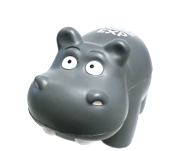
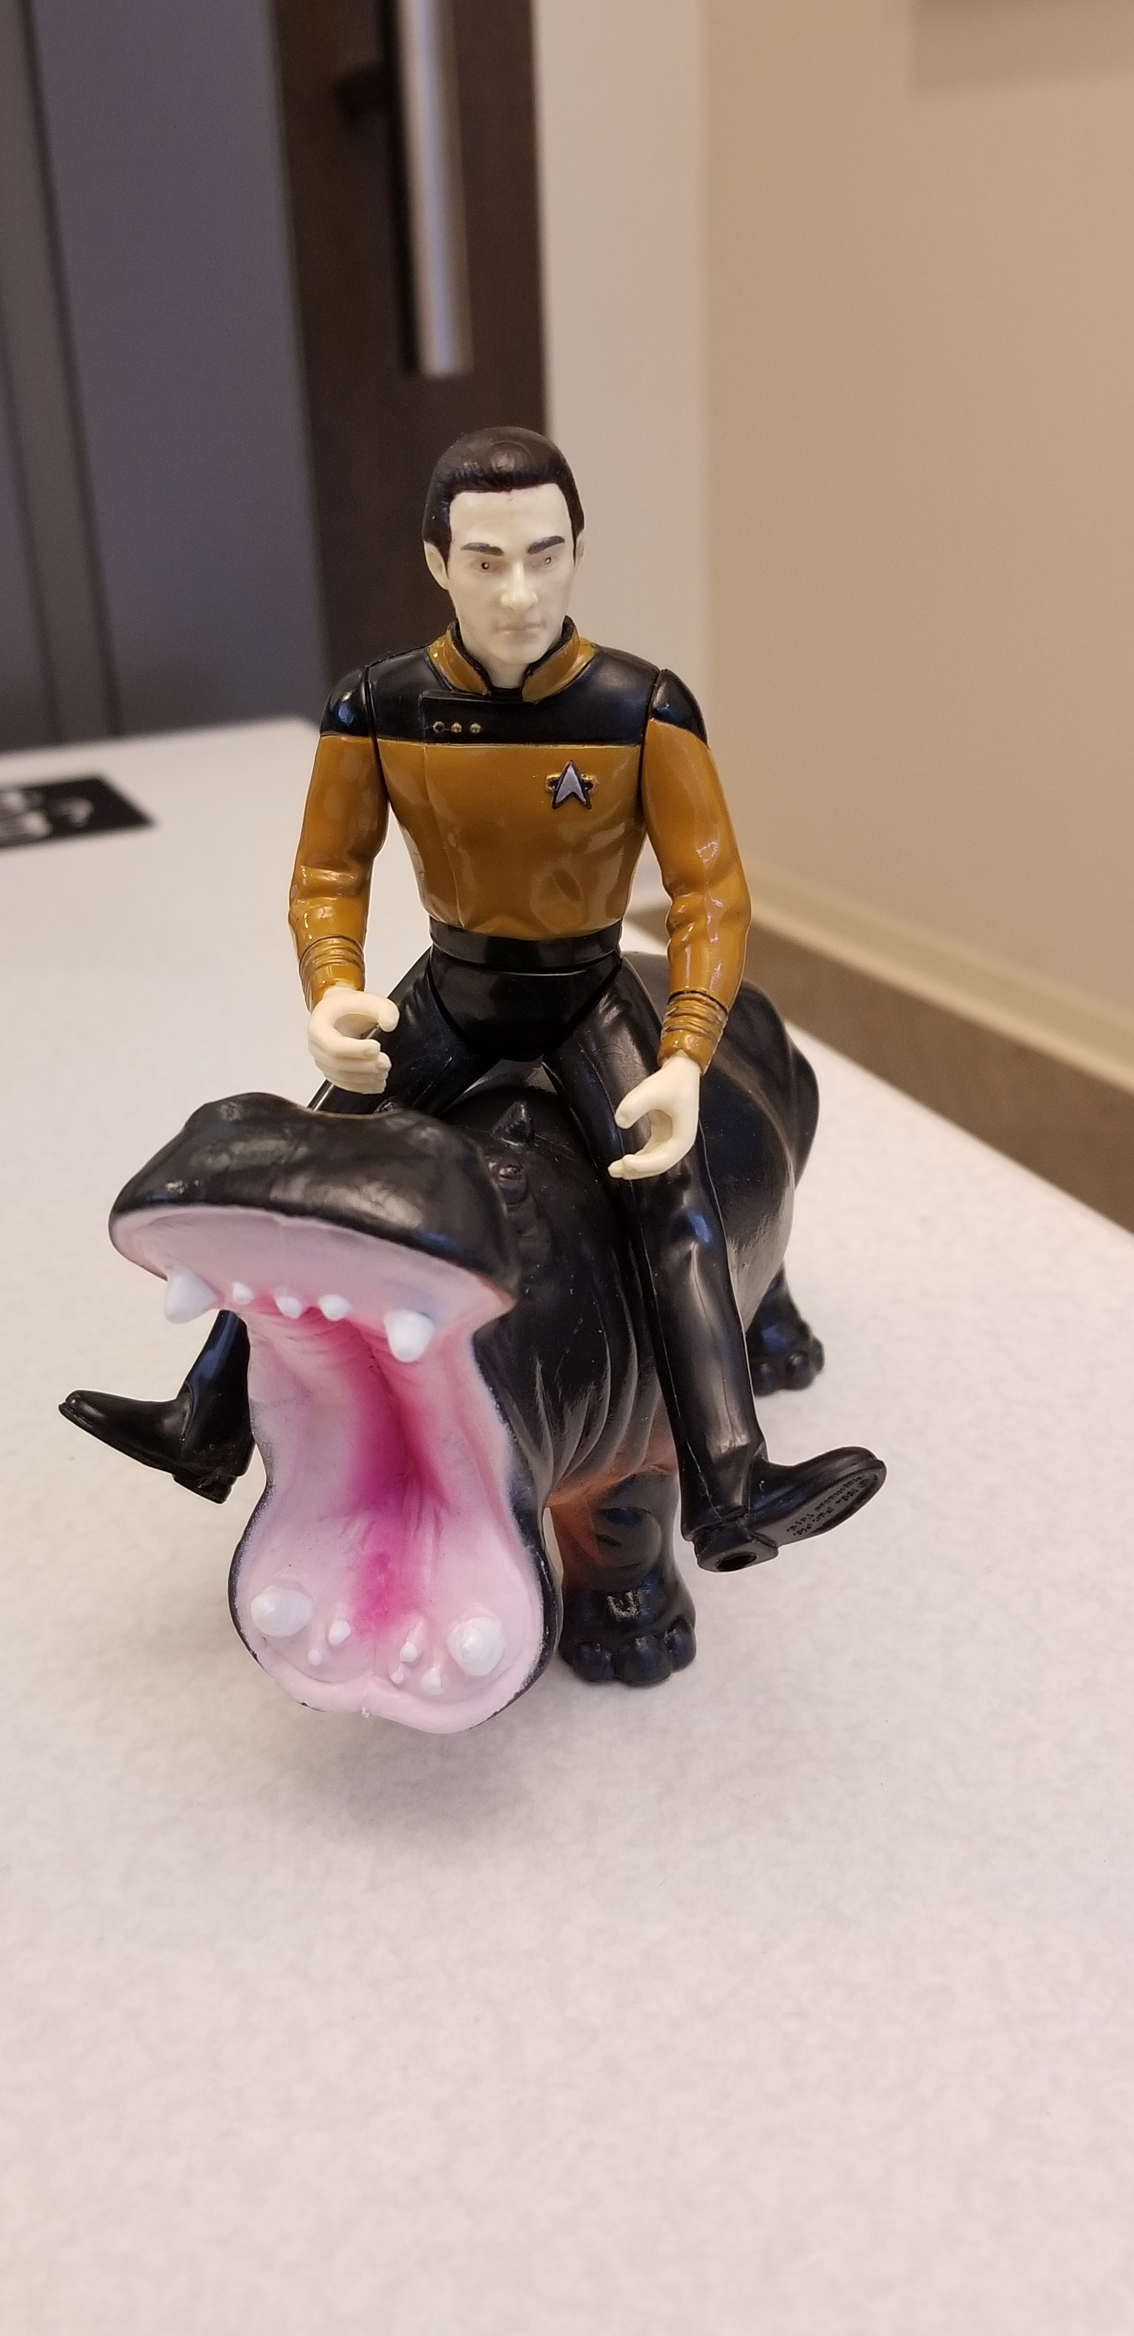
The HiPPO
Jim Barksdale (former CEO of Netscape) said it best
HiPPO: Highest Paid Person’s Opinion
We want a Data-driven HiPPO
The best data for software development decisions comes from
controlled experiments
Fact: Hippos kill more humans than any other (non-human) African mammal
Listen to the customers and don’t let the HiPPO kill good ideas
If we have data, let’s look at data.
If all we have are opinions, let’s go with mine

Slide 5
Team and Mission
(Why can I talk about scale?)
Analysis and Experimentation team at Microsoft:
  Mission: Accelerate innovation through trustworthy analysis and experimentation
  One of the largest experimentation systems on the planet
  Every month about 2,000 experiment treatments start (50-100/day)
  120 people (70 developers, 40 data scientists, 10 program managers).
  Team includes people who worked at Amazon, Facebook, Google
At Microsoft, I have been involved in experimentation for 13 years
I previously ran Amazon’s data mining and personalization,
including the Weblab experimentation system
Notes:
Video shows scorecard at https://www.youtube.com/watch?v=SiPtRjiCe4U&t=105

Slide 6
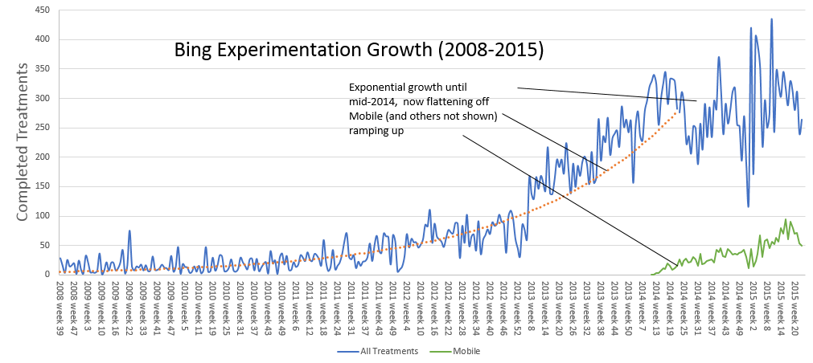
Bing - Experimentation at Scale
Bing runs over 1,000 experiment treatments per month
Typical treatment is exposed to millions of users, sometimes tens of millions.
There is no single Bing. Since a user is exposed to over 15 concurrent experiments,
they get one of 5^15 = 30 billion variants
(debugging takes a new meaning)
Until 2014, the system was
limiting usage as it scaled.
Now limits come from engineers’
ability to code new ideas
In the last year, ExP generated
250,000 scorecards
(weekly)
Notes:
Video shows scorecard at https://www.youtube.com/watch?v=SiPtRjiCe4U&t=105

Slide 7
Agenda for Rest of Talk
Controlled vs. observational (uncontrolled) studies
Three real examples: you’re the decision maker
Examples chosen to share lessons
Five Lessons
Cultural challenge

Slide 8
Observational Studies (uncontrolled)
An observational study is one where there is no proper control group
Example Observation (highly stat-sig)
Palm size correlates with your life expectancy
The larger your palm, the less long you will live, on average
Try it out - look at your neighbors and you’ll see who is expected to live longer
But…don’t try to bandage your hands assuming causality, as there is a common cause
Women have smaller palms and live 6 years longer on average
Obviously, you wouldn’t have believed that palm size is causal, but how about observational studies about features in products reducing churn?
Notes:
See www.justinmrao.com/here_there_everywhere.pdf for great paper

Slide 9
My Feature Reduces Churn! – Real Examples
Two presentations in Microsoft Office 365, each made the following key claim
    New users who use my cool feature are half as likely to churn when compared to new users that do not use it
    (churn means stop using the product 30 days later)
[Wrong] Conclusion: feature reduces churn and thus critical for retention
The feature may improve or degrade retention:
the data above is insufficient for any causal conclusion
Example: Users that see error messages in Office 365 also churn less.
This does NOT mean we should show more error messages.
They are just heavier users of Office 365
See more error messages
Heavy Users
Have higher retention rates

Slide 10
Measure user behavior before/after ship
Flaw: This approach misses time related factors such as external events, weekends, holidays, seasonality, etc.
Oprah calls Kindle "her new favorite thing"
The new site (B) always does worse than the original (A)
Before and after example

Slide 11
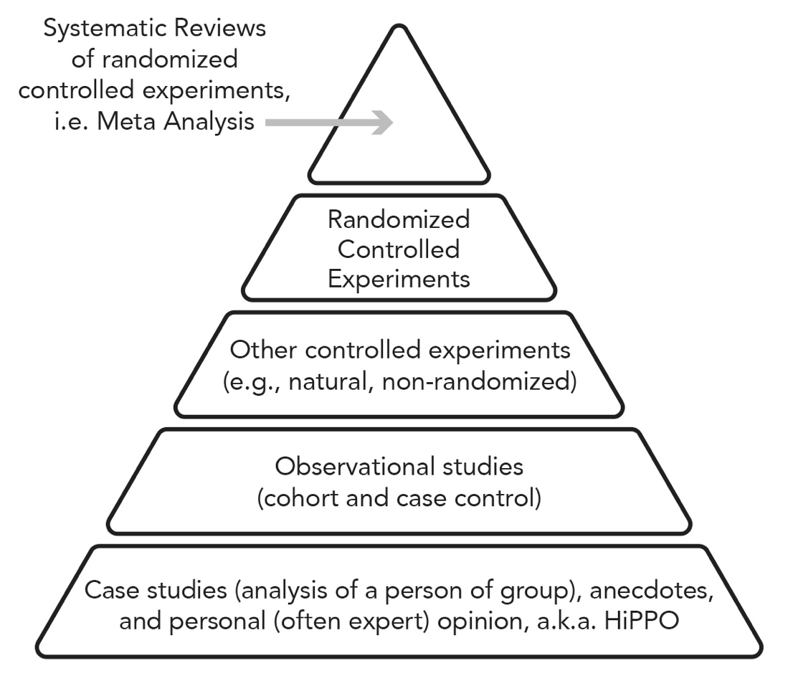
Hierarchy of Evidence
All studies are not created equally
Be very skeptical about unsystematic studies or single observational studies
The hierarchy of evidence (e.g., Greenhalgh 2014) helps assign levels of trust.
There are Quality Assessment Tools (QATs) that ask
multiple questions (Stegenga 2014)
Key point: at the top are the most trustworthy
  Randomized Controlled Experiments
  Even higher: Multiple (replications)
See Best Refuted Causal Claims from
Observations Studies for great examples
of highly referenced studies later refuted
Notes:
See also GRADE
Series intro: http://www.jclinepi.com/article/S0895-4356(10)00329-X/fulltext
http://www.jclinepi.com/article/S0895-4356(10)00330-6/fulltext
http://www.jclinepi.com/article/S0895-4356(10)00332-X/fulltext
In 1995 Guyatt etal. published the first hierarchy as a way to grade recommendations in the medical literature (Guyatt, et al., 1995). Greenhalgh published a paper (1997), that has evolved into a book in its 5th edition (Greenhalgh, 2014). Figure ‎1.6 shows a simple hierarchy of evidence, where multiple RCTs (Randomized Control Trials , the term used in medical domains for controlled experiments) are at the top, followed by single RCT, followed by non-randomized controlled trials, followed by observational studies, and finally Case Studies (analysis of a person or group), anecdotes, and personal (often expert) opinion. Bailar summarized this well: “No other method for studying the merits of clinical treatment regimens can approach the precision of estimating effects and the strength of inference permitted by sound RCTs ” (Bailar, 1983).
More complex models, such as the Levels of Evidence by the Oxford Centre for Evidence-based Medicine are available (2009), and it is important to note that other factors need to be considered, such as the quality of the study itself. Quality Assessment Tools (QATs) allow the user to answer multiple questions to assess the quality of the study; Stegenga (2014) shares a critique of hierarchies and a preference for QATs, but the key point is that high quality randomized controlled experiments are trustworthy, whereas it is hard to assess the reliability of studies lower in the hierarchy.

Slide 12
A/B Tests in One Slide
Concept is trivial
  Randomly split traffic between two (or more) versions
    A (Control, typically existing system)
    B (Treatment)
  Collect metrics of interest
  Analyze
A/B test is the simplest controlled experiment
  A/B/n is common in practice: compare A/B/C/D, not just two variants
  Equivalent names: Flights (Microsoft), 1% Tests (Google), Bucket tests (Yahoo!),
  Field experiments (medicine, Facebook), randomized clinical trials (RCTs, medicine)
Must run statistical tests to confirm differences are not due to chance
Best scientific way to prove causality, i.e., the changes in metrics are caused by changes introduced in the treatment(s)
Notes:
Sample of real users
Not WEIRD (Western, Educated, Industrialized, Rich,
and Democratic) like many academic research samples

Slide 13
Advantages
Best scientific way to prove causality, i.e., the changes in metrics are caused by changes introduced in the treatment(s)
Two Advantages for next slides:
  Sensitivity: you can detect tiny changes to metrics
  Detect unexpected consequences

Slide 14
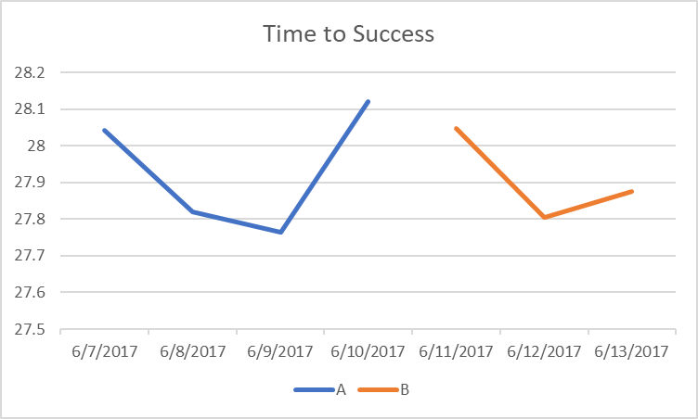
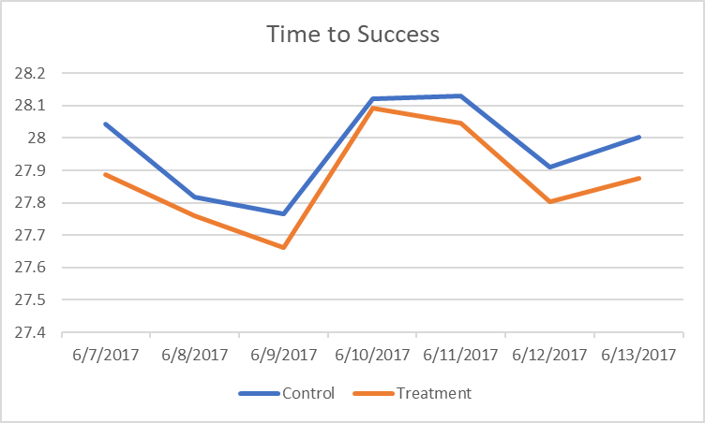
Advantage: Sensitivity!
Time-To-Success is a key metric for Bing
(Time from query to a click with no quickback.)
If you ran version A, then launched a change B,
could you say if it was good/bad?
But this was a controlled experiment
Treatment improved the metric by 0.32%
Could it be noise? Unlikely, p-value is 0.003
If there was no difference, the probability of
observing such as change (or more extreme)
is 0.003. Below 0.05 we consider stat-sig
Graph of both control/treatment (lower is better)
Notes:
http://exp/xCard/?view=8d654ac7-8a3a-473b-9e98-bc086b37d3aa

Slide 15
Why is Sensitivity Important?
Many metrics are hard to improve
Early alerting: quickly determine that something is wrong
Small degradations could accumulate
  To understand the importance of performance,
  we slowed Bing server in a controlled experiment
  One of the key insights:
        An engineer that improves server performance by 4msec
        more than pays for his/her fully-loaded annual costs
  Features cannot ship if they degrade performance by a few msec unexpectedly

Slide 16
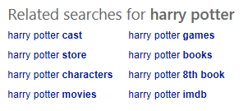
Advantage: Unexpected Consequences
It is common for a change to have unexpected consequences
Example, Bing has a related search block
A small change to the block (say bolding of terms)
  Changes the click rate to the block (intended effect)
  But that causes the distribution of queries to change
  And some queries monetize better/worse than others, so revenue is impacted
A typical Bing scorecard has 2,000+ metrics, so that when something unexpected changes, it will be highlighted

Slide 17
Real Examples
Three experiments that ran at Microsoft
Each provides interesting lessons
All had enough users for statistical validity
For each experiment, we provide the OEC, the Overall Evaluation Criterion
  This is the criterion to determine which variant is the winner
Let’s see how many you get right
  Everyone please stand up
  You will be given three options and you will answer by raising you left hand, right hand, or leave both hand down (details per example)
  If you get it wrong, please sit down
Since there are 3 choices for each question, random guessing implies
100%/3^3 =~ 4% will get all three questions right.
Let’s see how much better than random we can get in this room
Notes:
- Good Boss, Bad Boss: How to Be the Best... and Learn from the Worst by Robert I. Sutton
Most people suffer from “self-enhancement bias” and believe they are better than the rest—and they have a hard time accepting or remembering contrary facts.
One study showed, for example, that 90 percent of drivers believe they have above-average driving skills.

Slide 18


Windows Search Box
The search box is in the lower left part of the taskbar for most of the 800M machines running Windows 10
Here are two variants:
OEC (Overall Evaluation Criterion): user engagement--more searches (and thus Bing revenue)
Raise your left hand if you think the Left version wins (stat-sig)
Raise your right hand if you think the Right version wins (stat-sig)
Don’t raise your hand if they are the about the same
Notes:
500M is public from http://www.computerworld.com/article/3195802/microsoft-windows/microsoft-now-claims-half-a-billion-windows-10-devices.html
I saw “most” because some minimize it, and windows 10 includes non-desktop PCs (xbox, phones).

Slide 19
Windows Search Box (cont)
Intentionally not shown
Notes:
500M is public from http://www.computerworld.com/article/3195802/microsoft-windows/microsoft-now-claims-half-a-billion-windows-10-devices.html
I saw “most” because some minimize it, and windows 10 includes non-desktop PCs (xbox, phones).

Slide 20


Another Search Box Tweak
Those of you running Windows 10 Fall Creators update released October 2017 will see a change to the search box background
From
To
It’s another multi-million dollar winning treatment
Annoying at first, but Windows NPS score improved with this

Slide 21
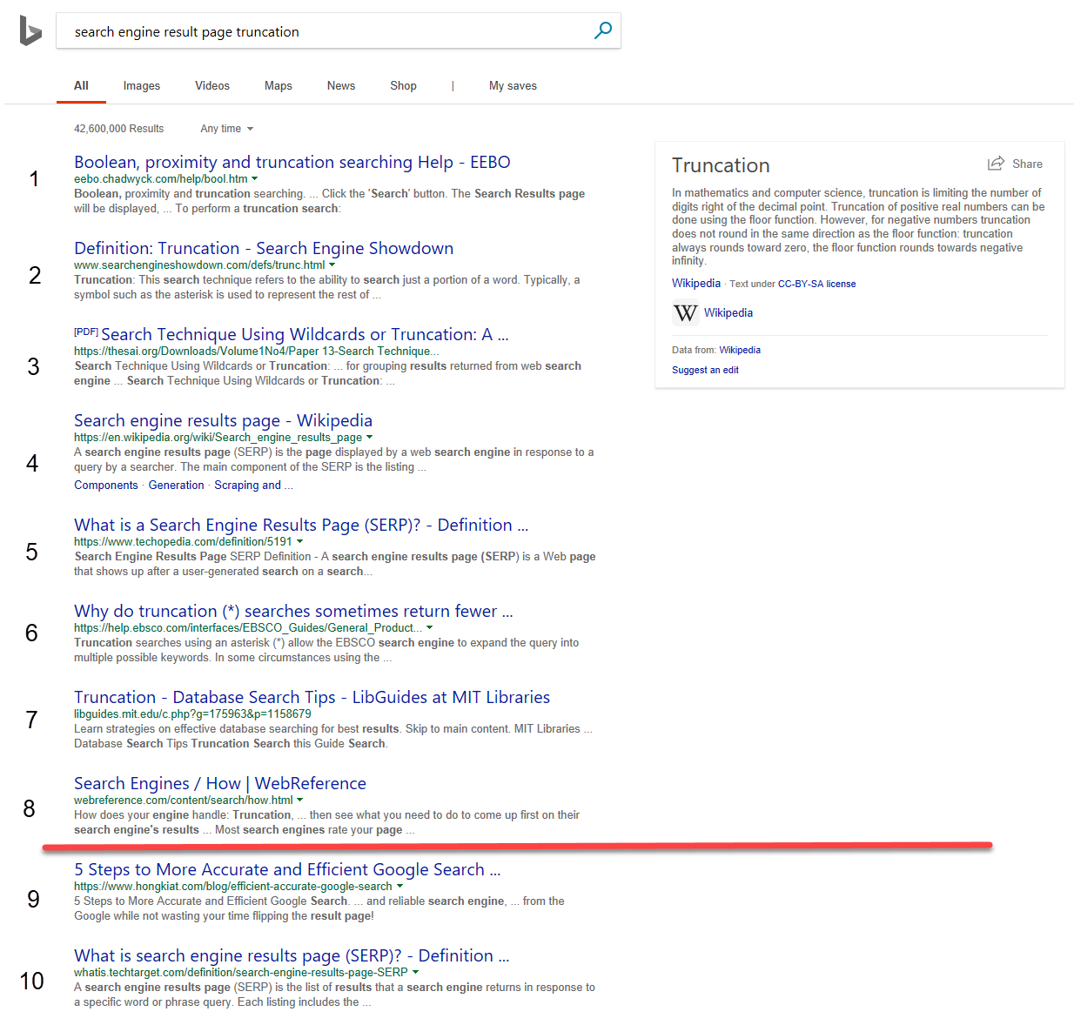
Example 2:
SERP Truncation
SERP is a Search Engine Result Page
(shown on the right)
OEC: Clickthrough Rate on 1st SERP per query
(ignore issues with click/back, page 2, etc.)
Version A: show 10 algorithmic results
Version B: show 8 algorithmic results by removing the last two results
All else same: task pane, ads, related searches, etc.
Version B is slightly faster (fewer results means
less HTML, but server-side computed same set)
Raise your left hand if you think A Wins (10 results)
Raise your right hand if you think B Wins (8 results)
Don’t raise your hand if they are the about the same

Slide 22
SERP Truncation
Intentionally not shown
We wrote a paper with several rules of thumb (http://bit.ly/expRulesOfThumb)
While there are obviously exceptions, most of the time users click at the same rate.
  In this case, with over 3M users in each variant, we could not detect a stat-sig delta.
  Users simply shifted the clicks from the last two algorithmic results to other elements of the page.
      Rule of Thumb: Reducing abandonment (1-clickthrough-rate) is hard.
      Shifting clicks is easy

Slide 23
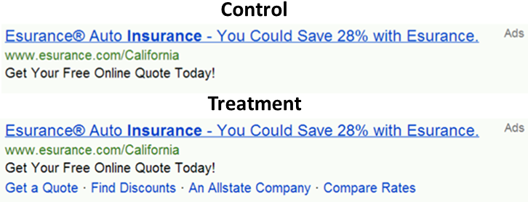
Example 3: Bing Ads with Site Links
Should Bing add “site links” to ads, which allow advertisers to offer several destinations on ads?
OEC: Revenue, ads constraint to same vertical pixels on avg
Pro adding: richer ads, users better informed where they land
Cons: Constraint means on average 4 “A” ads vs. 3 “B” ads
Variant B is 5msc slower (compute + higher page weight)
Raise your left hand if you think Left version wins
Raise your right hand if you think Right version wins
Don’t raise your hand if they are the about the same

Slide 24
Bing Ads with Site Links
Intentionally not shown
Stop debating – get the data

Slide 25
Agenda for Rest of Talk
Controlled vs. observational (uncontrolled) studies
Three real examples: you’re the decision maker
Examples chosen to share lessons
Five Lessons
Cultural challenge

Slide 26
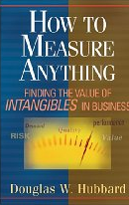

Lesson #1: Agree on a good OEC
OEC = Overall Evaluation Criterion
  Getting agreement on the OEC in the org is a huge step forward
  OEC should be defined using short-term metrics that predict
  long-term value (and hard to game)
  Think about customer lifetime value, not immediate revenue
  Ex: Amazon e-mail – account for unsubscribes
  Look for success indicators/leading indicators, avoid vanity metrics
  Read Doug Hubbard’s How to Measure Anything
  Use a few KEY metrics. Beware of the Otis Redding problem (Pfeffer & Sutton)
  “I can’t do what ten people tell me to do, so I guess I’ll remain the same.”
  Funnels use Pirate metrics: AARRR: acquisition, activation, retention, revenue, and referral
  Criterion could be weighted sum of factors, such as
    Conversion/action, time to action, visit frequency
  See https://bit.ly/ExPAdvanced -> OEC
Notes:
You can fill the page with ads, which is what happened with the early search engines

Slide 27
Lesson #1 (cont)
Microsoft support example with time on site
Bing example
  Bing optimizes for long-term query share (% of queries in market) and long-term revenue
  Short term it’s easy to make money by showing more ads ,but we know it increases abandonment.
  Selecting ads is a constraint optimization problem:
  given an agreed avg pixels/query, optimize revenue
  For query share, queries/user may seem like a good metric, but it’s terrible!
  See http://bit.ly/expPuzzling
Notes:
You can fill the page with ads, which is what happened with the early search engines

Slide 28
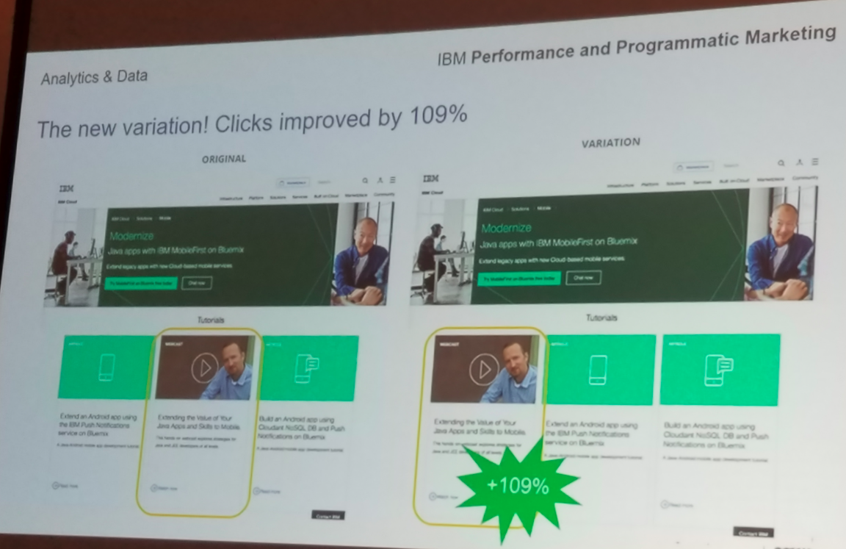

Example of Bad OEC
Example showed that moving bottom middle call-to-action left, raised its clicks by 109%
It’s a local metric and trivial to move
by cannibalizing other links
Problem: next week, the team
responsible for the bottom right
call-to-action will move it all the way
left and report 150% increase
The OEC could be global to page and
used consistently. Something like
($\sum_{i}{click_{i}∗value_i}$) per user
(i is in the set of clickable elements)

Slide 29
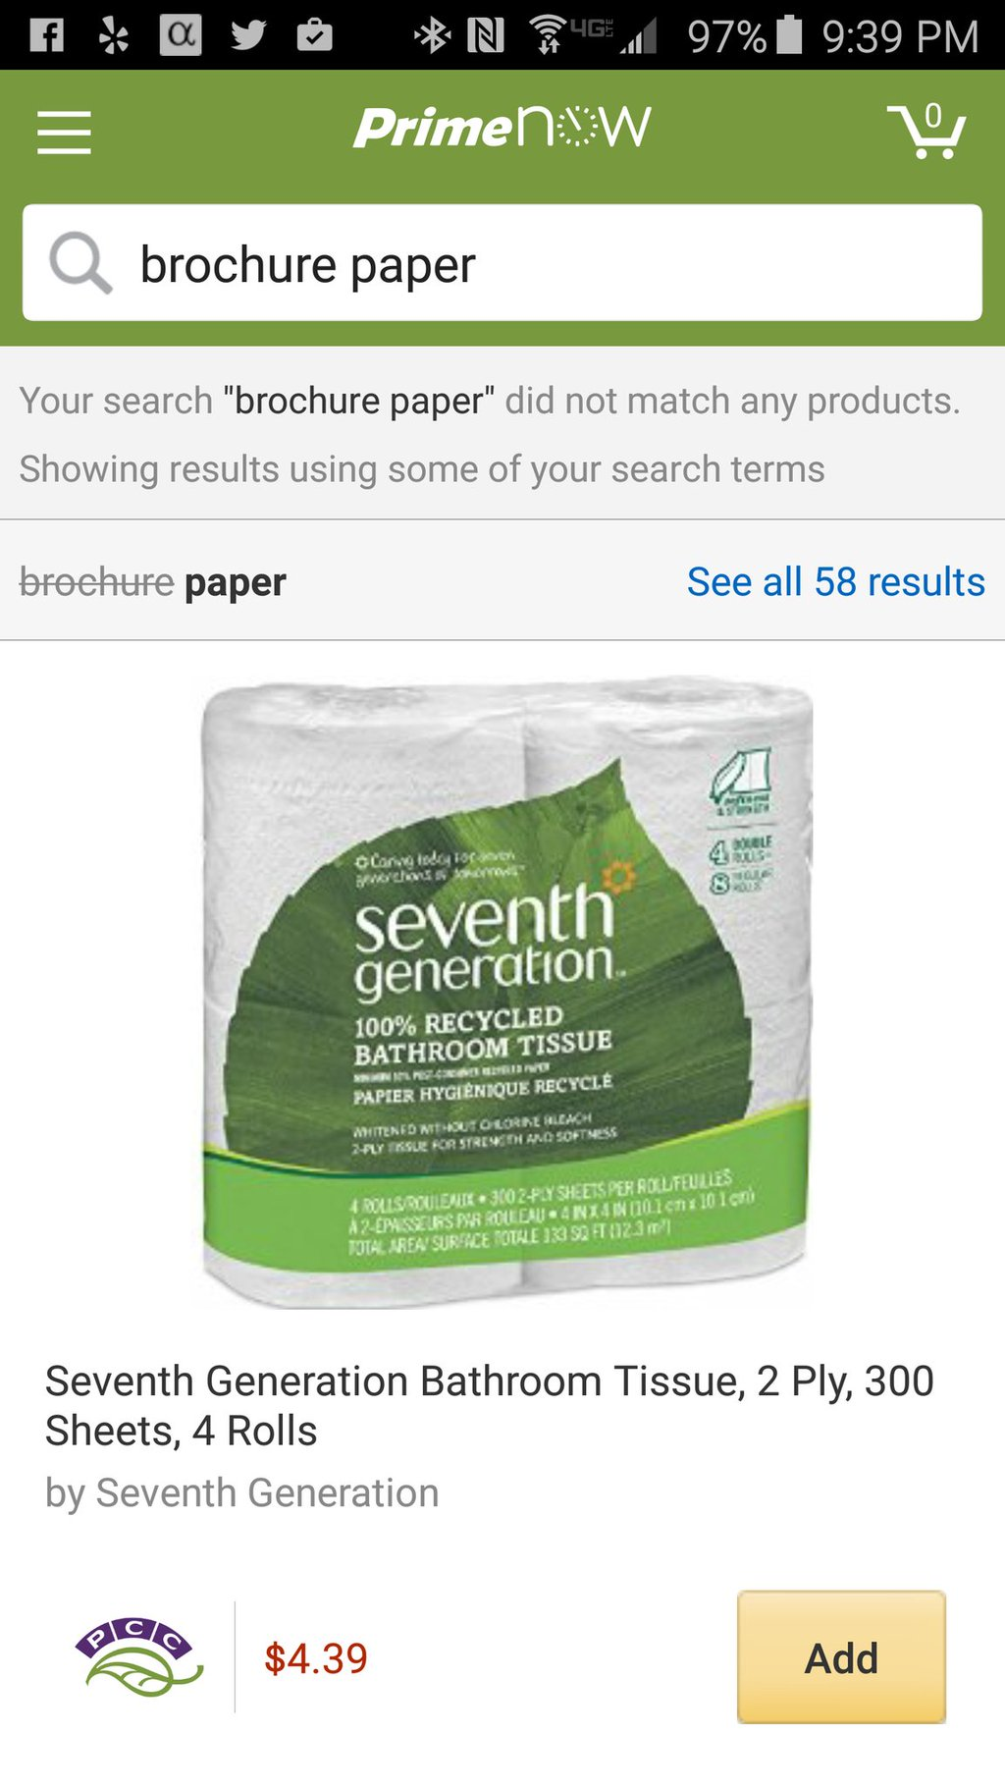
Bad OEC Example
Your data scientists makes an observation:
2% of queries end up with “No results.”
Manager: must reduce.
Assigns a team to minimize “no results” metric
Metric improves, but results for query
brochure paper
are crap (or in this case, paper to clean crap)
Sometimes it *is* better to show “No Results.”
This is a good example of gaming the OEC.
Real example from my Amazon Prime now search
https://twitter.com/ronnyk/status/713949552823263234
Notes:
@@Dev: if you’re wrong, it’s often clear: crashes.
Here: if the OEC is wrong, it’s hard to tell. MetricsLab, degradation flights. Tufte’s talk. Human behavior is not rocket science, it’s harder.
Point to Alex’s paper

Slide 30
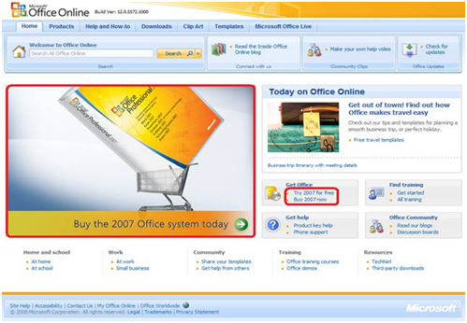
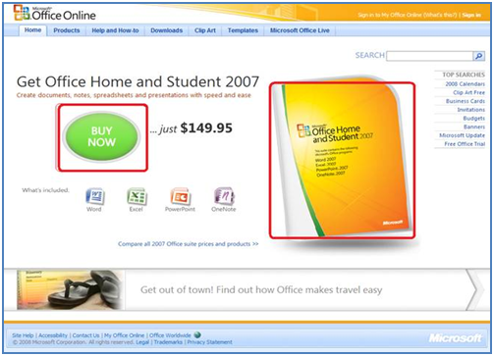
Bad OEC
Office Online tested new design for homepage
Overall Evaluation Criterion (OEC) was clicks on the Buy Button [shown in red boxes]
Why is this bad?
Treatment
Control

Slide 31

Bad OEC
Treatment had a drop in the OEC (clicks on buy) of 64%!
Not having the price shown in the Control lead more people to click to determine the price
The OEC assumes conversion downstream is the same
Make fewer assumptions and measure what
you really need: actual sales

Slide 32
Lesson #2: Most Ideas Fail
Features are built because teams believe they are useful.
But most experiments show that features fail to move the metrics they were
designed to improve
Based on experiments at Microsoft (paper)
  1/3 of ideas were positive ideas and statistically significant
  1/3 of ideas were flat: no statistically significant difference
  1/3 of ideas were negative and statistically significant
At Bing (well optimized), the success rate is lower: 10-20%.
For Bing Sessions/user, our holy grail metric, 1 out of 5,000 experiments improves it
Integrating Bing with Facebook/Twitter in 3rd pane cost more than $25M in dev costs and abandoned due to lack of value
We joke that our job is to tell clients that their new baby is ugly
The low success rate has been documented many times across multiple companies
      When running controlled experiments, you will be humbled!

Slide 33
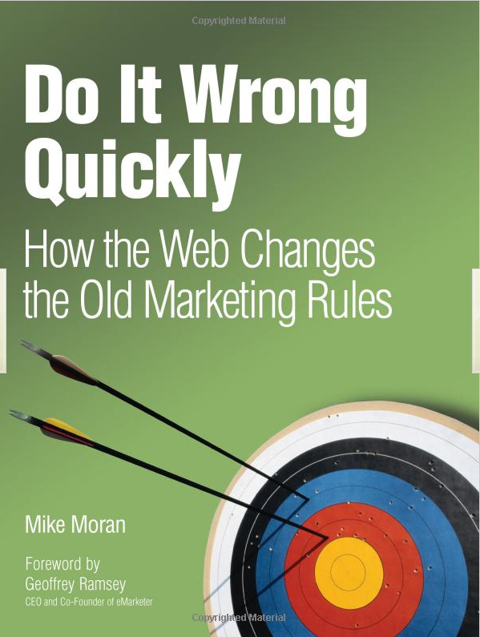
Key Lesson Given the Success Rate
Avoid the temptation to try and build optimal features through extensive planning without early testing of ideas
Experiment often
  To have a great idea, have a lot of them -- Thomas Edison
  If you have to kiss a lot of frogs to find a prince,
  find more frogs and kiss them faster and faster
  -- Mike Moran, Do it Wrong Quickly
Try radical ideas. You may be surprised
  Doubly true if it’s cheap to implement
  If you're not prepared to be wrong, you'll never come up
  with anything original – Sir Ken Robinson, TED 2006 (#1 TED talk)

Slide 34


Lesson #3: Small Changes can have a
Big Impact to Key Metrics
Tiny changes with big impact are the bread-and-butter of talks at conferences
  Opening example with Bing Ads in this talk, worth over $120M annually
  Changed text in Windows search box: $5M+ dollars
  Site links in ads: $50M annually
  Changed text color for fonts in Bing: over $10M annually
  100msec improvement to Bing server perf: $18M annually
  Opening mail link in new tab on MSN: 5% increase to clicks/user
  Credit card offer on Amazon shopping cart: 10s of millions of dollars annually
  Overriding DOM routines to avoid malware in Bing: millions of dollars annually
But the reality is that these are rare gems: few among tens of thousands of experiments

Slide 35
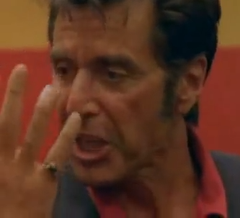
Lesson #4: Changes Rarely have a
Big Positive Impact to Key Metrics
As Al Pacino says in the movie Any Given Sunday:
winning is done inch by inch
Most progress is made by small continuous improvements: 0.1%-1% after a lot of work
Bing’s relevance team, several hundred developers running thousands of experiments every year, improve the OEC 2% annually
(2% is the sum of OEC improvements in controlled experiments)
Bing’s ads team improves revenues about 15-25% per year, but it is extremely rare to see an idea or a new machine learning model that improves revenue by >2%

Slide 36
Bing Ads Revenue per Search^{(*)} – Inch by Inch
Emarketer estimates Bing revenue grew 55% from 2014 to 2016
About every month a “package” is shipped, the result of many experiments
Improvements are typically small (sometimes lower revenue, impacted by space budget)
Seasonality (note Dec spikes) and other changes (e.g., algo relevance) have large impact
Feb lift:
-1.2%
Aug Lift:
1.4%
Oct lift:
1.9%
Apr lift:
1%
Oct :lift
0.15%
June lift:
1.1%
Jan lift:
2.5%
May lift:
0.6%
Aug lift:
4.2%
Mar lift:
0.2%
Jul lift: 2.2%
Jul lift:
-0.6%
Rollback/
cleanup
Sept lift:
1.6%
July lift:
2.6%
Aug lift:
8.6%
Oct: lift:
6.1%
Mar lift:
3.6%
May lift:
0.5%
Nov lift:
3.6%
Jan lift:
-3.1%
June lift:
1.05%
New models:
0.1%
Feb lift:
0.9%
Apr lift:
2.5%
Sep lift:
1.4%
Sep lift :
6.8%
New models:
0.2%
(*) Numbers have been perturbed for obvious reasons
Notes:
Emarketer: (2.94-1.90)/1.9 = 54.7%

Slide 37
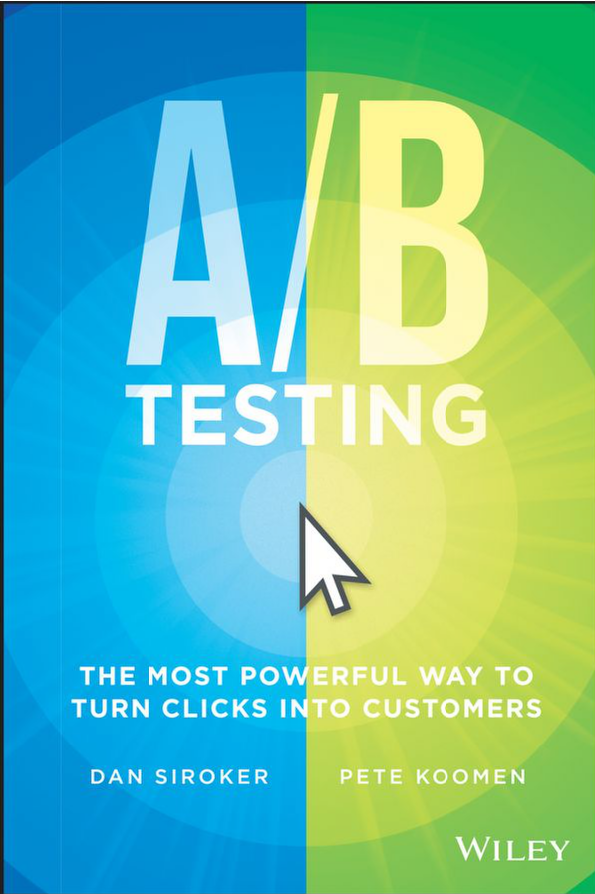
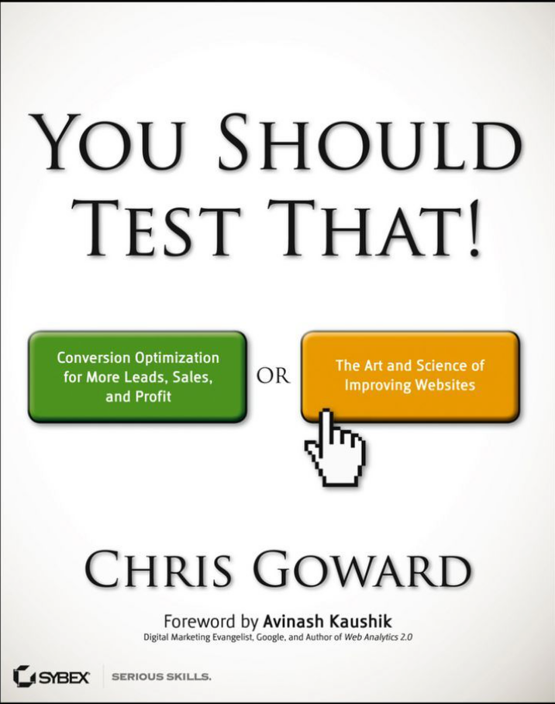

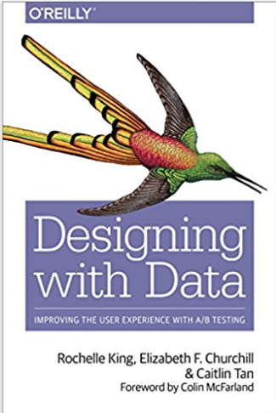
Lesson #5: Validate the
Experimentation System
Software that shows p-values with many digits of precision leads users to
trust it, but the statistics or implementation behind it could be buggy
Getting numbers is easy; getting numbers you can trust is hard
Example: Three good books on A/B testing get the stats wrong
(see my Amazon reviews)
Recommendation:
  Check for Bots, which can cause significant skews.
  At Bing over 50% of traffic in US is bot generated!
  In China and Russia, it’s over 90%
  Run A/A tests: if the system is operating correctly, the system should find a stat-sig difference only about 5% of the time . Is p-value uniform (next slide)?
  Run SRM checks (see slide)
Notes:
More examples:
webcache hit rate changes
mobile clicks (instrumentation bugs)
click loss (open in new tab)
- PLT improves: if you click in new tab before page loaded, those PLT that are excluded are larger
Books: A/B Testing from Optimizely founders Dan Siroker and Peter Koomen; and
You Should Test That by WiderFunnel’s CEO Chris Goward

Slide 38
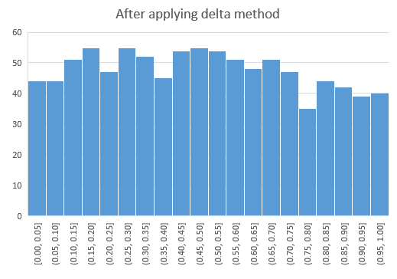
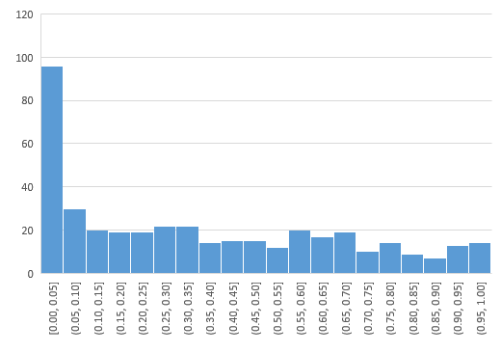
Example A/A test
P-value distribution for metrics in A/A tests should be uniform
Do 1,000 A/A tests, and check if the distribution is uniform
When we got this for some Skype metrics, we had to correct things (delta method)

Slide 39
Lesson #5 (cont)
SRM = Sample Ratio Mismatch
For an experiment with equal percentages assigned to Control/Treatment, you should have approximately the same number of users in each
Real example:
  Control: 821,588 users, Treatment: 815,482 users
  Ratio: 50.2% (should have been 50%)
  Should I be worried?
Absolutely
  The p-value is 1.8e-6, so the probability of this split (or more extreme) happening by chance is less than 1 in 500,000 (the Null hypothesis is true by design)
  See http://bit.ly/srmCheck for Excel spreadsheet to compute the p-value

Slide 40
Twyman’s Law
In the book Exploring Data: An Introduction to Data Analysis for Social Scientists, the authors wrote that Twyman’s law is
“perhaps the most important single law in the whole of data analysis.“
If something is “amazing,” find the flaw! Examples
  If you have a mandatory birth date field and people think it’s unnecessary, you’ll find lots of
  11/11/11 or 01/01/01
  If you have an optional drop down, do not default to the first alphabetical entry, or you’ll have lots of: jobs = Astronaut
  Traffic to many US web sites doubled between 1-2AM on Sunday Nov 5th,
  relative to the same hour a week prior. Why?
If you see a massive improvement to your OEC, call Twyman’s law and find the flaw. Triple check things before you celebrate. See http://bit.ly/twymanLaw
Any figure that looks interesting or different is usually wrong

Slide 41
The Cultural Challenge
It is difficult to get a man to understand something when his salary depends upon his not understanding it.
-- Upton Sinclair
Why people/orgs avoid controlled experiments
  Some believe it threatens their job as decision makers
  At Microsoft, program managers select the next set of features to develop. Proposing several alternatives and admitting you don’t know which is best is hard
  Editors and designers get paid to select a great design
  Failures of ideas may hurt image and professional standing.
  It’s easier to declare success when the feature launches
  We’ve heard: “we know what to do. It’s in our DNA,” and
  “why don’t we just do the right thing?”
The next few slides show a four-step cultural progression towards becoming data-driven

Slide 42
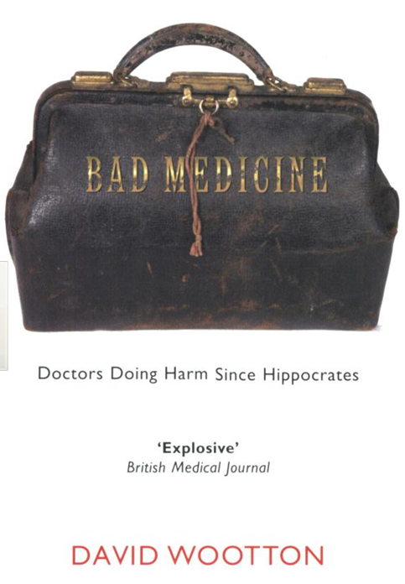
Cultural Stage 1: Hubris
Experimentation is the least arrogant method of gaining knowledge
—Isaac Asimov
Stage 1: we know what to do and we’re sure of it
  True story from 1849
  John Snow claimed that Cholera was caused by polluted water,
  although prevailing theory at the time was that it was caused by miasma: bad air
  A landlord dismissed his tenants’ complaints that their water stank
    Even when Cholera was frequent among the tenants
  One day he drank a glass of his tenants’ water to show there was nothing wrong with it
He died three days later
That’s hubris. Even if we’re sure of our ideas, evaluate them

Slide 43
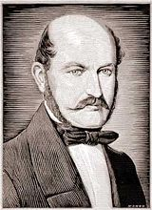
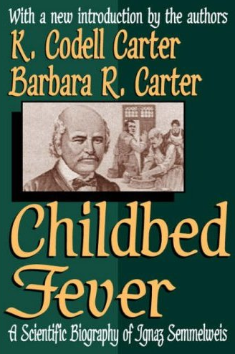
Cultural Stage 2: Insight through
Measurement and Control
Semmelweis worked at Vienna’s General Hospital, an
important teaching/research hospital, in the 1830s-40s
In 19th-century Europe, childbed fever killed more than a million women
Measurement: the mortality rate for women giving birth was
  15% in his ward, staffed by doctors and students
  2% in the ward at the hospital, attended by midwives
Notes:
Collecting stats is the first phase – instrument, measure

Slide 44
Cultural Stage 2: Insight through
Measurement and Control
He tries to control all differences
  Birthing positions, ventilation, diet, even the way laundry was done
He was away for 4 months and death rate fell significantly when he was away. Could it be related to him?
Insight:
  Doctors were performing autopsies each morning on cadavers
  Conjecture: particles (called germs today) were being transmitted to healthy patients on the hands of the physicians
He experiments with cleansing agents
  Chlorine and lime was effective: death rate fell from 18% to 1%

Slide 45
Cultural Stage 3: Semmelweis Reflex
Success? No! Disbelief. Where/what are these particles?
  Semmelweis was dropped from his post at the hospital
  He goes to Hungary and reduced mortality rate in obstetrics to 0.85%
  His student published a paper about the success. The editor wrote
    We believe that this chlorine-washing theory has long outlived its usefulness… It is time we are no longer to be deceived by this theory
In 1865, he suffered a nervous breakdown and was beaten at a mental hospital, where he died
Semmelweis Reflex is a reflex-like rejection of new knowledge because it contradicts entrenched norms, beliefs or paradigms
Only in 1800s? No! A 2005 study: inadequate hand washing is one of the prime contributors to the 2 million health-care-associated infections and 90,000 related deaths annually in the United States

Slide 46
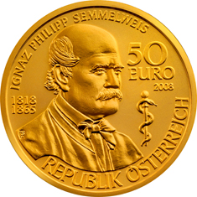
Cultural Stage 4: Fundamental Understanding
In 1879, Louis Pasteur showed the presence of Streptococcus in the blood of women with child fever
2008, 143 years after he died, a 50 Euro coin commemorating Semmelweis was issued

Slide 47
Summary: Evolve the Culture
Hubris
Measure and Control
Accept Results avoid Semmelweis Reflex
Fundamental Understanding
  Hippos kill more humans than any other (non-human) mammal (really)
In many areas we’re in the 1800s in terms of our understanding, so controlled experiments can help
  First in doing the right thing, even if we don’t understand the fundamentals
  Then developing the underlying fundamental theories

Slide 48
Maturity Model in Experimentation
Enabling experimentation in large software products is challenging
The experimentation platform capabilities is only one piece of the puzzle
Other aspects include:
  Data quality: instrumentation, pipelines, monitoring
  Integration of experimentation into team’s software development process
  Ability to clearly specify and measure product’s long-term goals (OEC)
  Development of experimentation knowledge and expertise within the team
  Cultural buy-in
We developed a model to describe this process and provide step-by-step guidance in The Evolution of Continuous Experimentation

Slide 49
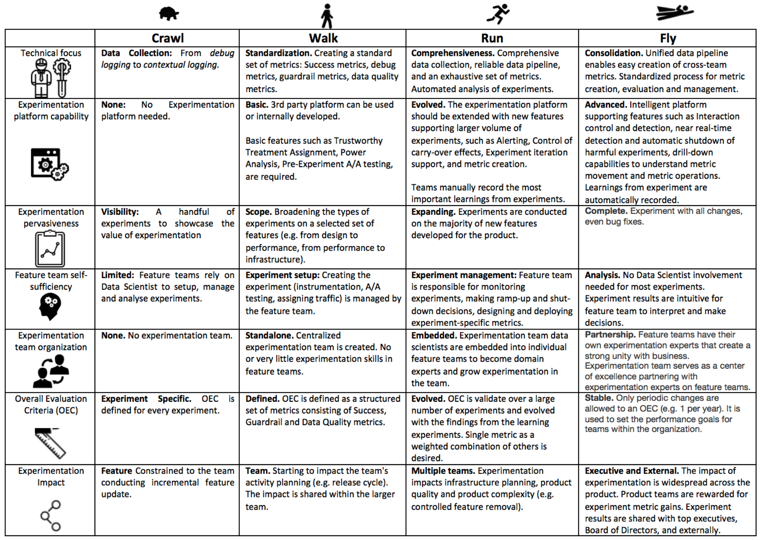

Slide 50
Ethics
Controversial examples
  Facebook ran an emotional contagion experiment (editorial commentary)
  Amazon ran a pricing experiment
  OK Cupid (matching site) modified the “match” score to deceive users who they believed matched at 30% so it showed 90%
Resources
  1979 Belmont Report
  1991 Federal “Common Rule” and Protection of Human Subjects
  Key concept: Minimal Risk: the probability and magnitude of harm or discomfort anticipated in the research are not greater in and of themselves than those ordinarily encountered in daily life or during the performance of routine physical or psychological examinations or tests
When in doubt, use an IRB: Institutional Review Board

Slide 51
Summary
  The less data, the stronger the opinions
Think about the OEC. Make sure the org agrees what to optimize
It is hard to assess the value of ideas
  Listen to your customers – Get the data
  Prepare to be humbled: data trumps intuition. Cultural challenges.
Compute the statistics carefully
  Getting numbers is easy. Getting a number you can trust is harder
Experiment often
  Triple your experiment rate and you triple your success (and failure) rate.
  Fail fast & often in order to succeed
  Accelerate innovation by lowering the cost of experimenting
See http://exp-platform.com for papers

Slide 52
Additional Slides

Slide 53
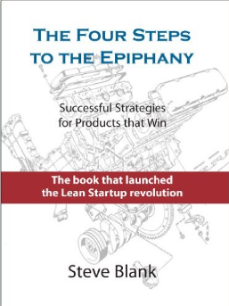
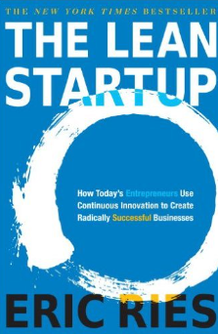
Motivation: Product Development
It doesn't matter how beautiful your theory is,
it doesn't matter how smart you are.
If it doesn't agree with experiment[s], it's wrong
-- Richard Feynman
Classical software development: spec->dev->test->release
Customer-driven Development: Build->Measure->Learn (continuous deployment cycles)
  Described in Steve Blank’s The Four Steps to the Epiphany (2005)
  Popularized by Eric Ries’ The Lean Startup (2011)
  Build a Minimum Viable Product (MVP), or feature, cheaply
  Evaluate it with real users in a controlled experiment (e.g., A/B test)
  Iterate (or pivot) based on learnings
Why use Customer-driven Development?
Because we are poor at assessing the value of our ideas
(more about this later in the talk)
Why I love controlled experiments
    In many data mining scenarios, interesting discoveries are made and promptly ignored.
    In customer-driven development, the mining of data from the controlled experiments
    and insight generation is part of the critical path to the product release
Notes:
Classical software dev
Program management writes the spec for the next revision of the product
Software developers implement the spec
Testers validate the software against the spec
Software is released
Also see In Praise of Continuous Deployment: The WordPress.com Story,” May 19, 2010
http://toni.org/2010/05/19/in-praise-of-continuous-deployment-the-wordpress-com-story/ and Berkun, Scott (2013-08-20). The Year Without Pants: WordPress.com and the Future of Work (p. 117). Wiley. Kindle Edition.

Slide 54
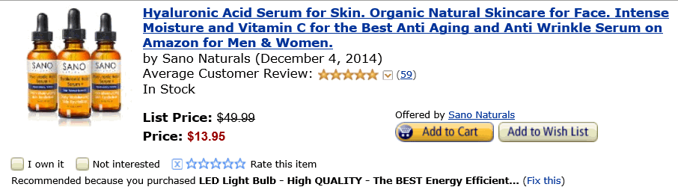


Personalized Correlated Recommendations
Actual personalized recommendations from Amazon.
(I was director of data mining and personalization at Amazon back in 2003, so I can ridicule my work.)
Buy anti aging serum because
you bought an LED light bulb
(Maybe the wrinkles show?)
Buy Atonement movie DVD because
you bought a Maglite flashlight
(must be a dark movie)
Buy Organic Virgin Olive Oil because
you bought Toilet Paper.
(If there is causality here, it’s probably
in the other direction.)

Slide 55
Advantage of Controlled Experiments
Controlled experiments test for causal relationships, not simply correlations
When the variants run concurrently, only two things could explain a change in metrics:
    The “feature(s)” (A vs. B)
    Random chance
  Everything else happening affects both the variants
  For #2, we conduct statistical tests for significance
The gold standard in science and the only way to prove efficacy of drugs in FDA drug tests
Controlled experiments are not the panacea for everything.
Issues discussed in the journal survey paper (http://bit.ly/expSurvey)

Slide 56
Systematic Studies of Observational Studies
Jim Manzi in the book Uncontrolled summarized papers by Ioannidis showing that
      90 percent of large randomized experiments produced results that stood up to replication,
      as compared to only 20 percent of nonrandomized studies
Young and Carr looked at 52 claims made in medical observational studies, which were grouped into 12 claims of beneficial treatments (Vitamin E, beta-carotene, Low Fat, Vitamin D, Calcium, etc.)
  These were not random observational studies, but ones that had follow-on controlled experiments (RCTs)
  NONE (zero) of the claims replicated in RCTs, 5 claims were stat-sig in the opposite direction in the RCT
  Their summary
  Any claim coming from an observational study is most likely to be wrong

Slide 57
The Experimentation Platform
Experimentation Platform provides full experiment-lifecycle management
  Experimenter sets up experiment (several design templates) and hits “Start”
  Pre-experiment “gates” have to pass (specific to team, such as perf test, basic correctness)
  System finds a good split to control/treatment (“seedfinder”).
  Tries hundreds of splits, evaluates them on last week of data, picks the best
  System initiates experiment at low percentage and/or at a single Data Center.
  Computes near-real-time “cheap” metric and aborts in 15 minutes if there is a problem
  System wait for several hours and computes more metrics.
  If guardrails are crossed, auto shut down; otherwise, ramps-up to desired percentage (e.g., 20% of users for each variant)
  After a day, system computes many more metrics (e.g., thousand+) and sends e-mail alerts about interesting movements (e.g., time-to-success on browser-X is down D%)
Notes:
Video shows scorecard at https://www.youtube.com/watch?v=SiPtRjiCe4U&t=105

Slide 58
OEC for Search
KDD 2012 Paper: Trustworthy Online Controlled Experiments:
Five Puzzling Outcomes Explained
Search engines (Bing, Google) are evaluated on query share (distinct queries) and revenue as long-term goals
Puzzle
  A ranking bug in an experiment resulted in very poor search results
  Degraded (algorithmic) search results cause users to search more to complete their task, and ads appear more relevant
  Distinct queries went up over 10%, and revenue went up over 30%
What metrics should be in the OEC for a search engine?

Slide 59
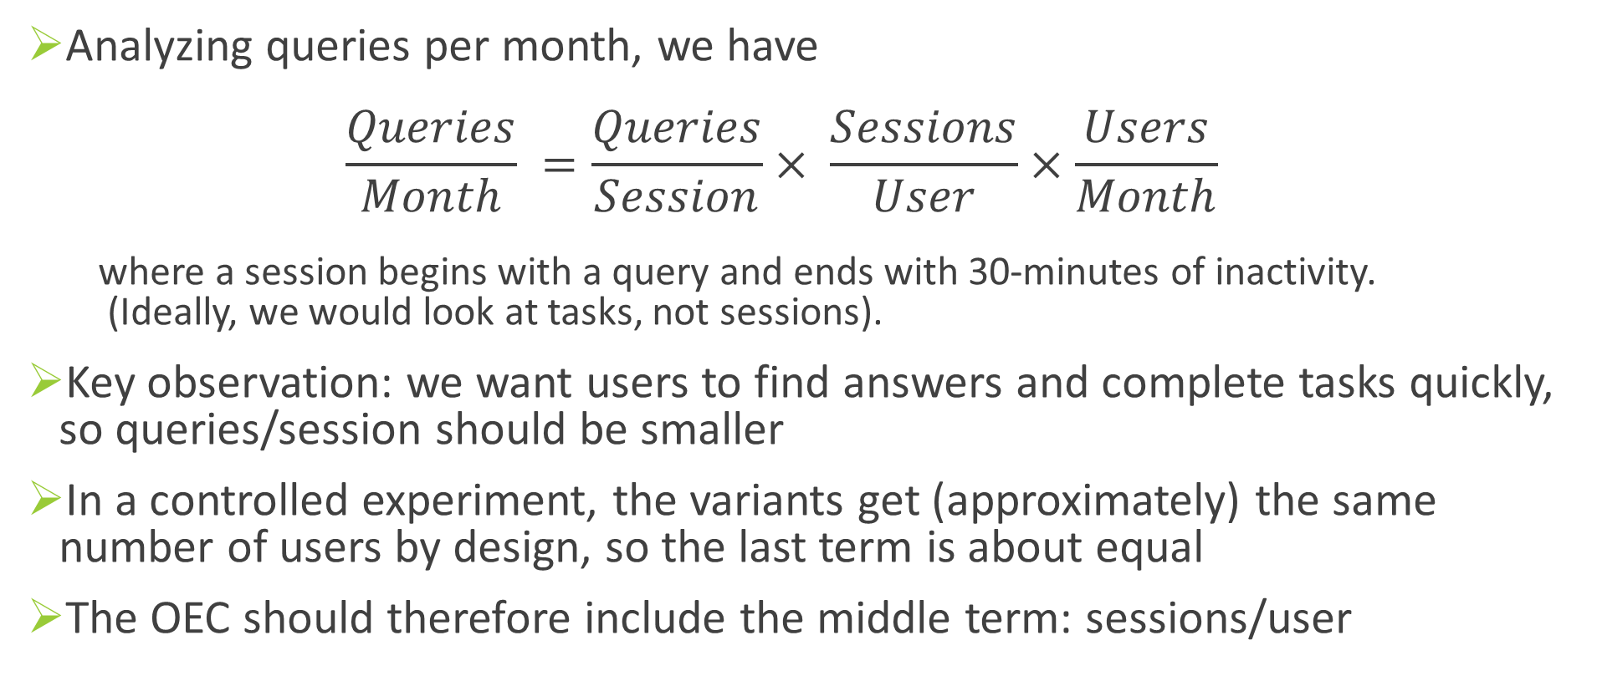
Puzzle Explained
Analyzing queries per month, we have
$\frac{Queries}{Month} =\frac{Queries}{Session}× \frac{Sessions}{User}×\frac{Users}{Month}$
  where a session begins with a query and ends with 30-minutes of inactivity.
  (Ideally, we would look at tasks, not sessions).
Key observation: we want users to find answers and complete tasks quickly, so queries/session should be smaller
In a controlled experiment, the variants get (approximately) the same number of users by design, so the last term is about equal
The OEC should therefore include the middle term: sessions/user

Slide 60
Online is Different than Offline (2)
Key differences from Offline to Online (cont)
  Click instrumentation is either reliable or fast (but not both; see paper)
  Bots can cause significant skews.
  At Bing over 50% of traffic is bot generated!
  Beware of carryover effects: segments of users exposed to a bad experience will carry over to the next experiment.
  Shuffle users all the time (easy for backend experiments; harder in UX)
  Performance matters a lot! We run “slowdown” experiments.
        A Bing engineer that improves server performance by 10msec (that’s 1/30 of the speed that our eyes blink) more than pays for his fully-loaded annual costs.
    Every millisecond counts

Slide 61
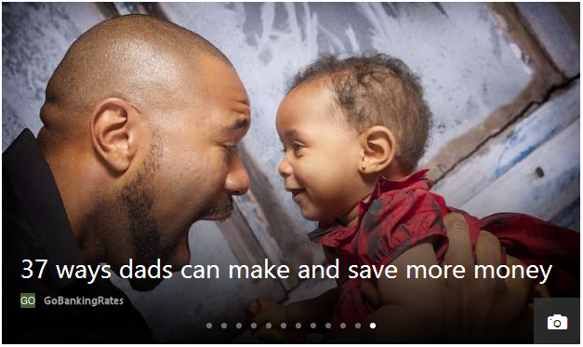
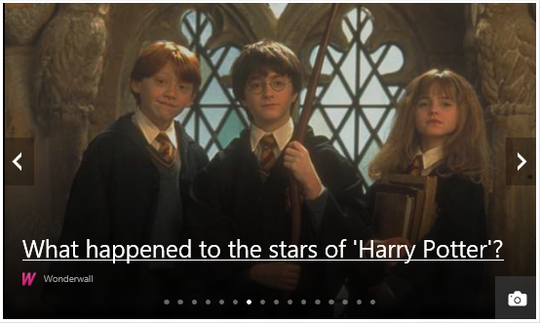


MSN Experiment: Add More Infopane Slides
The infopane is the “hero” image at MSN, and it
auto rotates between slides with manual option
Control: 12 slides
Treatment: 16 slides
Control was much better than treatment for engagement (clicks, page views)
Notes:
MSN shows 12 slides in the Infopane, whereas the competitors including Yahoo and AOL have order of magnitude more slides in theirs. So the hypothesis was that if we were to increase the number of slides in the Infopane we can get a better Today CTR as well as increase the Network PV/Clicks.

Slide 62
MSN Experiment: SRM
Except… there was a sample-ratio-mismatch with fewer users in treatment (49.8% instead of 50.0%)
Can anyone think of a reason?
User engagement increased so much for so many users, that the heaviest users were being classified as bots and removed
After fixing the issue, the SRM went away, and the treatment was much better

Slide 63
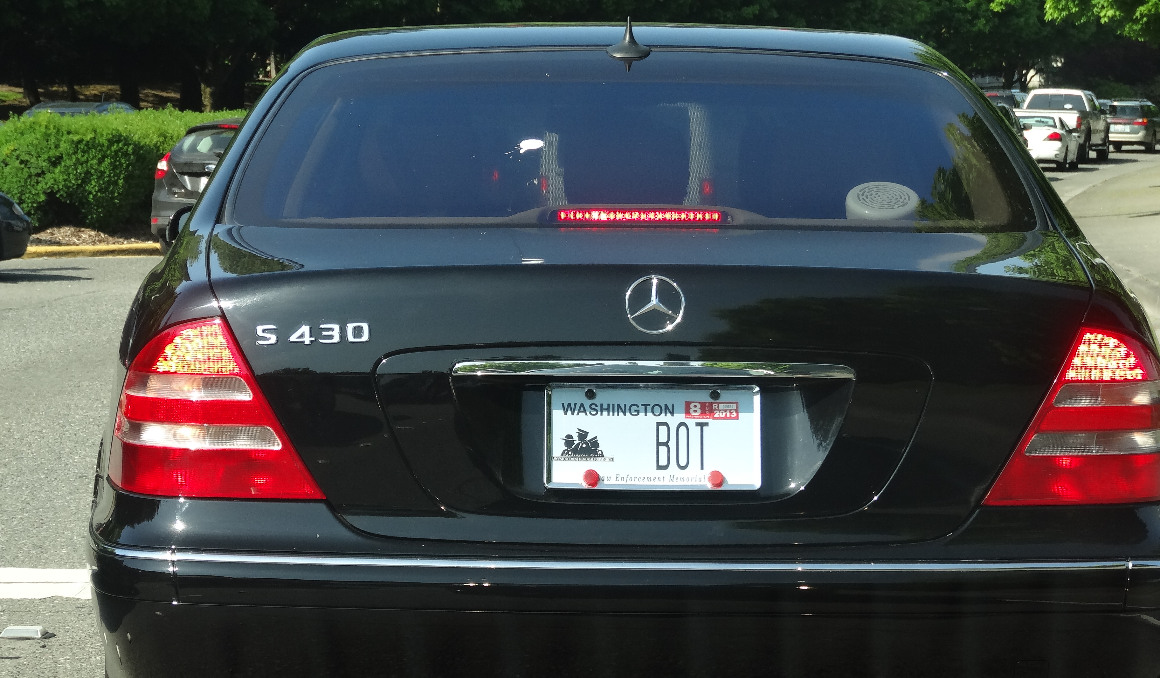
Pitfall: Failing to Validate Data Quality
Outliers create significant skew: enough to cause a false stat-sig result
Example:
  An experiment treatment with 100,000 users on Amazon, where 2% convert with an average of $30.
  Total revenue = 100,000*2%*$30 = $60,000.
  A lift of 2% is $1,200
  Sometimes (rarely) a “user” purchases double the lift amount, or around $2,500.
  That single user who falls into Control or Treatment is enough to significantly skew the result.
  The discovery: libraries purchase books irregularly and order a lot each time
  Solution: cap the attribute value of single users to the 99th percentile of the distribution
Example:
  Bots at Bing sometimes issue many queries
  Over 50% of Bing traffic is currently identified as non-human (bot) traffic!
Notes:
Negative times. Skype calls times of “days.”
Plot all univariate distributions
MSN added slides to slide show, caused more clicks, classified as bots. Reverse result. SRM

Slide 64
Pitfall: Misinterpreting P-values
NHST = Null Hypothesis Statistical Testing, the “standard” model commonly used
P-value <= 0.05 is the “standard” for rejecting the Null hypothesis
P-value is often mis-interpreted.
Here are some incorrect statements from Steve Goodman’s A Dirty Dozen
  If P = .05, the null hypothesis has only a 5% chance of being true
  A non-significant difference (e.g., P >.05) means there is no difference between groups
  P = .05 means that we have observed data that would occur only 5% of the time under the null hypothesis
  P = .05 means that if you reject the null hyp, the probability of a type I error (false positive) is only 5%
The problem is that p-value gives us Prob (X >= x | H_0), whereas what we want is
Prob (H_0 | X = x)
Notes:
A Dirty Dozen: Twelve P-Value Misconceptionsby Steven Goodman
#1: the null hypothesis is ASSUMED to be true, so clearly p-value can’t say anything about its probability directly. Must use Bayes Rule.
#2: the null effect is consistent with the observed. We may not have enough data to reject the null
#3: the p-value is seeing the observed value plus more EXTREME
#4: same as #1
Note that I’m both flipping the conditional and also changing from tail (X>=x) to (X=x).
Related to local false discovery rate: http://statweb.stanford.edu/~ckirby/brad/papers/2005LocalFDR.pdf

