Slide 1
An Unconventional Introduction to Statistical Foundations of A/B Testing
20min

Slide 2
How Unconventional?
Previous Tutorial (conventional)
http://alexdeng.github.io/ab-stats/
This one:
People with basic Machine Learning concept of regression and classification
Naïve Bayes classifier
Basic conditional probability, Bayes Rule
P-value won’t be at the center stage
“A crash course of A/B Testing for Machine Learners”

Slide 3
Causality and AI
Americans and English eat a lot of fat food. There is a high rate of cardiovascular diseases in US and UK.
French eat a lot of fat food, but they have a low(er) rate of cardiovascular diseases.
Americans and English drink a lot of alcohol. There is a high rate of cardiovascular diseases in US and UK.
Italians drink a lot of alcohol but, again, they have a low(er) rate of cardiovascular diseases.
Supervised learning, use (EatFatFood, DrinkAlcohol, Language) to predict Cardiovascular diseases. Conclusion?
Eat and drink what you want. And you have a higher chance of getting a heart attack if you speak English!

Slide 4
Causality allows us to predict the impact of a change/intervention
Causality provides more robust predictions than correlation
Simpson’s paradox
Better Generalization

Slide 5
Potential Outcomes and Missing Value

Slide 6
Randomized Experiment
Missing Data is not new in Statistics/ML/AI
Key is how do they miss, and do the missing data change the distribution
If data is missing completely at random (MCAR), the observed data distribution is unchanged
Randomization -> Counterfactual missing completely at random
Intuitively, randomization ensures “everything being equal” between variant groups. So there is no impact of confounders/self-selection.

Slide 7
Analyze Experiments --- Two Perspectives
Regression
What’s my effect? How big is it?
Classification
Is my treatment good, bad or flat?
Launch/No launch

Slide 8
Two Perspectives
Session #6
This Session
Estimate
What’s my effect? How big is it?
Hypothesis Testing
Is my treatment good, bad or flat?
Launch/No launch

Slide 9
Bayes Classification
$$\frac{P\left(ClassA | Data\right)}{P\left(ClassB | Data\right)}=\frac{P\left(Data | ClassA\right)}{P\left(Data | ClassB\right)}×\frac{P\left(ClassA\right)}{P\left(ClassB\right)}$$
Posterior Odds
Likelihood Ratio
Bayes Factor
(Evidence)
Prior Odds
Generative Model/ Naïve Bayes
Labeled Data

Slide 10
Hypothesis Classification
$$\frac{P\left(H_{0} | Data\right)}{P\left(H_{1} | Data\right)}=\frac{P\left(Data | H_{0}\right)}{P\left(Data | H_{1}\right)}×\frac{P\left(H_{0}\right)}{P\left(H_{1}\right)}$$
Posterior Odds
Likelihood Ratio
Bayes Factor
(Evidence)
Prior Odds

Slide 11
Hypothesis Classification
Exceedance/Tail Event: Test statistic exceeds the observed value
$$\frac{P\left(H_{0} | Exceedance\right)}{P\left(H_{1} | Exceedance\right)}=\frac{P\left(Exceedance | H_{0}\right)}{P\left(Exceedance | H_{1}\right)}×\frac{P\left(H_{0}\right)}{P\left(H_{1}\right)}$$
Cumulative
Likelihood Ratio
Bayes Factor
(Evidence)
Prior Odds
Posterior Odds

Slide 12
P-value
$$\frac{P\left(H_{0} | Exceedance\right)}{P\left(H_{1} | Exceedance\right)}=\frac{P\left(Exceedance | H_{0}\right)}{P\left(Exceedance | H_{1}\right)}×\frac{P\left(H_{0}\right)}{P\left(H_{1}\right)}$$

Slide 13
Statistical Power
$$\frac{P\left(H_{0} | Exceedance\right)}{P\left(H_{1} | Exceedance\right)}=\frac{P\left(Exceedance | H_{0}\right)}{P\left(Exceedance | H_{1}\right)}×\frac{P\left(H_{0}\right)}{P\left(H_{1}\right)}$$

Slide 14
Missing Info
No Labeled Data!
$$\frac{P\left(H_{0} | Exceedance\right)}{P\left(H_{1} | Exceedance\right)}=\frac{P\left(Exceedance | H_{0}\right)}{P\left(Exceedance | H_{1}\right)}×\frac{P\left(H_{0}\right)}{P\left(H_{1}\right)}$$

Slide 15
Missing Info
Data Generative Model under $H_{0}$ and $H_{1}$ generally unknown
$$\frac{P\left(H_{0} | Exceedance\right)}{P\left(H_{1} | Exceedance\right)}=\frac{P\left(Exceedance | H_{0}\right)}{P\left(Exceedance | H_{1}\right)}×\frac{P\left(H_{0}\right)}{P\left(H_{1}\right)}$$

Slide 16
Generative Model under Null How to compute p-value?
$P\left(Exceedance | H_{0}\right)$ or $P\left(Data | H_{0}\right)$ is computable, because
Parameter under the Null Hypothesis $H_{0}$ is specified as a single point, e.g. 0 (No difference in mean or percentile)
Central Limit Theorem: sample mean or percentile approximated by Normal Distribution when sample size is large
Typical issues centered around independence assumption, variance estimation, etc.

Slide 17
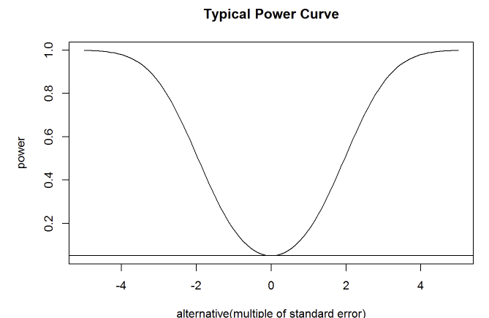
Generative Model under Alternative How to compute statistical power?
Same as Null except that
We often do not specify parametric value under Alternative $H_{1}$
Nobody knows the true treatment effect (except for an A/A test)
Statisticians refer to power as a function of the alternative parameter value, called the power curve.
Power is equally important as p-value, yet p-value
traditionally receives most of the attention
Back to this later ...

Slide 18
P-Value is only one side of the story
Evidence Might be selectively presented
Power is the other equally important side
need to hear from both sides:
Plaintiff(Experimenter Seeking Movement)
and Defendant

Slide 19
Hypothesis Testing
Decision based on p-value alone
Treat Power only as auxiliary info: sample size estimation to get enough chance of rejecting the Null if Alternative is true
One-sided: Can only reject Null Hypothesis, not accepting it (or reject Alternative)
To ship a “no hurt” feature, just test with small sample size
Need adjustment for selective evidences
Multiple Testing and Selective Inference
Continuous Monitoring, Peeking and Early Stopping
Confirmation Bias
Retry if you don’t get success, repeat until you do
…

Slide 20
Hypothesis Classification
Hypothesis Classification need extra information. But let’s give it a try:
$\frac{P\left(H_{0}\right)}{P\left(H_{1}\right)}$ : It is possible to objectively choose one, based on your domain knowledge and risk preference (1:1 or 2:1 both good starting point, but you can’t sell 1:9).
It can also be trained from historical data without label[4].
Choosing prior odds is as subjective as picking 0.05 as p-value threshold
Generative Model under $H_{1}$ can be learned from historical data[4] or the Bayes Factor can be bounded [1,2]
Bottomline:
Evidences for both $H_{0}$ and $H_{1}$ are equally important. Only focusing one will have consequences
You will generally get better results even when putting seemingly strong assumptions, such as parameter of $H_{1}$ follows normal distribution. Some evidence in Session 6!

Slide 21
Quiz on p-Value: True or False
A p-value of 5% means the null hypothesis has only a 5% chance of being true

Slide 22
Quiz on p-Value : True or False
Studies with the same p-value provide the same evidence against the null hypothesis?

Slide 24
Posterior Odds and False Discovery Rate
Posterior Odds: $\frac{P\left(H_{0} | Data\right)}{P\left(H_{1} | Data\right)}$
$$P\left(H_{0} | Data\right)=P\left(H_{0} | PosteriorOdds\right)=\frac{PosteriorOdds}{1+PosteriorOdds}$$
$P\left(H_{0} | Data\right)=$ Probability of making a false rejection/positive = False Discovery Rate

Slide 25
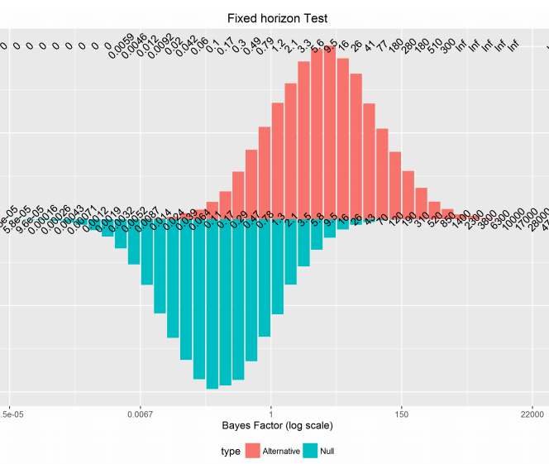
X : Posterior Odds
Y: Observed Ratio
(Posterior Odds = Bayes Factor when prior odds = 1)
50k simulation runs

Slide 26
Session 6 continues the discussion
Bounding Bayes Factors
How to estimate priors objectively with historical experiments results?
Treatment effect point estimation and intervals

Slide 27
References
“Redefine statistical significance”, Benjamin et.al. 2017, Nature Human Behavior
“Calibration of ρ Values for Testing Precise Null Hypotheses”, Sellke et.al. 2001, The American Statistician
“Continuous monitoring of A/B tests without pain: Optional stopping in Bayesian testing”, Deng et.al. 2016, IEEE DSAA
“Objective Bayesian two sample hypothesis testing for online controlled experiments”, Deng 2015, WWW
“Three Recommendations for Improving the Use of p-Values”. Benjamin and Berger, 2019, The American Statistician

Slide 28
Extra Quiz/Challenge
What happens if you continuously monitor the results and stop experiment when …
Posterior Odds > K
P-value < $α$

Slide 29
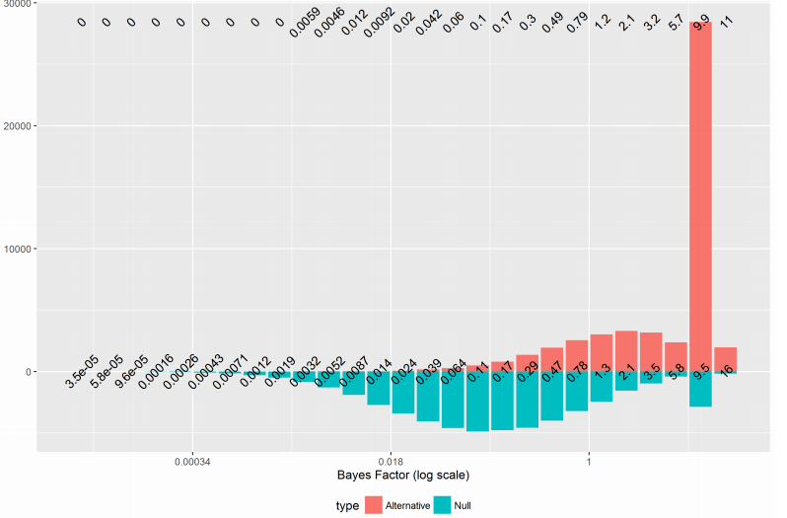
Peeking/Early Stopping when Posterior Odds > 9

Slide 30
Peeking/Early Stopping when p-value < 0.05
More likely to be from
Null!

Slide 31
Quiz
Why Hypothesis Classification could be immune to peeking?

