Slide 1
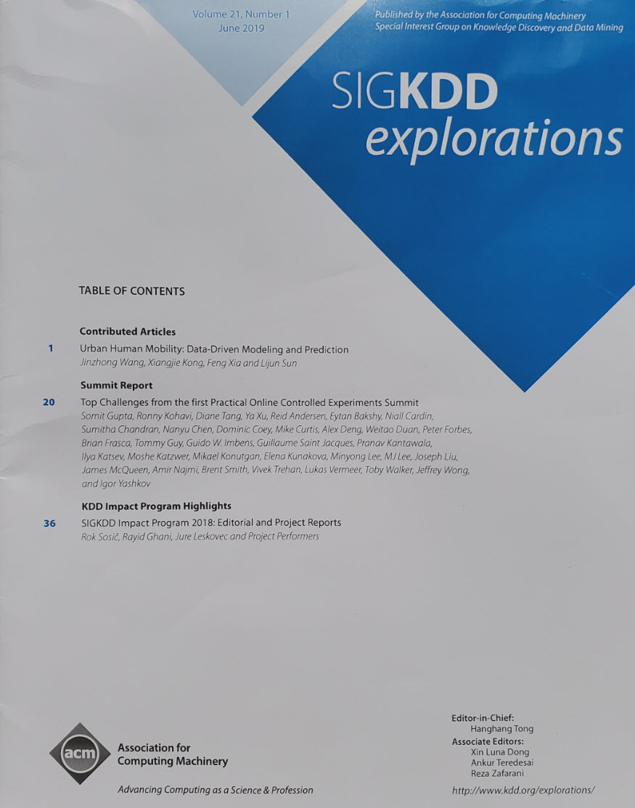
Top Challenges from the First Practical Online Controlled Experiments Summit
2019 Conference on Digital Experimentation (CODE)
Ronny Kohavi, Ex(*) Technical Fellow and Corporate Vice President,
Analysis and Experimentation, Microsoft
@RonnyK
Talk at https://bit.ly/CODE2019RonnyK
SIGKDD Explorations paper: https://bit.ly/OCESummit1
(*) My last day at Microsoft is Nov 8; I’m on vacation until then
Notes:
Title: Top Challenges from the first Practical Online Controlled Experiments Summit
Abstract: Online controlled experiments, also known as A/B tests, have become ubiquitous in evaluating the impact of changes made to software products and services. To understand the top practical challenges, representatives with experience in large-scale experimentation from thirteen different organizations (Airbnb, Amazon, Booking.com, Facebook, Google, LinkedIn, Lyft, Microsoft, Netflix, Twitter, Uber, Yandex, and Stanford University) were invited to the first Practical Online Controlled Experiments Summit. All thirteen organizations sent representatives. Together these organizations tested more than one hundred thousand experiment treatments last year. Thirty-four experts from these organizations participated in the summit in Sunnyvale, CA, USA on December 13-14, 2018.
The talk will summarize the top challenges faced across the industry and some common solutions. The talk is based on the SIGKDD Exploration paper, available at https://bit.ly/OCESummit1 .

Slide 2
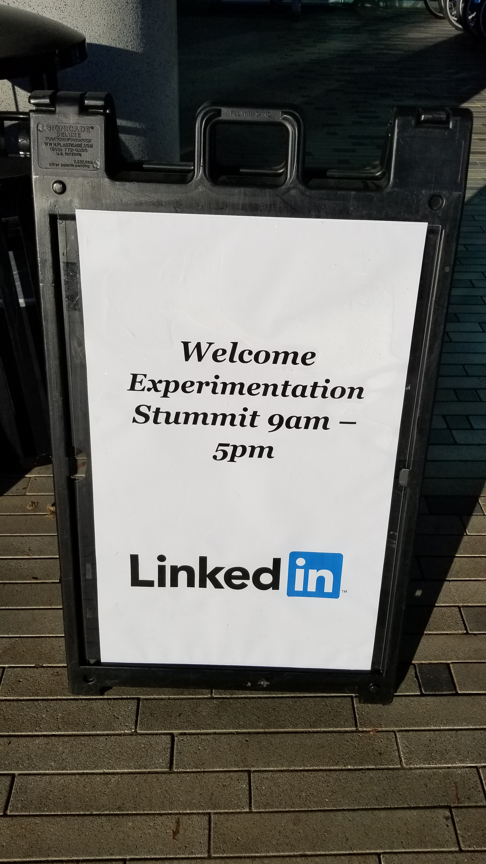
Big Thank You
Anyone else notice the “t”-test in the middle of the Summit?
This summary is possible because 34 people attended the summit
Special thanks to my co-chairs: Diane Tang and Ya Xu, and to Somit Gupta who worked tirelessly on organization and getting all the legal approvals for publications (including a tough Amazon legal team)
Thanks to Google, LinkedIn, and Microsoft for sharing hosting costs
Notes:
Our session on network effects had to be renamed Network Interactions because the term “network effects” is forbidden at Amazon, which are effects some have associated with the company.

Slide 3
The Evolution of the Idea
The idea of doing a practical experiments summit evolved at KDD 2018
The ExP team at Microsoft taught tutorials at SIGIR 2017, KDD 2017, and Strata 2018
A team from Yandex taught a tutorial at KDD 2018
Gleb and others from Yandex asked if we should do a workshop on controlled experiments
I said, “I think MIT CODE is a fine workshop and I’m not sure we need another.”
On 9/3/2018 I suggested a summit with “folks from the biggest experimentation platforms to openly discuss:
Areas where we do something different
Challenges”
Diane Tang (Google) and Ya Xu (LinkedIn) agreed to co-chair this with me and help with hosting in the Bay Area (e.g., rooms) and expenses (e.g., food). Somit Gupta (Microsoft) volunteered to coordinate

Slide 4
The Evolution of the Idea (2)
Things moved quickly
On 9/14/2018 Somit Gupta sent a Doodle for dates in Dec, Jan, Feb
We quickly got an empty set of dates – no date worked even for the organizers
I pushed harder on my co-organizers and on 9/16/2018 we settled on Dec 13-14
On 9/18/2018, Got independent e-mail from Weitao Duan (LinkedIn) suggesting a Bay Area Experimentation Meetup on Dec 3 or 4. I convinced him to align with our Dec 13 date when other experimenters are in town

Slide 5
Invites
Diane, Ya, and I made a very subjective call on
Companies to invite: Airbnb, Amazon, Booking.com, Facebook, Google, LinkedIn, Lyft, Microsoft, Netflix, Twitter, Uber, Yandex (no vendors)
Attendee allocation per company based on company size, platform capabilities, and publications
Agenda
5-minute intro from each company on organization, functions, people
Survey for topics of interest and spend a lot of time on these
No recruiting during summit days (keep that to the Meetup at night)
We didn’t know how many of the 12 companies would show up?
Guesses as to percentage?
108% (all invited and Guido Imbens from Stanford heard about it and asked to join ☺)

Slide 6
Attendees
Organizers: Somit Gupta, Microsoft Ronny Kohavi, Microsoft | Diane Tang, Google Ya Xu, LinkedIn
Reid Andersen, Airbnb Eytan Bakshy, Facebook Niall Cardin, Google Sumitha Chandran, Lyft Nanyu Chen, LinkedIn Dominic Coey, Facebook Mike Curtis, Google Alex Deng, Microsoft Weitao Duan, LinkedIn Peter Forbes, Netflix Brian Frasca, Microsoft Tommy Guy, Microsoft Guido W. Imbens, Stanford Guillaume Saint Jacques, LinkedIn Pranav Kantawala, Google | Ilya Katsev, Yandex Moshe Katzwer, Uber Mikael Konutgan, Facebook Elena Kunakova, Yandex Minyong Lee, Airbnb MJ Lee, Lyft Joseph Liu, Twitter James McQueen, Amazon Amir Najmi, Google Brent Smith, Amazon Vivek Trehan, Uber Lukas Vermeer, Booking Toby Walker, Microsoft Jeffrey Wong, Netflix Igor Yashkov, Yandex

Slide 7
Challenge 1 – Long Term Effects
Key metrics of interest lag
Lag by definition
Shareholders want long-term stock appreciation but running experiments (e.g., interrupted time series) and watching the stock price isn’t very useful
Satisfaction from booking a vacation rental or hotel room may be months away
Net revenue lags if cancellations and returns are included
Renewal for annual service is months away for most users
Learning effects: increasing ads per page (usually of lower quality) increases short-term revenue, but causes attrition and ad blindness in the long-term
Market effects: In multi-sided markets, such as search (users, advertisers), rideshares (riders, drivers), and home-sharing (guests, hosts) equilibrium takes time

Slide 8
Challenge 1 - Solutions and Issues (1/2)
Possible solutions to the long-term problem and their issues
Long-term experiments
Long experiment cycles hurt agility and the desire to learn from many shorter and varied experiments
Hard to run multi-month experiments without logged-in users (cookie loss)
Use proxies: metrics that are predictive of the long-term metrics of interest
Proxies may correlate, but not be causal (e.g., Netflix found predictors for retention using logistic regression)
It is important that there exist some believable causal model (e.g., Bing and Google have estimates based on user utility)

Slide 9
Challenge 1 Solutions (2/2)
More solutions and the long-term problem
Model user learning – explicitly model the user learning effects (e.g., cookie-cookie-day). See Henhold etal. 2015
Surrogates – a surrogate lies on the causal path between the treatment and the long-term outcome and meets conditional independence conditions. Multiple surrogates can be useful; see Athey et al. 2016

Slide 10
Challenge 2 – Overall Evaluation Criterion (OEC)
A good agreed-upon OEC is highly beneficial as it empowers the team to make decisions without deferring to the HiPPO (Highest Paid Person’s Opinion).
Properties of a good OEC
Indicative of long-term gain to key metrics
Hard to game – provide truly beneficial incentives
Sensitive – noisy metrics will make it hard to discern a useful signal
Computable at reasonable time and cost – human surveys and human judges fail here
Account for diverse and new scenarios – for example, instant/direct answers in search reduce clicks, a common metric to determine user satisfaction
Note, in additional to an OEC, we need other metrics that ensure trustworthiness and raise red flags (e.g., SRM, outliers); we need guardrail metrics to verify that we are not outside the envelope of “reasonable” decisions that do not harm goals; we need diagnostic and local metrics.

Slide 11
Challenge 2 Solutions and Issues
Search (satisfaction) vs. Discovery
In search, query-share is a long-term goal but a terrible OEC (See Kohavi et al. 2012). Metrics that evaluate success are important, such as the HEART framework (Happiness, Engagement, Adoption, Retention, and Task success (Hassan et al. 2013; Machmouchi et al. 2017)
Discovery (browsing) lacks obvious success signals. Duration is sometimes a key metric
Tradeoffs
With multiple factors, how do you weigh them against each other? Bing has an OEC that weighs user satisfaction metrics and revenue metrics
Evaluating and updating the OEC
Create a corpus of past experiments allows new metrics to be evaluated for sensitivity and deviations from prior decisions
Degradation experiments (e.g., slowdown) helps identify questionable metrics that improve.
Use Machine Learning models
These are harder to interpret and trust

Slide 12
Challenge 3 – Heterogeneous Treatment Effects
The average treatment effect (ATE) is the primary metric reported in A/B tests.
Understanding conditional average treatment effects (CATE), where we condition on some segment provides insights (e.g., treatment works better in some markets) and can help isolate bugs (e.g., treatment fails for Firefox version X).
What are good segments to condition?
Which segments provide valuable insights, such as a significant change in treatment direction, not just in the magnitude
Grouping/clustering/discretization is important (e.g., regions, English-speaking)
Presentation is important: how do we present such insights to experimenters?
Methodology and computational issues: efficiency, multiple testing, summarization/presentation
Correlations vs. Causation: different CATE for iOS vs. Android may be due to population, not the implementation

Slide 13
Challenge 3 – Solutions and Issues
Useful segments are
Market/Country
User activity level: heavy, light, new
Device/platform: desktop, mobile, browser and version, OS and version (e.g., Android X)
Day of week and time
Product specific segments: Netflix segments by network speed; Airbnb segments by first booking and origin (vs. vacation destination)

Slide 14
Challenge 4 – Experimentation Culture
Organizations go through phases: hubris, skepticism, humility, understanding
Solutions
Build experimentation platforms that lower the cost of experiments and improve trust
Make it easy to manage many experiments and communicate results
Get top-down buy-in
Share case studies
Onboard some groups at high-touch and show successes
Start with pain areas, such as safe rollouts of features
Provide education and support
Amazon: Weblab Bar Raisers
Booking: Experimentation Ambassadors and Peer-review program
Google: Just-in-time education
Microsoft Center of Excellence
Twitter: Experiment Shepherds
Yandex: Experts on experiments

Slide 15
More in Paper
Other challenges
Computation of experiment scorecard
Metric standardization, ownership
Client bloat
Network interactions [network effects]
Interactions between experiments
See SIGKDD Explorations paper: https://bit.ly/OCESummit1

