Slide 1

Trustworthy Online Controlled Experiments
Alexa Lab Fishbowl
4/28/2021
Ronny Kohavi
Ex-VP and Technical Fellow, Airbnb
Ex-Technical Fellow and Corp VP, Microsoft
Ex-Director of Data Mining and Personalization, Amazon
@RonnyK

Slide 2
Agenda
Intro & Welcome
Short presentation: 20 mins
Q&A: 35 mins
Please interrupt at any point with quick questions,
but please leave philosophical debates to offline discussions
Ideas are often wrong, so don’t assume my forward-looking opinions are right

Slide 3
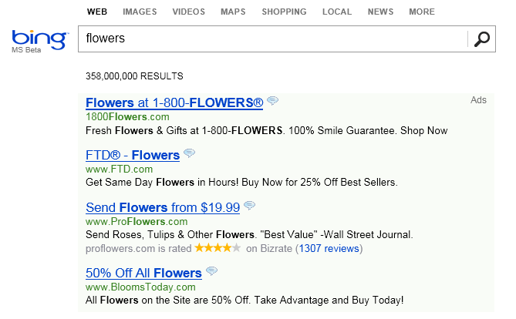
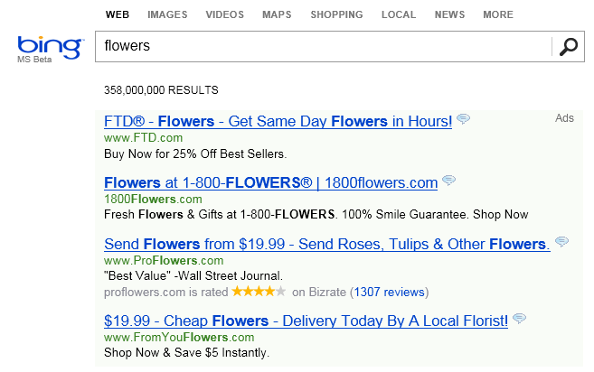
The Life of a Great Idea – True Bing Story
An idea was proposed several years ago to change the way ad titles were displayed on Bing
Move ad text to the title line to make it longer
Control – Existing Display
Treatment – new idea called Long Ad Titles

Slide 4
The Life of a Great Idea (cont)
…meh…
It’s one of hundreds of ideas proposed and seems
Implementation was delayed in:
Multiple features were stack-ranked as more valuable
It wasn’t clear if it was going to be done by the end of the year
An engineer thought: this is trivial to implement.
He implemented the idea in a few days, and started a controlled experiment (A/B test)
An alert fired that something is wrong with revenue, as Bing was making too much money.
Such alerts have been very useful to detect bugs (such as logging revenue twice)
But there was no bug. The idea increased Bing’s revenue by 12% (over $120M at the time)
without hurting guardrail metrics
We are terrible at assessing the value of ideas.
Few ideas generate over $100M in incremental revenue (as this idea), but
the best revenue-generating idea in Bing’s history was badly rated and delayed for months!
Feb
March
April
May
June
@RonnyK

Slide 5

My Background in Experimentation (1 of 2)
Why should you listen to me?
Director of Data Mining and Personalization, Amazon
  One of my teams was Weblab, Amazon’s experimentation system
Technical Fellow and Corporate VP, Microsoft (14+ years)
  Led the Analysis & Experimentation team, which built ExP,
  the experimentation platform used by 15+ major product groups
  including Bing, MSN, Office Clients, Office online, Exchange, Edge, Xbox, Storefront, Skype, Cortana, Teams, Windows
  Team had 70 developers, 40 data scientists, 10 program managers
  Focus on trust: multiple tests to identify problems automatically
  Large scale: 100+ new treatments started every workday
Notes:
Video shows scorecard at https://www.youtube.com/watch?v=SiPtRjiCe4U&t=105

Slide 6



My Background in Experimentation (2 of 2)
Vice President and Technical Fellow, Airbnb (1.5 years)
  Relevance, personalization, and experimentation
  Tried 250 experiments in Relevance team.
  Twenty positive (92% failed to move the metrics they were designed to improve)
  [stat approved for sharing by Airbnb]
Co-author of Trustworthy Online Controlled Experiments:
A Practical Guide to A/B Testing (March 2020)
https://experimentguide.com
HiPPO: Highest Paid Person’s Opinion
Japanese and Chinese translations:
Apr 2021
Notes:
Airbnb line approved by Georgia Dempsey 3/23/2021

Slide 7
Controlled Experiments
Concept is trivial
  Randomly split traffic between two (or more) versions
    A (Control, typically existing system)
    B (Treatment)
  Collect metrics of interest
  Analyze
A/B test is the simplest controlled experiment
  A/B/n is common in practice: compare A/B/C/D, not just two variants
  Equivalent names: Flights (Microsoft), 1% Tests (Google), Bucket tests (Yahoo!),
  Field experiments (medicine, Facebook), randomized clinical trials (RCTs, medicine)
Must run statistical tests to confirm differences are not due to chance
Best scientific way to prove causality, i.e., the changes in metrics are caused by changes introduced in the treatment(s)
Notes:
Sample of real users
Not WEIRD (Western, Educated, Industrialized, Rich,
and Democratic) like many academic research samples

Slide 8

Interesting Examples
How do we define interesting experiments?
  The absolute difference between the expected outcome and the actual result is large
  If you thought something was going to happen and it didn’t, then you’ve learned something important
  If you thought something minor was going to happen, and the results are a major surprise and lead to a breakthrough, you’ve learned something highly valuable
  If you thought something was going to happen and it happened, then you confirmed your existing knowledge, but have not learned much

Slide 9
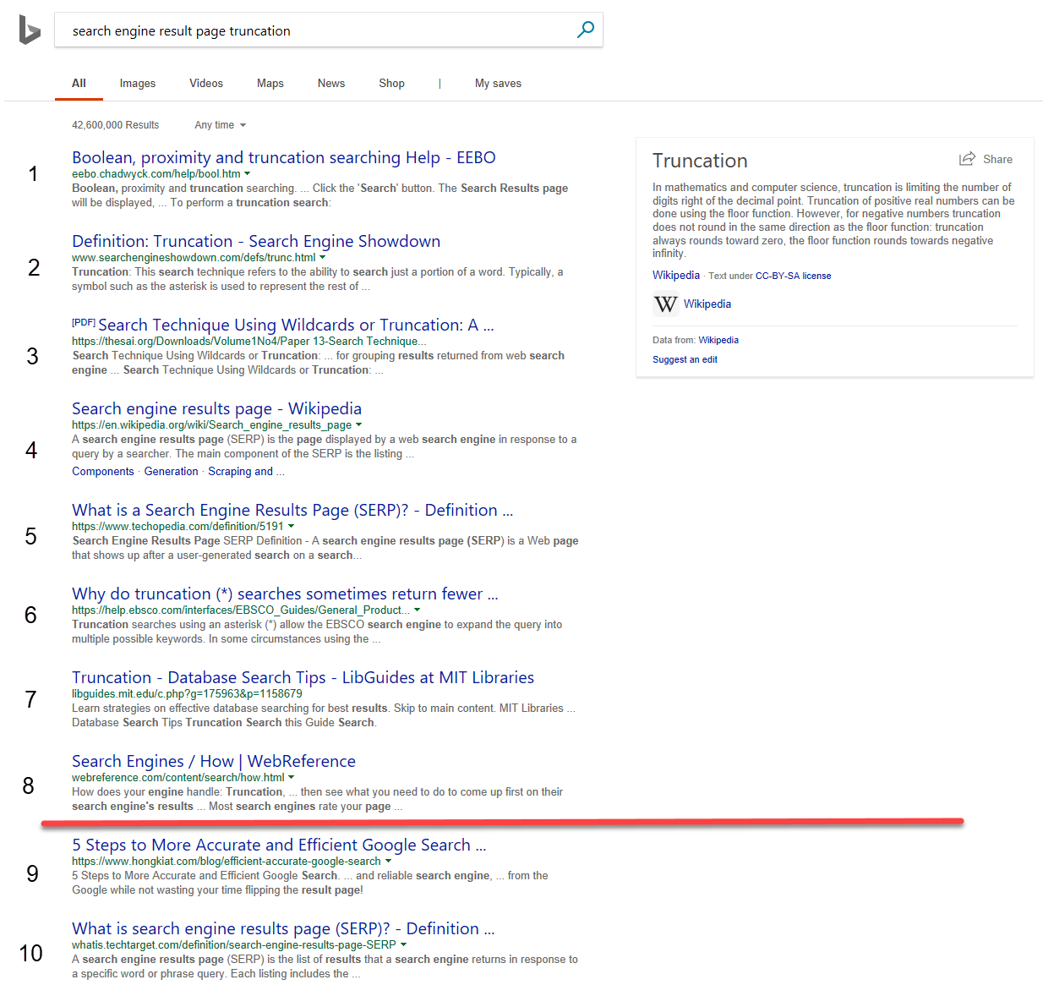
Surprising Example 1:
SERP Truncation
SERP is a Search Engine Result Page
(shown on the right)
OEC (Overall Evaluation Criterion):
Clickthrough Rate on 1st SERP per query
(ignore issues with click/back, page 2, etc.)
Version A: show 10 algorithmic results
Version B: show 8 algorithmic results by removing the last two results
All else same: task pane, ads, related searches, etc.
Version B is slightly faster (fewer results means
less HTML, but server-side computed same set)
Raise your left hand i you think A Wins (10 results)
Raise your right hand if you think B Wins (8 results)
Don’t raise your hand if they are the about the same

Slide 10
SERP Truncation
If you raised any hand, you were wrong
We wrote a paper with several rules of thumb (http://bit.ly/expRulesOfThumb)
While there are obviously exceptions, most of the time users click at the same rate.
  In this case, with over 3M users in each variant, we could not detect a stat-sig delta.
  Users simply shifted the clicks from the last two algorithmic results to other elements of the page.
Several examples in the above paper show stability of the page clickthrough-rate, including: moving related searches below the bottom ads, or from right pane, or even truncating to 4 results when there is a big “card” (so the page above the fold looks full)
      Rule of Thumb: Reducing abandonment (1-clickthrough-rate) is hard.
      Shifting Clicks is Easy.

Slide 11
Most Ideas Fail
Features are built because teams believe they are useful.
But most experiments show that features fail to move the metrics they were
designed to improve
Based on experiments at Microsoft (paper)
  1/3 of ideas were positive ideas and statistically significant
  1/3 of ideas were flat: no statistically significant difference
  1/3 of ideas were negative and statistically significant
At Bing (well optimized), the success rate is lower: 15%.
For Bing Sessions/user, our holy grail metric, 1 out of 5,000 experiments improves it
At Airbnb relevance, the success rate was 8%
Integrating Bing with Facebook/Twitter in 3rd pane cost more than $25M in dev costs and abandoned due to lack of value
We joke that our job is to tell clients that their new baby is ugly
The low success rate has been documented many times across multiple companies
      When running controlled experiments, you will be humbled!
Notes:
Airbnb line approved by Georgia Dempsey 3/23/2021

Slide 12
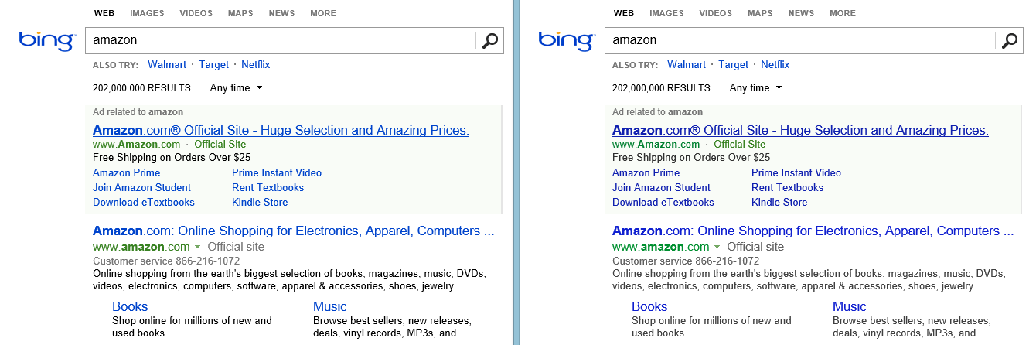


Surprising Example 2: Color Optimization
Figure 1: Font color experiment. Can you tell the difference?
Hard to even tell the difference
Change is trivial: a few numbers change in the CSS
Sessions success rate improved, time-to-success improved, +$10M annually
Replicated with 32M users
What causal diagram would you create to explain this?

Slide 13
Google Color Optimization
Google tested 41 gradations of blue for Google pages (Holson, 2009)
The visual design lead at Google was frustrated with the quantitative environment and quit, writing on his last day at Google (Bowman, 2009)
I can’t operate in an environment like that.
I’ve grown tired of debating such minuscule design decisions”
Some people view this example of analysis paralysis: running experiments for tiny incremental improvements that mean nothing. However…
Google’s tweaks to the color scheme were worth over $200 million annually
(Hern, 2014)!
Notes:
Bing’s color experiment ran in 2013 when Bing’s share in the US was about 17% vs.
Google’s 67% (comScore). Extrapolate the $10M * 4 (US) * 2 worldwide = $80M

Slide 14
Example 3: Performance / Speed
Improving server performance by 100msec (0.1 seconds) improves many key metrics for Bing
  Session success rate improves.
  Success is defined as a click from Bing to a destination from which the user does not return quickly (under 20 seconds)
  Time to success improves. Users are successful faster
  Revenue improves by 0.6%. When Bing was $3B business, this was worth $18M
  (now more).
  An engineer that improves server performance by 4 milliseconds more than pays
  for his/her fully-loaded annual costs
Half hour presentation at Convex about this experiment:
https://vwo.com/events/sessions-and-presentations/
For many ideas, there is a tradeoff between revenue and user metrics.
With perf, everything improves (rare)!

Slide 15
Controlled Experiments Pitfalls
Controlled Experiments are the gold standard is science for establishing causality
Yet there are many pitfalls we regularly face (next slides)
  Wrong OEC (Overall Evaluation Criterion)
  SRM – Sample Ratio Mismatch
  Std-dev of ratio metrics
  The following are in the slide deck for those interested:
  Ratio metrics
  Novelty effects

Slide 16
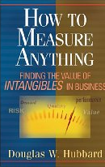

The OEC
OEC = Overall Evaluation Criterion
  Getting agreement on the OEC in the org is a huge step forward
  OEC should be defined using short-term metrics that predict
  long-term value (and hard to game)
  Think about customer lifetime value, not immediate revenue
  Ex: Amazon e-mail example counting revenue of orders referred through e-mail
  Look for success indicators/leading indicators, avoid vanity metrics
  Read Doug Hubbard’s How to Measure Anything
  Use a few KEY metrics. Beware of the Otis Redding problem (Pfeffer & Sutton)
  “I can’t do what ten people tell me to do, so I guess I’ll remain the same.”
  Funnels use Pirate metrics: AARRR: acquisition, activation, retention, revenue, and referral
  Criterion could be weighted sum of factors, such as
    Conversion/action, time to action, visit frequency
Notes:
You can fill the page with ads, which is what happened with the early search engines

Slide 17
Pitfall: Wrong OEC(*)
Search engines (Bing, Google) are evaluated on query share (distinct queries) and revenue as long-term goals
It is natural to define these as the OEC: Overall Evaluation Criterion for experiments
Key Example
  A ranking bug in an experiment resulted in very poor search results
  Queries per user improved by 10% (hence query share is going up).
  Why? People had to reformulate queries several times
  Revenue went up over 30% (we’re making a lot more money!).
  Why? Ads (not impacted by the bug) became relatively more useful
We fired the relevance team, and
Bing’s US PC query share is up from 8% in 2009 to 26% in 2021; Bing is profitable
(*) KDD 2012 Paper: Trustworthy Online Controlled Experiments: Five Puzzling Outcomes Explained
Notes:
https://www.statista.com/statistics/267161/market-share-of-search-engines-in-the-united-states/

Slide 18
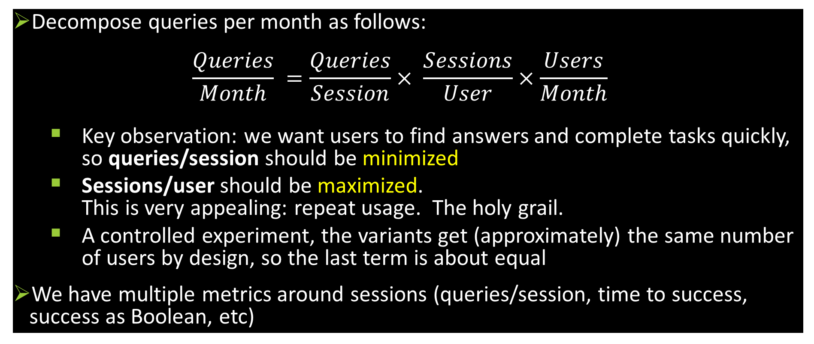
Key Insight: Sessions are Critical
Decompose queries per month as follows:
$\frac{Queries}{Month} =\frac{Queries}{Session}× \frac{Sessions}{User}×\frac{Users}{Month}$
  Key observation: we want users to find answers and complete tasks quickly, so queries/session should be minimized
  Sessions/user should be maximized.
  This is very appealing: repeat usage. The holy grail.
  A controlled experiment, the variants get (approximately) the same number of users by design, so the last term is about equal
We have multiple metrics around sessions (queries/session, time to success, success as Boolean, etc)

Slide 19
SRM – Sample Ratio Mismatch
For an experiment with equal percentages assigned to Control/Treatment, you should have approximately the same number of users in each
Real example:
  Control: 821,588 users, Treatment: 815,482 users
  Ratio: 50.2% (should have been 50%)
  Should I be worried?
Absolutely
  The p-value is 1.8e-6, so the probability of this split (or more extreme) happening by chance is less than 1 in 500,000 (the Null hypothesis is true by design)
  See http://bit.ly/srmCheck for Excel spreadsheet to compute the p-value
  About 6% of Microsoft experiments have an SRM, so this is a big problem

Slide 20
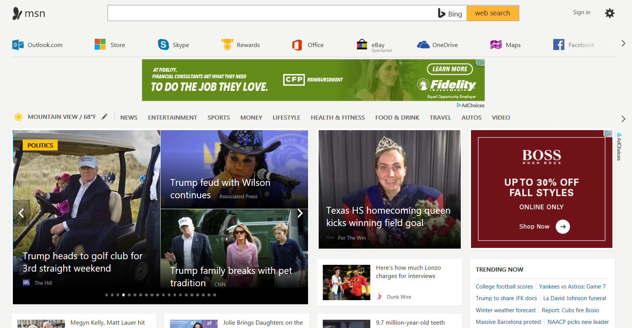
Ratio Metrics and by-page Aggregates
In 2009 paper: opening Hotmail/Outlook.com link in a new tab at MSN showed significant benefits
Later experiment opened MSN news articles in new tab
Surprising result: 8% increase (degradation) in page load time (measured at 75th percentile)
Why?
Page load time is measured by page, not by user
Fewer pages in treatment (8.4M vs. 9.2M)
Control: users hit back button to go back
from news to home page, which refreshes
Treatment: there is no back button. Users kill
the tab and see the previous tab with home page
Reloading the home page is faster than average
page due to caching effects (e.g., images cached),
and treatment has fewer of these loads, so
it looks …slower by metrics (it’s actually faster!)
Any ratio metric (click-through) suffers from this

Slide 21
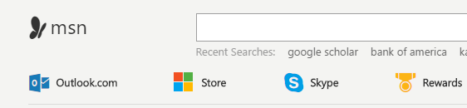
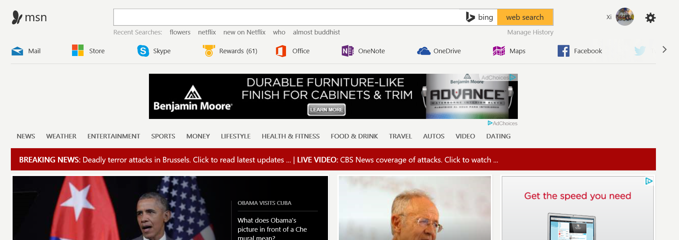
Novelty Effects and Twyman’s Law
Experiment changed Outlook.com link (left) to Mail app
Result: 28% increase in the number of clicks on the button.
Even better: 27% increase in the number of clicks on the button adjacent to the mail button.
Celebrate? NO! Remember Twyman
Twyman’s Law: Any figure that looks interesting or different is usually wrong

Slide 22
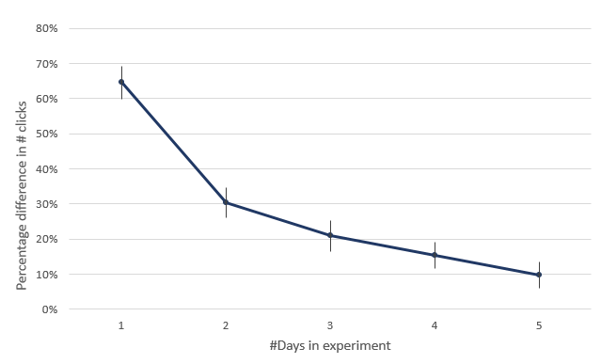
Novelty Effect (cont)
Graph over time showed dramatically diminishing delta
Users were confused, repeatedly clicked on icon and nearby icon.
They were expecting outlook web site, and the mail app popped up.
Learned not to click: Proportion of users clicking on the whole stripe was down
Lesson:
  We are biased to celebrate good results and investigate
  bad results
  Remember Twyman’s law, especially if results look
  Too-Good-To-Be-True™

Slide 23

Std-dev of Ratio Metrics
For computing p-values, we need the standard deviation of the mean of the OEC
(for each variant, or for the delta)
Classically, this is simply
Key assumption: The Y_i are i.i.d. (independently and identically distributed) or at least uncorrelated.
For ratio metrics, such as click-through (total clicks / total page views), the
assumption does not hold if randomization is done by user
Bootstrap or the Delta Method has to be used to compute the std-dev
How bad is it if we use the naïve approach?

Slide 24
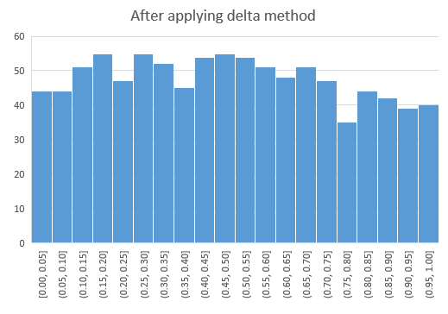
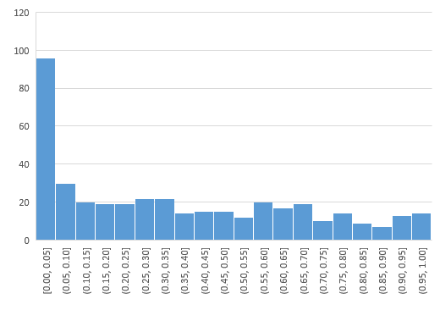
Std-dev of Ratio Metrics (cont)
P-value distribution for metrics in A/A tests should be uniform
Do 1,000 A/A tests, and check if the distribution is uniform
Left: Naïve approach; right computed with delta method

Slide 25
Q&A - Trends
What are some of the most important changes in online A/B experimentation
Trustworthiness – the first word in the title of our book
  Critical checks to address flawed execution
  Example: Sample-ratio-mismatch, correct confidence intervals/p-values (CTR, rare-events, outliers)
  Use of A/A tests to detect issues
Culture – ideal: test everything
  Config is code
Concurrency – support for running concurrent experiments with critical safety
  Prevention – warn about the same parameters modified in concurrent experiments
  Detection – detect interacting experiments and improve prevention
Automated segments of interest – provide slice & dice capability, then automatically tell experimenters about interesting combinations, correcting for multiple-testing
Near-real-time experimentation
  Support for experiment ramp-up and auto-abort. Don’t allow issues to become sev-0/1
  Early in the life of an experiment, check every 15 minutes
Statistical power – metric variations, CUPED

Slide 26
Q&A - Culture
How do you build a culture of experimentation in a business / team?
Pick a “beachhead“ to prove value. Should have the following characteristics
  Agile – development cycle must be agile, shipping often (web site, service).
  Harder in client applications (Office clients, mobile apps requiring 2-week approvals), OS (e.g., windows)
  Believable OEC can be derived (tenet 1 in the book)
  Exec support to try – invest in experimentation infrastructure (tenet 2 in the book)
  Humble – org is willing to evaluate ideas and be wrong most of the time (tenet 3 in the book)
Generate surprising results, share widely
Address pain points: for Microsoft Office, addressing “safe velocity” or “safe deployments” through near-real-time experimentation was critical

Slide 27
Q&A – Institutional Memory
How do we share learnings across orgs
Hard problem to automate
Give talks about surprising results
(e.g., we did quarterly 5 best experiments across Microsoft).
Make it easy to go back and see these for the last few years.
Make it easy to “document” the experiment and results
  Hypothesis? Specific differences between variants
  Screen shots highlighting differences
  Definitive scorecard from which decision was made
  (some experiments generate dozens: dates, triggered/untriggered, segments)
  Search (by name, keyword, date-range, impact)

Slide 28
Q&A: Experiment Experts
How do we quantify the impact of these champions, science-deliverables and that of an experimentation platform to the eco-system?
See https://bit.ly/OCESummit1.
Most companies have some attempt to improve experimentation
  Amazon: Weblab Bar Raisers
  Booking.com: Experimentation Ambassadors
  Booking.com: Peer review program
  Google: Just-in-time Education Mode
  Microsoft: Center of Excellence
  Twitter: Experiment Shepherds
  Yandex: Experts on Experimentation
It boils down to trust in the results.
If you find that deep dives by experts invalidate results, you need to do more.
If you find that replication runs fail (a key tool)…
More important, you need the experimentation platform to do more automated checks

Slide 29
Q&A – OEC (1)
How much of the OEC is leadership driven vs. science-driven
I don’t believe that’s an OR (or vs.)
Leaders define the strategy.
The OEC should be our best attempt at quantifying progress on the strategy
The tradeoffs are hard (see Chapter 6 in book):
  Short-term metrics need to be used, but our goal is to commonly to predict long-term value
  Simpler is better. The OEC should be understood and broadly accepted
  Stable. It can’t be overly specific, requiring modifications for new features
  Resistant to gaming. If you can do obviously bad things and improve the OEC, it’s not a good OEC.

Slide 30
Q&A – OEC (2)
Did the OEC change over the course of 10 years that you were in Microsoft?
Of course. You *want* to update the OEC as you improve understanding
Bing was the best example: OEC updated every year.
Strong effort over multiple months to evaluate new ideas for the OEC, back-test them against many prior experiments
Most common evolution
  Start simple: revenue-related (e.g., purchase – indicator or actual revenue, add-to-cart, click)
  Adjust for long-term impact: returns/cancellations, user satisfaction (e.g., rating, quickback in seach).
  Simple example: e-mail/notifications – must consider unsubscribes (significant customer value lost if you can no longer send emails/notifications)
Big reason to change the OEC: strategic change

Slide 31
Q&A – OEC Tradeoffs
How do you handle trade offs among key metrics
Ideally translate everything to long-term dollars (e.g., customer-lifetime-value)
Email/notifications example: estimate lost value due to unsubscribes.
Can lead to interesting features, such as: unsubscribe from X (not all emails/notifications)
Start by putting lower/upper-bounds, if it’s borderline, do deep dives.
Refine over time

Slide 32
Q&A – Experimentation Platform
How do you scale experimentation?
Think about lowering the marginal cost of running and analyzing experiments
Initially expert data scientists help analyze each experiment
Goal for experimentation platform team: put the data scientists out of a job ☺
Automate more and more of the repetitive boring stuff, leaving the data scientists to do more interesting stuff
  Automate checks like SRM
  Build tools to help find the reason for SRM – huge time investment
  Automated drill-downs: report segments of interest – heterogeneous treatment effects
  Address experiment lifecycle – code cleanup after experiment
  Triggering / filtering
  Logging reliability (e.g., click logging is usually lossy, crashes)
  Institutional memory

Slide 33
Q&A – Mobile and Offline
Did you have experiments running on devices (mobile apps, and physical devices) that were not always online? How did you combat challenges that were unique to that space?
Office 365 runs as desktop client and on mobile devices.
Monthly releases have hundreds of features run as experiments
Key ideas
  Provide library to enable experimentation and handle assignments
  Cache assignment for offline scenarios
  Safety: disable features that cause crashes (even when offline)

Slide 34
Summary
  The less data, the stronger the opinions
Think about the OEC. Make sure the org agrees what to optimize
It is hard to assess the value of ideas
  Listen to your customers – Get the data
  Prepare to be humbled: data trumps intuition. Cultural challenges.
Compute the statistics carefully
  Getting numbers is easy. Getting a number you can trust is harder
Experiment often
  Triple your experiment rate and you triple your success (and failure) rate.
  Fail fast & often in order to succeed
  Accelerate innovation by lowering the cost of experimenting

